Slide 1

KECT200950000001
표준전자(세금)계산서(v3.0)
개발지침 v1.0
2017. 8.

Slide 2
KECT200950000001
목
차
1. 지침의 상태 및 개요 ·························································································································· 1
1.1. 지침의 상태 ··································································································································· 1
1.1.1. 연혁 ·········································································································································· 1
1.1.2. 작성자 ······································································································································ 1
1.1.3. 감수자 ······································································································································ 2
1.2. 지침의 개요 ··································································································································· 3
1.2.1. 목적 ·········································································································································· 3
1.2.2. 적용범위 ·································································································································· 3
1.2.3. 대상 ·········································································································································· 3
1.2.4. 구성 ·········································································································································· 3
1.2.5. 관련 규격 ································································································································ 4
2. 전자(세금)계산서 프로세스 ················································································································ 5
2.1. 개요 ················································································································································· 5
2.2. 전자(세금)계산서 발급 프로세스 ······························································································· 6
2.2.1. 시스템 구성 개요 ·················································································································· 6
2.2.2. 전자(세금)계산서 발급 ·········································································································· 6
2.2.3. 전자(세금)계산서 재발급 ··································································································· 10
2.2.4. 전자(세금)계산서 전송 권장 기한 ··················································································· 11
2.2.5. 전자(세금)계산서 구문 구조 ····························································································· 11
2.3. 국세청 연동 프로세스 ··············································································································· 12
2.3.1. 국세청 연동 개요 ················································································································ 12
2.3.2. 연동 프로세스 ······················································································································ 12
3. 전자(세금)계산서 항목 ······················································································································ 20
3.1. 표준 정의 절차 ··························································································································· 20
3.2. 전자(세금)계산서 전자문서 항목 ····························································································· 22
3.2.1. 전자(세금)계산서 전자문서 항목 “관리정보(ExchangedDocument)” ························ 22
3.2.2. 전자(세금)계산서 전자문서 항목 “전자서명(Signature)” ············································· 23
3.2.3. 전자(세금)계산서 전자문서 항목 “기본정보(TaxInvoiceDocument)” ························ 23
3.2.4. 전자(세금)계산서 전자문서 항목 “거래처정보-공급자(InvoicerParty)” ····················· 25
3.2.5. 전자(세금)계산서 전자문서 항목 “거래처정보-공급받는자(InvoiceeParty)” ············ 26
3.2.6. 전자(세금)계산서 전자문서 항목 “거래처정보-수탁사업자(BrokerParty)” ················ 27
3.2.7. 전자(세금)계산서 전자문서 항목 “결제정보-결제방법별금액(SpecifiedPaymentMeans)”· 29
3.2.8. 전자(세금)계산서 전자문서 항목 “결제정보-Summary(SpecifiedMoneySummation)” · 29
3.2.9. 전자(세금)계산서 전자문서 항목 “상품정보(TaxInvoiceTradeLineItem)” ················· 30

Slide 3
KECT200950000001
4. 국세청 응답문서 ································································································································ 32
4.1. 개요 ··············································································································································· 32
4.2. 응답문서 구조 ····························································································································· 33
4.2.1. 전자(세금)계산서 접수증 ··································································································· 34
4.2.2. 처리결과 문서 ······················································································································ 35
4.3. 국세청 응답문서 코드표 ··········································································································· 40
4.3.1. 처리상태 코드 ······················································································································ 40
4.3.2. 전송메시지 처리실패 원인 코드 ······················································································ 40
4.3.3. 처리결과 코드 ······················································································································ 41
4.3.4. 응답문서 코드 ······················································································································ 42
5. 문서 보안 ·········································································································································· 43
5.1. 개요 ··············································································································································· 43
5.1.1. 수행 주체 ······························································································································ 43
5.1.2. 주요 표준 ······························································································································ 44
5.1.3. 본인 확인 방법 ···················································································································· 44
5.1.4. 전자(세금)계산서 서명 및 암호화 업무 흐름 ······························································· 45
5.2. 전자서명 ······································································································································· 47
5.2.1. 개요 ········································································································································ 47
5.2.2. XML 정규화 ·························································································································· 48
5.2.3. 알고리듬 ································································································································ 48
5.2.4. 전자서명의 대상 ·················································································································· 50
5.2.5. 전자서명 수행 및 검증 정보 추가 ·················································································· 51
5.2.6. XML 전자서명의 예 ············································································································ 52
5.2.7. 전자서명의 검증 ·················································································································· 53
5.3. 암호화 ··········································································································································· 54
5.3.1. 개요 ········································································································································ 54
5.3.2. 암호화 대상 데이터 ············································································································ 54
5.3.3. EnvelopedData의 구성 ······································································································· 55
5.3.4. EnvelopedData의 생성 ······································································································· 56
5.3.5. 메시지에 대한 OID 정의 ··································································································· 56
5.3.6. 암호화 알고리듬 ·················································································································· 57
5.3.7. 국세청 인증서의 획득과 검증 ·························································································· 58
5.3.8. EnvelopedData의 구성 ······································································································· 59
6. 전자(세금)계산서 통신 ······················································································································ 61
6.1. 개요 ··············································································································································· 61
6.1.1. 통신규약 표준의 범위 ········································································································ 61
6.2. 통신 프로세스 및 메시지 구조 ······························································································· 62

Slide 4
KECT200950000001
6.2.1. 통신 프로세스 개요 ············································································································ 62
6.2.2. 전자(세금)계산서 송/수신 처리 절차 ·············································································· 62
6.2.3. 메시지 기본구조 ·················································································································· 63
6.2.4. 업무 별 Request, Response data 및 첨부문서 구조 ················································· 69
6.2.5. 송수신 문서 코드표 ············································································································ 74
6.3. 전송 보안 ····································································································································· 75
6.3.1. 전송보안 개요 ······················································································································ 75
6.3.2. 메시지 전자서명 항목 ········································································································ 75

Slide 5
KECT200950000001
부록 ························································································································································· 78
A. 전자문서 유형별 항목표 ············································································································ 78
A.1. KEC표준전자(세금)계산서 v3.0 항목표 ·············································································· 78
A.2. 국세청 응답문서 항목표 ······································································································· 83
B. 전자(세금)계산서 관련 표준 문서(Schema) 및 예제 ··························································· 84
B.1. 표준전자(세금)계산서 루트 스키마(TaxInvoiceSchemaModule_1.0).xsd ····················· 84
B.2. 국세청 응답문서 루트 스키마(TaxInvoiceResponseSchemaModule_1.0).xsd ············ 86
B.3. 재사용 ABIE 스키마(ReusableAggregateBusinessInformationEntitySchemaModule_1.0.xsd)·· 88
B.4. 한정 데이터 타입 스키마(QualifiedDataTypesSchemaModule_1.0).xsd ····················· 97
B.5. 코드 리스트 스키마(CodeListSchemaModule_1.0).xsd ················································· 131
B.6. 전자(세금)계산서 샘플 문서 ······························································································ 147
B.7. 국세청 응답문서 중 접수증 샘플 문서 ··········································································· 153
B.8. 국세청 응답문서 중 처리결과 샘플 문서 ······································································· 154
C. 메시지 예제 및 관련 WSDL··································································································· 156
C.1. 전자(세금)계산서 제출 메시지 예제 ················································································ 156
C.2. 전자세금계산서 제출 처리 WSDL ···················································································· 161
C.3. 전자(세금)계산서 처리결과 전송 WSDL ········································································· 166
C.4. 전자(세금)계산서 처리결과 요청 WSDL ········································································· 171
D. 용어 정의 ··································································································································· 176
D.1. 용어 목록 ···························································································································· 176
D.2. 약어 목록 ······························································································································ 178

Slide 6

KECT200950000001
1. 지침의 상태 및 개요
1.1. 지침의 상태
1.1.1. 연혁
이 지침은 국세청이 제안하여 한국전자문서표준위원회(KEC) 산하 공통(전자세금계산서)
표준화그룹(SG)에서, UN/CEFACT/TRADE/22의 공개 개발 프로세스(Open Development
Process)에 따라 개발하였다.
이 지침은 정보통신산업진흥원에서 개발한 XML 전자문서 개발지침 v3.5에서 제시하고
있는 방법론을 완전히 준용하였다.
이 지침은 부가가치세법 및 소득세법, 법인세법에 의거, 사업자가 전자(세금)계산서를
국세청에 신고하기 위하여 시스템을 개발할 때, 사용자의 편의성을 높이고 이해를 쉽게 하기
위하여 개발되었다.
현재 버전 : KEC 표준전자(세금)계산서(v3.0) 개발 지침 v1.0
1.1.2. 작성자
소 속
국세청
직 급
사무관
사무관
부 장
상 무
대 표
부 장
차 장
책 임
성 명
e-mail
최 원 봉
함 민 규
안 경 림
이 정 남
심 재 훈
이 충 섭
cbj1195@nts.go.kr
ham2160@nts.go.kr
krahn@klnet.co.kr
jnlee@torpedo.co.kr
neolook@gmail.com
shortpig@skcc.com
chj71@skcc.com
lkr0211@nipa.kr
국세청
케이엘넷
토피도
훈솔루션
SK C&C
SK C&C
최
정
정보통신산업진흥원
이 경 록
※ 연락처 : 한국인터넷진흥원, 전자문서유통팀, 061-820-1453
- 1 -

Slide 7

KECT200950000001
1.1.3. 감수자
소 속
국세청
직 급
분석관
분석관
조사관
과 장
팀 장
교 수
위 원
부 장
단 장
팀 장
수 석
책 임
성 명
e-mail
이 승 신
이 현 진
강 준 원
김 삼 진
이 윤 수
박 찬 권
김 범 중
문 신 철
강 현 구
이 중 구
강 동 현
이 상 타
lss1004@nts.go.kr
국세청
hjlee7122@nts.go.kr
kjw0329@nts.go.kr
nhsjkim@hyosung.com
gazuo@torpedo.co.kr
chankwon@hycu.ac.kr
bjkim@skcc.com
국세청
노틸러스효성
토피도
한양사이버대학교
SK C&C
SK C&C
moonsc@skcc.com
hkkang@nipa.kr
정보통신산업진흥원
정보통신산업진흥원
정보통신산업진흥원
정보통신산업진흥원
roylee@nipa.kr
dhkang@nipa.kr
stlee@nipa.kr
- 2 -

Slide 8
KECT200950000001
1.2. 지침의 개요
1.2.1. 목적
본 지침은 사업자가 KEC표준전자(세금)계산서 v3.0에 기반을 두고 전자(세금)계산서
시스템의 개발과정에 실제적으로 적용할 수 있는 기준과 절차를 제공하기 위한 것이다.
본 지침은 국내 전자(세금)계산서 시스템 개발자들에게 시스템 개발에 필요한 세부 절차와
방법을 제공함으로써, 보다 효과적인 전자(세금)계산서 시스템의 개발을 지원하고자 한다.
1.2.2. 적용범위
본 지침은 부가가치세법 및 소득세법, 법인세법에 의거하여 시스템사업자(이하 ‘사업자’라
한다)가 국세청 신고를 위하여 개발하는 전자(세금)계산서 시스템에 대해 적용한다.
1.2.3. 대상
본 지침은 국내 전자(세금)계산서 시스템 개발 및 운영 업체, 기타의 이해 관계자들을 대상
으로 하며, 본 지침에 앞서 아래 관련 규격에 제시된 “KEC XML 전자문서 개발지침 v3.5" 등
관련 기술 규격을 먼저 읽을 것을 권고한다.
본 지침과 관련해서 문의나 교육이 필요한 경우에는 앞서 기술된 연락처를 이용한다.
1.2.4. 구성
본 지침은 6개의 장과 부록으로 구성되었으며, 본문에서는 개발에 직접 관련된 내용을 기술
하고, 부록에서는 개발과 간접적으로 관련된 사항을 기술하고 있다.
개발과 직접 관련된 부분은 ‘전자(세금)계산서 프로세스’, ‘전자(세금)계산서 항목’, ‘전자
(세금)계산서 보안관련 지침’, 그리고 ‘전자(세금)계산서 통신’ 등으로 이루어진다.
2장에서는 전자(세금)계산서 생성에서 국세청 신고까지의 전체 프로세스에 대해 기술하고 있다.
3장에서는 사업자가 국세청에 전송하기 위한 전자(세금)계산서의 각 항목에 대해 기술하고 있다.
4장에서는 국세청에서 사업자에게 전송하는 응답문서(접수증, 결과 통보)의 각 항목에 대해
기술하고 있다.
5장에서는 전자(세금)계산서 보안(전자서명, 암호화 등) 관련 지침에 대하여 기술하고 있다.
6장에서는 사업자와 국세청 간에 전자(세금)계산서 및 관련 전자문서의 송․수신 방법과 그에
이용되는 메시지 구조에 대해 기술하고 있다.
부록에서는 본 지침과 관련된 제반 참고 자료가 제공된다.
- 3 -

Slide 9
KECT200950000001
1.2.5. 관련 규격
KEC XML 전자문서개발지침 v3.5, 정보통신산업진흥원, 2008
KEC 표준전자(세금)계산서 v3.0, 2009
KEC CCL08, 정보통신산업진흥원, 2008
Core Component Technical Specification v2.01 , UN/CEFACT TMG, 2003
XML Naming and Design Rule, UN/CEFACT ATG, 2004
Data Type Catalogue v2.1, UN/CEFACT ATG, 2008
XML Signature Syntax and Processing, W3C/IETF, 2002
Simple Object Access Protocol v1.1, W3C, 2000
Simple Object Access Protocol v1.2, W3C, 2007
SOAP Message with Attachment, W3C, 2000
Web Service Addressing v1.0-Core, W3C, 2006
Web Service Security v1.1, OASIS, 2004
Cryptographic Message Syntax, IETF, 2004
128비트 블록암호알고리듬 SEED, TTA, 2005
128비트 블록암호알고리듬 ARIA, KS, 2004
- 4 -

Slide 10
KECT200950000001
2. 전자(세금)계산서 프로세스
2.1. 개요
부가가치세법 제32조에는 사업자가 전자적인 방법으로 세금계산서를 발급하여 국세청에 전송
하는 전자세금계산서 제도의 내용이 포함되어 있다. 법인사업자와 발급의무자인 개인사업자는
대통령령으로 정하는 전자적 방법에 의해 세금계산서("전자세금계산서")를 발급하여야만 한다.
또한, 소득세법시행령 211조의2에는 사업자가 전자적인 방법으로 계산서를 발급 할 수 있도
록 하는 전자계산서 제도의 내용이 포함되어 있다. 이에 따라 관련 법령에서 계산서를 발급할
수 있는 사업자는 전자적 방법에 의해 계산서("전자계산서")를 발급할 수 있다.
전자(세금)계산서는 공급사업자와 공급받는자 사이에 발생하는 상거래에 의해 업무가 처리
될 때, 상호간의 지불에 대한 업무를 처리하는 과정에서 기 발급하는 (세금)계산서를 전자적
으로 발급하는 경우에 사용되는 전자문서를 의미한다. 본 장에서는 공급사업자와 공급받는자
또는 수탁사업자와 공급받는자 사이에 발급되는 전자(세금)계산서 발급 프로세스와 발급된
전자(세금)계산서를 국세청으로 전송하는 처리 프로세스를 설명한다.
전자(세금)계산서 업무에 사용되는 전자문서는 ebXML 스키마 형태이며 국제 표준과 국내
표준을 기반으로 정의하였다. 사용되는 표준 규격으로는 CCTS v2.0.1과 XML NDR 그리고
UN/CEFACT CCL08A와 KEC XML 전자문서개발지침 v3.5, KEC CCL08이 있다.
전자(세금)계산서를 발급하는 공급사업자(또는 대행사업자)와 국세청 사이의 데이터 교환을
위한 통신 규약은 웹서비스에서 권고하는 표준 통신 규약 SOAP v1.1과 v1.2를 채택하였다.
이에 본 장에서도 전자(세금)계산서 처리 프로세스를 정의하기 위해 국내 표준으로 정의된
사항을 기반으로 작성하였다.
전자(세금)계산서를 발급하는 시스템은 사용자가 자체적으로 시스템을 보유하고 발급하는
경우와 ASP 서비스를 사용하는 경우로 구분하였다.
- 5 -

Slide 11
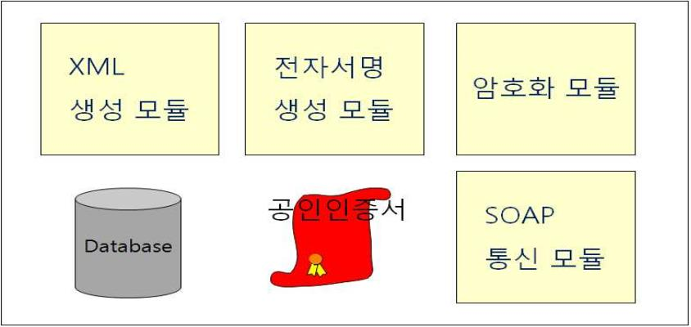
KECT200950000001
2.2. 전자(세금)계산서 발급 프로세스
2.2.1. 시스템 구성 개요
부가가치세법 및 소득세법에 의해 사업자가 전자(세금)계산서를 발급하기 위한 시스템의 기본
구성은 다음 [그림 2-1]과 같다.
[그림 2-1] 전자(세금)계산서 시스템 구성 예
발급 시스템은 크게 3가지로 구분할 수 있다.
(1) 전자(세금)계산서를 작성하기 위해 KEC 표준전자(세금)계산서 v3.0을 생성하기 위한
모듈과 전자(세금)계산서의 신뢰성을 위한 전자서명 모듈
(2) 사업자와 국세청 간 안정적이고 신뢰할 수 있는 통신을 위해 암호화, WS-Security
그리고 SOAP 엔진
(3) 전자(세금)계산서 데이터를 보관하기 위한 데이터베이스와 전자서명 및 암호화를 위한
사업자의 공인인증서
필요한 모듈과 S/W 그리고 H/W는 사업자 및 사용자의 환경에 따라 구성하면 되고 시스템
및 소프트웨어의 구성 또한 환경에 따라 다양하게 조직될 수 있다.
사업자가 전자(세금)계산서를 발급하는 경우 발급되는 전자(세금)계산서는 XML 형식이여야
하며, UTF-8 인코딩을 기본으로 한다.
2.2.2. 전자(세금)계산서 발급
전자(세금)계산서를 발급하는 사용자는 자체적으로 시스템을 보유하고 발급하는 경우와
ASP 서비스를 사용하는 경우로 구분할 수 있다. 먼저 [그림 2-2]와 같이 자체 시스템을
보유하고 있는 사용자의 경우이다.
- 6 -

Slide 12
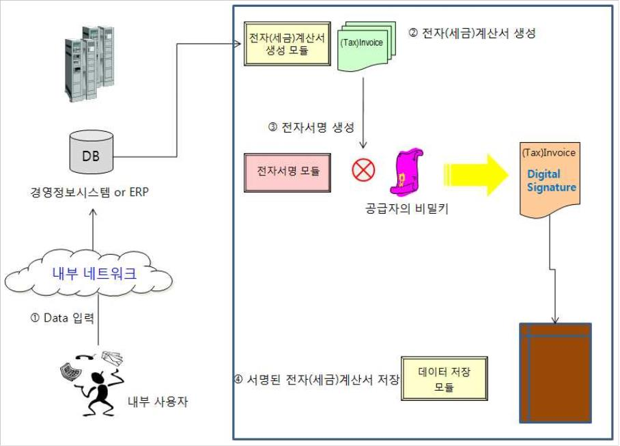
KECT200950000001
[그림 2-2] 자체 시스템 보유 사용자 전자(세금)계산서 발급
회사 내부 사용자는 자체 회계 시스템의 클라이언트 프로그램을 이용하여 자사 정보
시스템에 데이터를 입력한다. 담당자가 입력한 후 즉시 전자(세금)계산서를 발급하거나
관리자 승인 후에 발급할 수도 있다. 관리자는 승인 요청된 내용을 검토한 후 이상이 없다고
판단되면 승인 작업을 하게 된다. 승인이 완료된 전자(세금)계산서는 본격적으로 전자적 발급
프로세스를 거치게 된다. 본 지침에서는 담당자가 데이터를 ERP 등에 입력하고, 관리자가
승인한 후에 전자(세금)계산서를 발급하는 것으로 간주한다.
입력된 데이터에 대해 KEC 표준전자(세금)계산서v3.0 문서로 생성한다. 이 때, 생성된
전자(세금)계산서 문서에는 전자서명법에 근거한 법적 효력을 부여하고 데이터의 무결성과
발급자의 인증을 보장하기 위해 전자서명이 포함되어야 한다. 전자서명은 전자(세금)계산서
원문에 해시 함수를 적용함으로써 얻어진 해시값에, 다시 공급사업자의 개인키를 사용한
전자서명을 수행함으로써 이루어진다. 마지막으로 생성된 전자서명은 전자(세금)계산서에
다시 포함되어 공급받는자에게 발급한다.
- 7 -

Slide 13
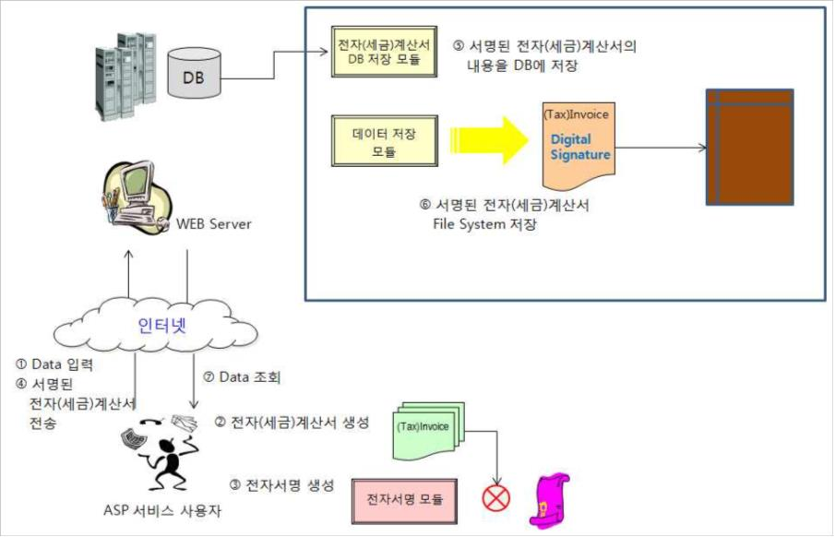
KECT200950000001
[그림 2-3] ASP 서비스 사용자 전자(세금)계산서 발급
다음은 [그림 2-3]에 보이는 것처럼 ASP 서비스를 이용하는 사용자의 경우이다. ASP
서비스 사용자는 웹 브라우저를 통하여 해당 ASP 서비스 시스템에 접속한 다음 전자(세금)
계산서 발급 페이지로 이동한다. 이 때 거래 내역을 신규로 입력하여 발급할 수도 있고
기존에 발급된 전자(세금)계산서 내용을 수정하여 발급할 수도 있다. 여기서는 신규 입력에
의해 발급하는 경우에 대해 설명하겠다.
공급받는자 형태는 다시 ASP 서비스를 사용하는 경우와 자체 시스템을 보유한 경우로
구분할 수 있다. 먼저 자체 시스템을 보유한 경우, 서명이 포함된 전자(세금)계산서를 수신
받은 공급받는자는 서명을 생성한 공급사업자를 인증하고 데이터 무결성을 위해 전자서명을
검증할 수 있다. [그림 2-4]는 이러한 흐름을 보여주고 있다. 즉 전자서명을 제외한
전자(세금)계산서 원문에 공급사업자와 동일한 해시 함수를 적용해서 얻어진 해시값과,
전자서명을 공급자의 공개키로 복호화해서 얻어진 해시값을 비교한다. 이 두 해시 값이 동일할
경우 전송 도중 변조가 없었다는 것과 정당한 사용자로부터 발급되었다는 것을 확인할 수
있다.
- 8 -

Slide 14
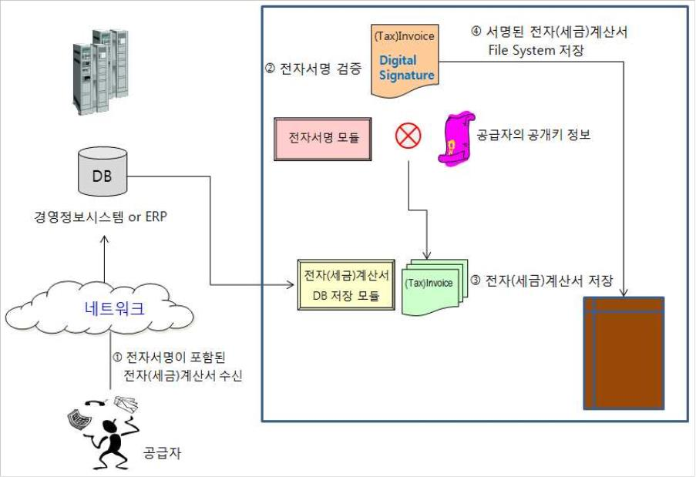
KECT200950000001
[그림 2-4] 자체 시스템 보유 사용자 전자(세금)계산서 검증
공급받는자가 ASP 서비스를 사용하는 사용자일 경우는 [그림 2-5]와 같이 ASP 서비스
시스템에 접속하여 발급된 전자(세금)계산서의 수신여부 및 상세 내역을 확인하고 수신 된
전자(세금)계산서의 무결성 등을 확인하기 위하여 전자서명을 검증할 수 있다.
전자서명을 검증하기 위하여서는 전자서명을 제외한 전자(세금)계산서 원문에 공급자와
동일한 해시 함수를 적용해서 얻어진 해시값과 전자서명을 공급사업자의 공개키로 복호화
해서 얻어진 해시값을 비교한다. 이 두 해시 값이 동일할 경우 전송 도중 변조가 없었다(데이터
무결성)는 것과 정당한 사용자로부터 발급되었다(공급자 인증)는 것을 확인할 수 있다.
- 9 -

Slide 15
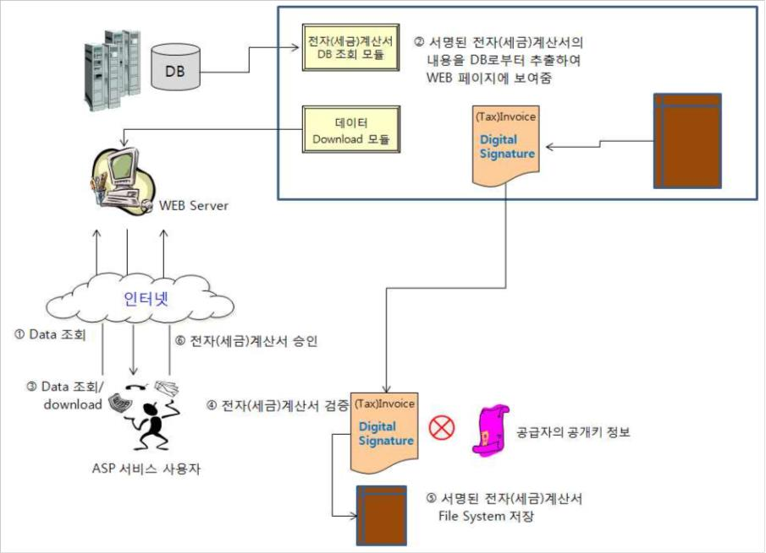
KECT200950000001
[그림 2-5] ASP 서비스 사용자 전자(세금)계산서 승인
2.2.3. 전자(세금)계산서 재발급
부가세법령에 따라 세금계산서를 발급하는 공급자는 전자서명이 포함된 전자세금계산서를
공급받는자에게 발급하고 국세청에 전송하여야만 하며, 소득세법, 법인세법에 따라 전자
서명이 포함된 전자계산서를 발급한 경우에는 국세청에 전송할 수 있다
전자(세금)계산서 재발급 프로세스는 국세청에서 전자서명이 포함된 전자(세금)계산서를
수신한 후 검증한 결과, 오류가 존재하는 경우에 해당한다. 공급자로부터 수신한 전자(세금)
계산서에 대해 XML 스키마 검증, 전자(세금)계산서 항목 검증, 전자서명 및 암호화 검증
등에 대해서 오류가 발생할 경우 국세청 시스템은 공급사업자(전송사업자)에게 오류내역을
통지한다. 오류 통지된 경우에는 전자(세금)계산서가 발급된 것으로 보지 아니한다.
국세청에 전송한 전자(세금)계산서 중 오류내역이 통지된 전자(세금)계산서는 오류 원인을
제거하여 관련 법령 기한(익월 10일) 내에 재발급하여 국세청에 전송하여야 한다. 발급
마감일에 전송하여 오류가 발생하여 오류내역이 통지된 전자세금계산서는 가산세 대상이 될 수
있으므로 지침 2.2.4절에서 설명하는 발급 및 전송 권장 기한을 참고하여야만 한다. 또한
재발급 절차는 지침2.2.2절에서 설명한 전자(세금)계산서 발급 프로세스를 따른다.
- 10 -

Slide 16
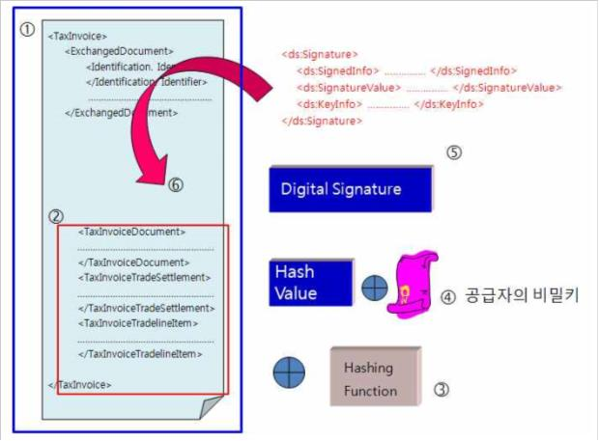
KECT200950000001
2.2.4. 전자(세금)계산서 발급 및 전송 기한
사업자가 전송한 전자(세금)계산서를 국세청 시스템의 검증에 의해 오류를 포함하지 않는
경우에 한해 정상적인 전자(세금)계산서로 접수되고, 비로소 전송이 완료된 것으로 간주된다.
이 때 부가가치세법에 따라, 전자세금계산서는 재화 또는 용역의 공급시기(표준전자(세금)
계산서 v3.0의 작성일자)를 기준으로 익월 10일까지 발급되어야 하며, 발급된 전자세금
계산서는 발급일의 다음날까지 전송되어야 한다. 단, 발급기한 및 전송기한이 토요일 또는
공휴일인 경우에는 그 다음날로 연장된다.
한편 국세청 시스템으로부터 검증 결과 통보는 사업자가 전자(세금)계산서를 전송한 익일
이후에 이루어질 수 있으므로, 검증결과에 따라 전자(세금)계산서의 재발급 프로세스가
수반될 경우 발급 마감 기한 내에 발급이 완료될 수 없는 경우가 발생할 수 있다.
따라서 발급기한을 넘기지 않도록 사업자는 익월 7일까지는 전자세금계산서를 발급하고
발급 즉시 전송할 것을 권고한다.
또한 국세청이 전자(세금)계산서의 전자서명 값을 검증하는 시점(전송 일자 기준 익일)에
전자서명을 수행한 인증서가 유효하지 않으면 정상적인 세금계산서가 될 수 없으므로 사업자는
전자(세금)계산서 발급 시 전자서명을 수행한 인증서의 유효기간 관리를 철저히 할 것을 권고
한다.
2.2.5. 전자(세금)계산서 구문 구조
전자(세금)계산서는 자체 발급 시스템 또는 ASP 서비스 시스템에서 발급되며 공급사업자의
공인인증서로 생성한 전자서명을 포함하는 전자문서이다. 다음 [그림 2-6]은 전자(세금)
계산서 문서가 생성된 후, 전자 서명을 생성하고 생성된 전자서명을 다시 전자(세금)계산서
원문 내에 포함시키는 흐름과 문서 구조를 보여주고 있다.
[그림 2-6] 전자(세금)계산서 구문 구조
- 11 -

Slide 17
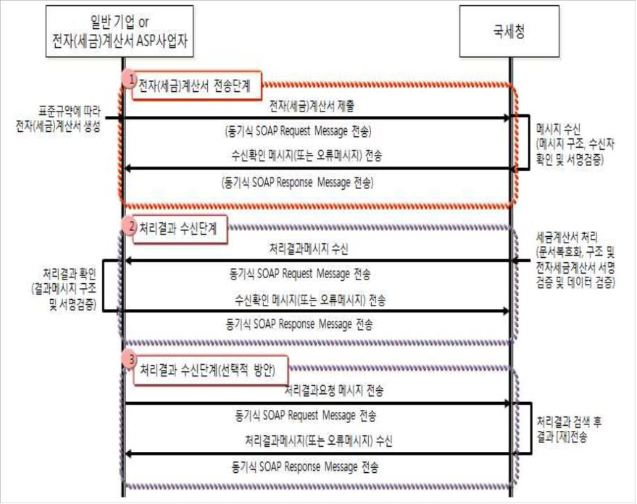
KECT200950000001
2.3. 국세청 연동 프로세스
2.3.1. 국세청 연동 개요
부가가치세법에 따라 공급자는 공급받는자에게 전자세금계산서를 발급하고 그 원본을
국세청에 전송하여야만 하며, 소득세법 또는 법인세법에 따라 공급받는자에게 전자계산서를
발급한 경우 국세청에 전송할 수 있다.
2.3.2. 연동 프로세스
사업자와 국세청 간 연동을 위해 사업자가 국세청에 전자(세금)계산서를 전송하는 프로세스는
다음 “[그림 2-7] 전자(세금)계산서 전송 프로세스”와 같다.
[그림 2-7] 전자(세금)계산서 전송 프로세스
전송프로세스의 각 단계를 살펴보면 다음과 같다.
∘ 전자(세금)계산서 전송 프로세스는 “① 전자(세금)계산서 전송단계”, “② 처리결과
수신 단계”, “③ 처리결과 수신단계(선택적 방안)”라는 3가지 프로세스의 조합으로
이루어진다.
여기서 각 단계는 다음과 같이 구성된다.
- 12 -

Slide 18
KECT200950000001
∘ "① 전자(세금)계산서 전송단계": 전자(세금)계산서 제출(전자(세금)계산서 첨부)과
수신확인 메시지(접수증 첨부) 수신이라는 2개의 동기식 트랜잭션으로 구성
∘ "② 처리결과 수신단계": 처리결과 메시지(처리결과문서 첨부) 수신과 수신확인
메시지 전송이라는 2개의 동기식 트랜잭션으로 구성
∘ “③ 처리결과 수신단계(선택적 방안)”: 처리결과요청 메시지 전송과 처리결과메시지
(처리결과문서 수신) 수신이라는 2개의 동기식 트랜잭션으로 구성(단, 처리결과 요청
서비스는 과세기간 이내의 접수 완료된 메시지에 한함)
프로세스의 각 단계들은 별도의 트랜잭션으로 처리가 된다. 다시 말해 전자(세금)계산서
전송단계가 끝나면 사업자는 통신을 끊고 각자 업무처리를 하다가 처리수신이 필요한
시점에 다시 통신을 연결하고 메시지를 주고받게 된다는 의미이다.
∘ 사업자가 처리결과를 국세청으로부터 수신할 수 있는 환경이면 처리 프로세스는
다음과 같은 조합으로 이루어질 수 있다.
- ① 전자(세금)계산서 전송단계 ⇒ ② 처리결과 수신단계
- 위의 프로세스를 기본으로 하나, 처리결과 수신시한이 지난 후에도 처리결과를
수신하지 못한 경우에는 “③ 처리결과 수신단계(선택적 방안)”에 의해 사업자는
국세청에 처리결과를 전송해 줄 것을 요청하여 받을 수 있다.(다만, “③ 처리결과
수신단계(선택적 방안)”는 전송 권장기한(익월 7일) 이후에는 허용하지 않는다)
- 처리결과 수신시한은 전자(세금)계산서 전송 성공 후 익일을 의미한다.
∘ 사업자가 처리결과를 국세청으로부터 수신할 수 있는 환경이 아닌 경우에는 사업
자의 처리 프로세스는 다음과 같은 조합으로 이루어질 수 있다.
- ① 전자(세금)계산서 전송단계 ⇒ “③ 처리결과 수신 단계(선택적 방안)”에 의해
국세청에 처리결과를 전송해 줄 것을 요청하여 수신하거나 국세청 전자(세금)계
산서 관련 홈페이지에서 처리 결과를 확인할 수 있다.(다만, “③ 처리결과 수신단
계(선택적 방안)”는 전송권장기한(익월 7일) 이후에는 허용하지 않는다)
- 처리결과 수신시한 및 홈페이지 확인은 상기된 시한과 동일하다.
※ 국세청으로부터 문서를 수신할 수 있는 환경이 아닌 경우 : 1) 사업자가 고정 IP를
확보하지 못한 경우, 2) 방화벽 등 사업자의 보안정책에 의하여 국세청에서 오는
메시지 통로가 차단된 경우, 3) 실시간으로 메시지를 받을 수 있도록 서버 운영을
할 수 없는 경우 등
2.3.2.1. 사업자 à국세청 전송
1) 전자(세금)계산서 제출
부가가치세법에 따른 공급자는 공급자의 인증서로 생성된 전자서명이 포함된 전자세금
계산서를 발급하여 다음날까지 국세청으로 전송하여야만 하며, 소득세법 또는 법인세법에
따라 공급자의 인증서로 생성된 전자서명이 포함된 전자계산서를 발급한 경우 다음날까지
국세청에 전송할 수 있다
국세청으로 전송하기 위해서는 국세청에서 제시하는 표준 규약을 준수하여야만 한다.
전자서명이 포함된 전자(세금)계산서를 국세청으로 전송하기 전에 표준에서 규정한 암호화
알고리듬을 사용하여 콘텐츠 암호화를 하여야 한다.
- 13 -

Slide 19
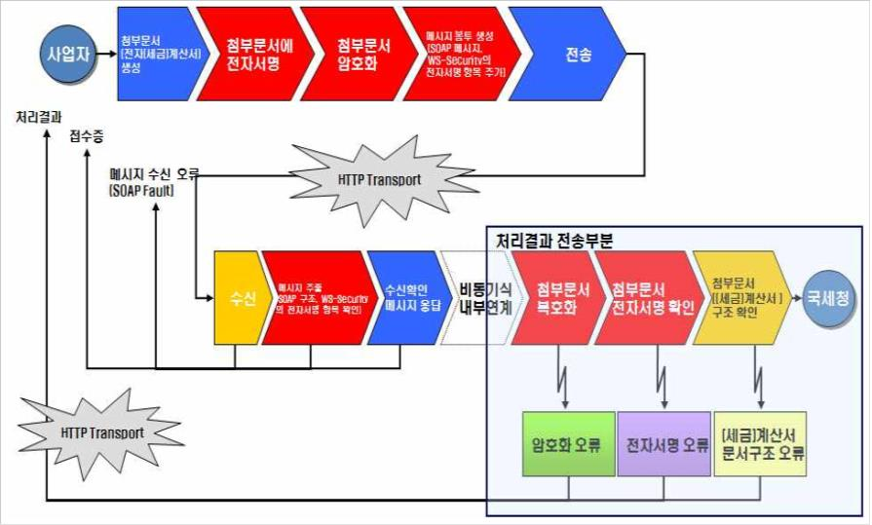
KECT200950000001
표준 통신 규약은 웹서비스의 메시징 표준인 SOAP v1.1 또는 v1.2를 채택하였으며, 하부
네트워크로 HTTP 통신을 사용한다. 또한 통신 상 안전하고 신뢰할 수 있는 전송을 보장하기
위해 WS-Security규약을 채택하였다.
자체 발급 사업자 또는 ASP 사업자는 발급된 전자(세금)계산서를 국세청으로 전송하기
위해 전자(세금)계산서를 SOAP 메시지로 Enveloping하여야 한다. SOAP 메시지의 헤더에는
전송하는 사업자에 대한 정보와 수신자인 국세청을 명시하며, 그 외에 메시지 전송시간,
업무명 및 메시지 유형정보 등을 포함하고 있다. 전자서명이 포함된 전자(세금)계산서는 표준
에서 규정한 암호화 알고리듬을 사용하여 콘텐츠 암호화를 하고, 암호화된 전자(세금)계산서는
SOAP 메시지의 첨부 문서로 구성된다. 또한 사업자와 국세청 간의 안전하고 신뢰할 수 있는
전송을 보장하기 위해 WS-Security를 사용하여야만 한다. 즉, 사업자의 공인인증서로 전자
서명을 생성하고 이를 SOAP 헤더에 포함한다.
사업자와 국세청에 전자(세금)계산서를 전송하고 국세청이 처리하여 사업자에게 통보하는
처리 절차를 도식화하면 다음 “[그림 2-8] 전자(세금)계산서 전송절차”와 같다.
[그림 2-8] 전자(세금)계산서 전송 및 처리절차
각 단계별로 설명을 하면 다음과 같다.
∘ 사업자가 국세청에 전자(세금)계산서를 전송하는 단계
- 1단계: 전자(세금)계산서 표준문서 규약에 맞게 문서를 생성한다.(“3. 전자(세금)
계산서 항목”부분 참조)
- 2단계: 각 전자(세금)계산서는 발급사업자의 공인인증서로 전자서명을 한다.(“5.
전자(세금)계산서 보안관련 지침”부분 참조)
- 14 -

Slide 20
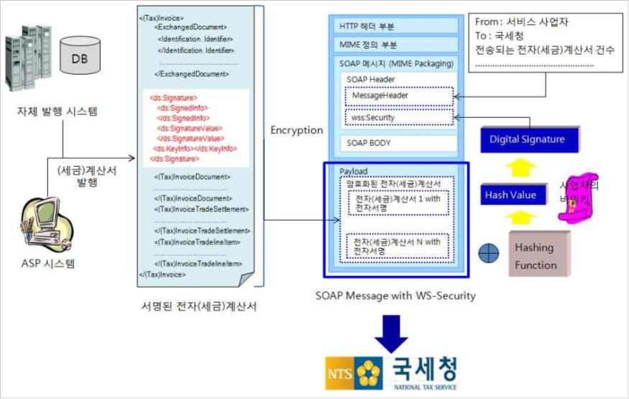
KECT200950000001
- 3단계: 전송하고자하는 1~100개의 전자서명된 전자(세금)계산서를 하나의 묶음으로
하여 한 번에 비밀키(대칭키)로 암호화가 되며, 비밀키는 국세청의 공개키로 암호화
되어 교환된다.(“5. 전자(세금)계산서 보안관련 지침”부분 참조)
- 4단계: 암호화된 전자(세금)계산서 묶음은 “SOAP Message with Attachment”
규약에 따라 SOAP메시지의 첨부로 추가된다. 사업자는 전송 전에 SOAP 헤더 내의
요청메시지와 암호화되어 첨부된 전자(세금)계산서를 대상으로 전자서명을 한다.(“6.3.2
메시지 전자서명 항목”부분 참조)
- 5단계: 전송프로토콜 규약에 따라 메시지를 전송한다.
전자(세금)계산서 국세청 전송을 위한 사업자 처리절차를 도식화하면 다음 “[그림2-9]와
같다.
[그림 2-9] 전자(세금)계산서 국세청 전송을 위한 사업자 처리절차
∘ 국세청이 사업자로부터 수신한 메시지를 처리하는 단계
- 1단계: 메시지를 수신한 후 SOAP 메시지 구조를 검증, 메시지에 대한 서명 검증 후
첨부문서를 추출한다.
- 2단계: 수신한 문서에 대해 접수증을 발급하고 동기식 응답메시지로 전달한다.
- 3단계: 국세청 내부에서는 수신한 메시지에서 첨부문서를 추출하고 추출한 전자(세금)
계산서를 복호화한다.
- 4단계: 복호화된 전자(세금)계산서가 묶음인 경우에는 (세금)계산서 단위로 분할한 후
각 개별 (세금)계산서에 대해 전자서명 검증을 수행한다.
- 15 -

Slide 21
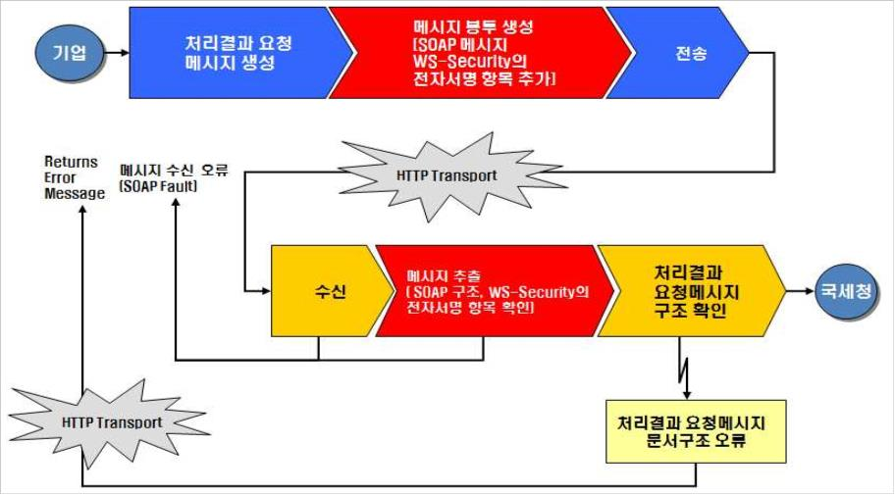
KECT200950000001
- 5단계: 전자(세금)계산서의 구조를 검증하고, 국세청 내부시스템과 연계하여 데이터
검증을 수행한다.
※ 3~5단계는 이해를 돕기 위해 국세청이 사업자에게 처리결과메시지를 전송하기
전에 내부시스템과 연동하여 처리하는 과정을 설명한 것이다.
국세청으로 전송하는 방식은 전자(세금)계산서가 발급된 후 바로 전송하는 경우와 배치로
일괄 전송하는 방식으로 구분될 수 있다. 사업자는 각자 시스템 운영 방식에 따라 국세청으로
전송하면 된다.
2) 처리결과요청 메시지 및 수신확인 메시지 전송
사업자가 국세청으로부터 처리결과를 수신하지 못한 경우에 처리결과를 요청하는 메시지를
전송하는 절차(처리결과 수신의 선택적 방안)와, 국세청으로부터 처리결과를 수신한 후
수신확인메시지를 전송하는 절차는 동일하다. 물론 처리결과를 요청하는 메시지는 SOAP의
Request 메시지로 전송되며, 처리결과 수신에 대한 수신확인메시지는 SOAP의 Response
메시지로 전송된다는 점에서는 차이가 있으나, 사업자 시스템에서 메시지 전송을 위한 처리
과정과 국세청 내부에서 메시지 수신 후 처리과정은 동일한 처리절차에 따라 이루어진다.
이 경우에는 모두 첨부문서는 없이 SOAP Body에 업무에 따른 Request Data를 실어서
SOAP규약에 따라 메시지를 생성한 후 전송한다.
[그림 2-10] 처리결과 요청메시지 및 수신확인 메시지 전송절차
사업자가 국세청에 전자(세금)계산서 제출에 대한 처리결과를 요청하는 단계는 다음과 같다.
- 1단계: 전자(세금)계산서 전송한 후 처리결과를 확인하기 위해 처리결과를 요청하는
메시지를 표준규약에 맞게 생성한다.(“6.2.4 업무 별 Request, Response data 및
첨부문서 구조”부분 참조)
- 16 -

Slide 22
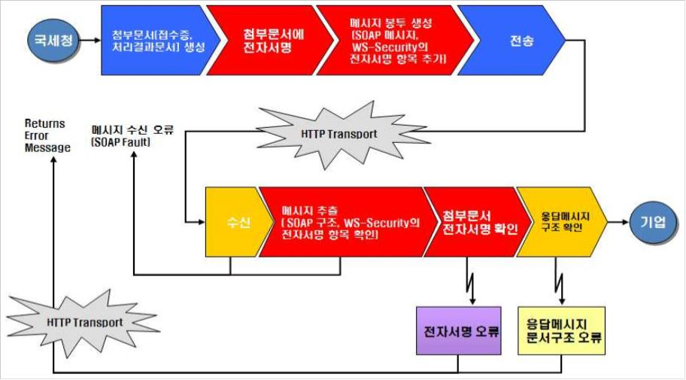
KECT200950000001
- 2단계: 규약에 따라 SOAP 메시지를 생성하고, 전송 전에 SOAP 메시지를 대상으로
전자서명을 한다.(“6.3.2 메시지 전자서명 항목”부분 참조)
- 3단계: 전송프로토콜 규약에 따라 메시지를 전송한다.
국세청으로부터 메시지를 수신한 사업자는 다음단계에 따라 처리를 한다.
- 1단계: 메시지를 수신한 후 SOAP 메시지 구조를 검증, 메시지에 대한 서명 검증을 한다.
- 2단계: 요청메시지를 내부시스템에 전달한다.
2.3.2.2. 국세청 à사업자 전송
1) 수신확인메시지(접수증 첨부) 및 처리결과메시지 수신 절차
사업자로부터 전자(세금)계산서 제출 메시지를 수신한 국세청은 수신하였다는 확인을 위해
접수증을 발급하고 이를 SOAP Response 메시지로 사업자에게 전송한다.
이는 Connection-Oriented 방식의 통신 방식과 유사한 것으로 사업자가 전송한 트랜잭션에
대해 국세청이 수신하였음을 확인해 주는 절차이다. 사업자가 이 응답 메시지를 수신하지
못했을 경우에는 국세청이 전자(세금)계산서 제출 메시지를 정상적으로 수신하지 못했다고
판단하고 반드시 재전송하여야 한다.
국세청은 접수증을 돌려주기 전에 수신한 제출 메시지의 SOAP 구조를 검증하고, 제출자
(전송사업자)의 공인인증서로 WS-Security 규약에 따라 전자서명된 메시지의 서명만을
검증한 후 접수증을 발급해준다.
[그림 2-11] 수신확인 메시지 및 처리결과 수신절차
- 17 -

Slide 23
KECT200950000001
또한 국세청은 사업자에게 접수증을 돌려준 이후에, 비동기식으로 암호화된 전자(세금)계산서
묶음을 복호화하고 (세금)계산서 단위로 나눠서 내부시스템과 연동하여 처리한 후, 그 처리
결과를 처리결과메시지로 만들어 사업자에게 다시 되돌려 준다.
내부시스템과의 연동과정에서 국세청 시스템은 공급사업자의 전자서명이 포함된 전자(세금)
계산서에 대해 XML 스키마 검증, 전자(세금)계산서 항목 검증, 전자서명 검증 등을 수행하게
된다. 이와 같은 전자(세금)계산서 검증 결과는 실시간으로 즉시 사업자에게 전송하지 않고
익일 전송을 원칙으로 한다.
국세청이 사업자에게 전송하는 수신확인메시지(접수증 첨부) 및 처리결과메시지 수신 절차를
도식화하면 다음 “[그림 2-11] 수신확인메시지 및 처리결과메시지 수신 절차”와 같다.
국세청이 사업자에게 전자(세금)계산서 제출에 대한 수신응답으로서 접수증을 돌려주거나
처리 결과를 돌려주는 단계는 다음과 같다.
- 1단계: 전자(세금)계산서 수신 후 접수증이나, 처리결과문서를 표준 규약에 맞게
생성한다.(“6.2.4 업무 별 Request, Response data 및 첨부문서 구조”부분 참조)
- 2단계: 생성한 문서에 대해 국세청의 공인인증서로 전자서명을 수행한다.
- 3단계: 서명된 문서를 첨부물로 한 SOAP 메시지를 생성하고, 전송 전에 SOAP 메시지와
첨부문서를 대상으로 전자서명을 한다.(“6.3.2 메시지 전자서명 항목”부분 참조)
- 4단계: 전송프로토콜 규약에 따라 메시지를 전송한다.
국세청으로부터 메시지를 수신한 사업자는 다음단계에 따라 처리를 한다.
- 1단계: 메시지를 수신한 후 SOAP 메시지 구조를 검증, 메시지에 대한 서명 검증 후
첨부문서를 추출한다.
- 2단계: 추출한 첨부문서(접수증, 처리결과문서)의 전자서명을 검증한다.
- 3단계: 첨부문서에 대한 메시지 구조를 확인한 후 내부시스템과 연계한다.
앞서도 언급하였지만, 국세청에서 사업자에게 보내는 문서는 내용에 대한 기밀성을 요하지
않으므로, 전자(세금)계산서와 달리 암호화 단계를 생략한다.
[그림 2-12]와 같이 국세청으로부터 처리결과메시지를 수신한 사업자는 처리결과메시지의
첨부영역에서 처리결과문서를 추출한다. 추출된 처리결과문서를 분석(“4.3 처리결과 문서”
부분 참조)하여 오류 통지된 전자(세금)계산서를 파악한다. 오류로 통지된 전자(세금)계산서에
대해 오류 원인을 확인하고 오류를 수정한 후 전자(세금)계산서를 재발급하여 다시 국세청
으로 전송하여야 한다. 다만 오류가 발생한 전자세금계산서에 대해 발급기한(익월 10일) 내에
국세청으로 재전송하지 않을 경우 이는 발급하지 않은 것으로 분류되어 가산세 대상이 된다.
- 18 -

Slide 24
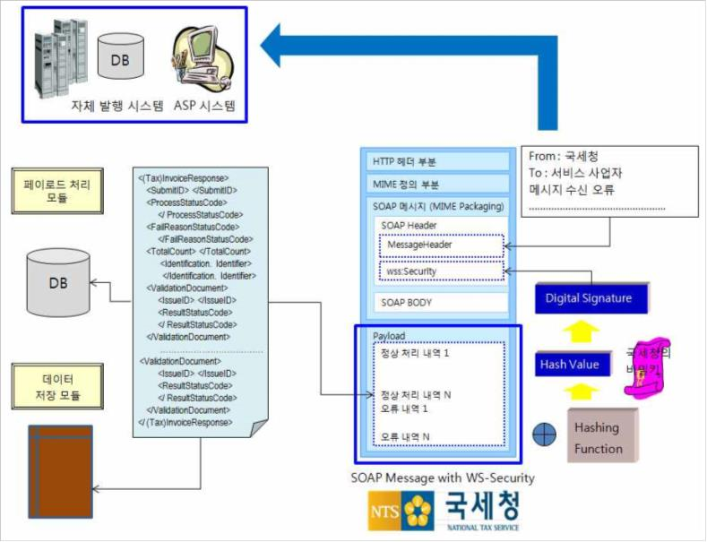
KECT200950000001
[그림 2-12] 국세청으로부터 응답 내역 수신 및 처리 절차
- 19 -

Slide 25
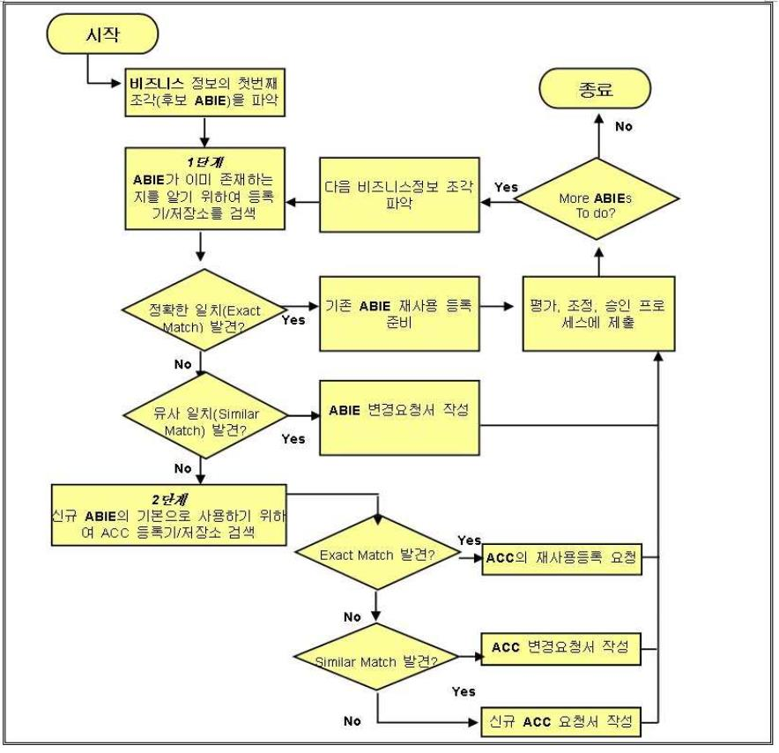
KECT200950000001
3. 전자(세금)계산서 항목
3.1. 표준 정의 절차
국세청에서 권고하는 표준전자(세금)계산서의 항목과 메시지 구조는 국제 및 국내 표준
지침에 따라 정의되었다. 본 규격에서 참고한 표준 지침으로는 KEC XML 전자문서 개발지침 v3.5,
UN/CEFACT CCL08A와 KEC CCL08을 참고로 하였다. 전자서명은 W3C의 XML DSig
규격을 참고로 하여 정의하였다. 전자(세금)계산서 항목은 다음 [그림 3-1]의 절차에 따라
정의하였다. 자세한 사항은 KEC XML 전자문서 개발지침 v3.5를 참조하기 바란다. 먼저
신규 전자문서를 설계하기 위해 기 등록된 BP(Business Process)가 존재하는지를 확인한다.
유사 일치는 일치하는 BP가 존재할 경우 이를 확장하여 사용하도록 하며, 적절한 BP가 존재
하지 않을 경우 BP 모델링을 하고 이를 등록하여 사용한다.
[그림 3-1] 비즈니스 정보 발견 절차
- 20 -

Slide 26
KECT200950000001
다음으로는 사용가능한 비즈니스 정보 개체를 검토하여 BP 요구사항을 충족하는지 검토
한다. 다음 설명은 비즈니스 정보 개체를 발견하는 절차에 대해 설명하고 있다.
1단계: 개발자가 필요로 하는 비즈니스 정보와 동일한 정의를 가진 기존 ABIE를 찾기
위하여 BIE 라이브러리를 검색.
§ 정확한 일치(Exact Match): 비즈니스 요구를 충족시키는 정의와 구성을 가진 ABIE가 있다면,
해당 ABIE를 재사용하기 위한 재사용 등록 요청 수행
§ 유사한 일치(Similar Match): 비즈니스 요구를 완전히 충족시키지 못하며 약간의 수정이 필요한
ABIE가 있다면, ABIE 변경요청서를 작성하여 제출
§ 비즈니스 요구를 충족시키는 ABIE가 없으면, 2단계로 감
2단계: 신규 ABIE가 기반으로 할 수 있는 적절한 구조와 정의를 가진 기존 ACC를 CC
라이브러리에서 검색
§ 비즈니스 요구를 충족시키는 정의와 구조를 갖는 ACC가 있다면, ACC의 재사용 등록 요청을
수행
§ 비즈니스 요구를 완전히 충족시키지 못하며 약간의 수정이 필요한 ACC가 있다면, ACC 변경
요청서를 작성하여 제출
§ 비즈니스 요구를 충족시키는 정의와 구조를 가진 ACC가 없다면, 신규 ACC 요청서를 작성하여
제출
전자문서를 정의하기 위해 필요로 하는 비즈니스 정보 개체가 있다면, 사용 가능한 XML
스키마가 존재하는지 확인하여 정의한다. 만족하는 XML 스키마가 존재하지 않을 경우 신규로
정의하여 등록 요청을 한다.
- 21 -

Slide 27
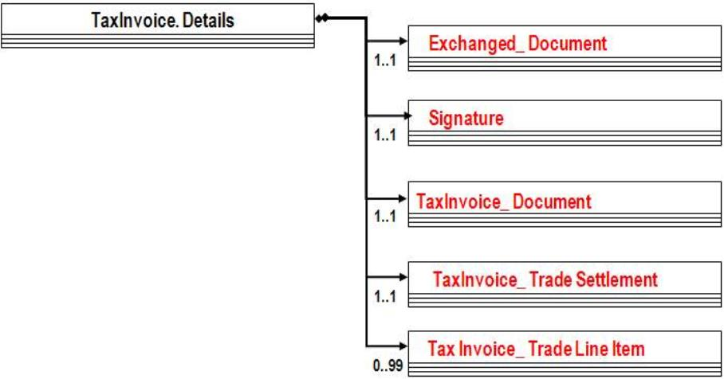
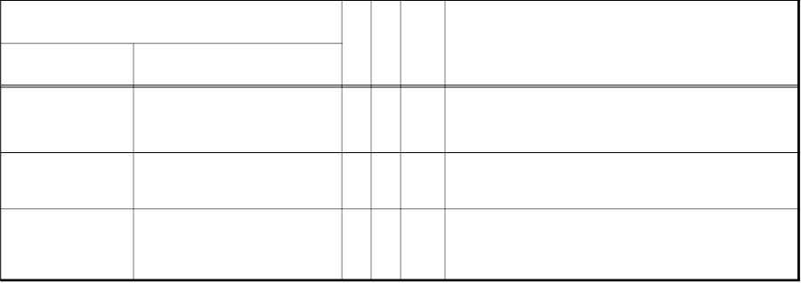
KECT200950000001
3.2. 전자(세금)계산서 전자문서 항목
[그림 3-2]는 표준전자(세금)계산서 v3.0의 스키마 구조를 보여 주고 있으며, 자세한 항목
설명은 “부록 A. 표준전자(세금)계산서 v3.0 항목표”를 참조하면 된다.
[그림 3-2] 표준전자(세금)계산서 전자문서 구조
3.2.1. 전자(세금)계산서 전자문서 항목 “관리정보(ExchangedDocument)”
관리정보는 [표 3-1]에서 설명하는 것처럼 사업자가 전자(세금)계산서를 이용 할 때 서비스
사업자와 이용 사업자가 이용할 수 있는 서비스번호(ID) 등 관리정보 관련 항목을 포함하고
있다.
[표 3-1] 표준전자(세금)계산서 전자문서 항목 “관리정보(ExchangedDocument)" 내 항목
항목명(경로 포함)
T L
O
비고
국문
영문
서비스관리번호 ID
S 24 0..1
ASP 사업자 또는 ERP 시스템에서 관리하는
식별체계
사업자관리번호 ReferenceDocument/ID S 24 0..1 발급 전자(세금)계산서에 부여하는 식별체계
발급일시
Issue. Datetime
N 14 1..1
전자서명 생성 일시 및 전자(세금)계산서 발급
일시
- 22 -

Slide 28
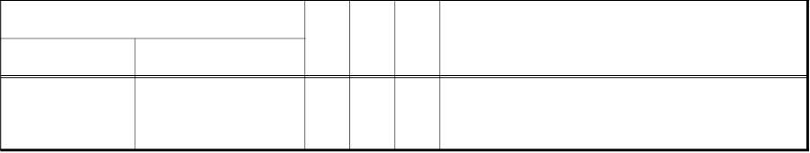

KECT200950000001
3.2.2. 전자(세금)계산서 전자문서 항목 “전자서명(Signature)”
전자서명은 [표 3-2]에서 설명하는 것처럼 전자(세금)계산서의 무결성 등을 위하여 공인
인증서에 기반을 두어 계산서정보를 전자서명 하는 전자서명(Signature) 항목을 포함하고
있다.(“5.2절 전자서명”을 참조)
[표 3-2] 표준전자(세금)계산서 전자문서 항목 “전자서명(Signature)" 내 항목
항목명(경로 포함)
T
L
O
비고
국문
영문
전자서명
Signature
S
-
1..1 지침 내 “5.2 전자서명” 참조
3.2.3. 전자(세금)계산서 전자문서 항목 “기본정보(TaxInvoiceDocument)”
기본정보는 [표 3-3]에서 설명하는 것처럼 전자(세금)계산서 승인번호(Issue. ID) 등 기본
정보 관련 항목을 포함하고 있다.
[표 3-3] 표준전자(세금)계산서 전자문서 항목 “기본정보(TaxInvoiceDocument)" 내 항목
항목명(경로 포함)
T
L
O
비고
국문
영문
전자(세금)계산서에 대한 국세청에서 식별
하는 식별체계
승인번호
Issue. ID
S
24 1..1 형식 : 작성일자(숫자 8자리)+국세청등록
번호(숫자 8자리)+식별자(a~z와 숫자를
조합한 8자리)
작성일자
Issue. Datetime
Type. Code
N
8
1..1
전자(세금)계산서 작성일자
형식 : YYYYMMDD
(세금)계산서
종류
(세금)계산서 분류(2자리) : 01(세금계산서), 02
(수정세금계산서), 03(계산서), 04(수정계산서)
N
N
N
4
1..1 (세금)계산서 종류(2자리) : 01(일반), 02
(영세율), 03(위수탁), 04(수입), 05(영세율
위수탁), 06(수입납부 유예)
영수/청구 구분 Purpose. Code
2
2
0..1 01 : 영수, 02 : 청구
전자(세금)계산서 수정 사유 코드 : 01(기재사항의
착오·정정, 세율을 잘못 적용한 경우), 02(공
0..1 급가액 변동), 03(환입), 04(계약의 해제), 05
(내국신용장 사후 개설), 06(착오에 의한
이중발급, 면세 등 발급대상이 아닌 거래 등)
수정코드
AmendemntStatus. Code
당초승인번호 OriginalIssue. ID
S
S
24 0..1 당초 전자(세금)계산서 승인번호
150 0..3 3회까지 반복 사용 가능
비고
Description. Text
수입(세금)계산서
관련 정보
ReferencedImportDocument
-
-
-
지침 3.2.3.1절 참조
- 23 -

Slide 29
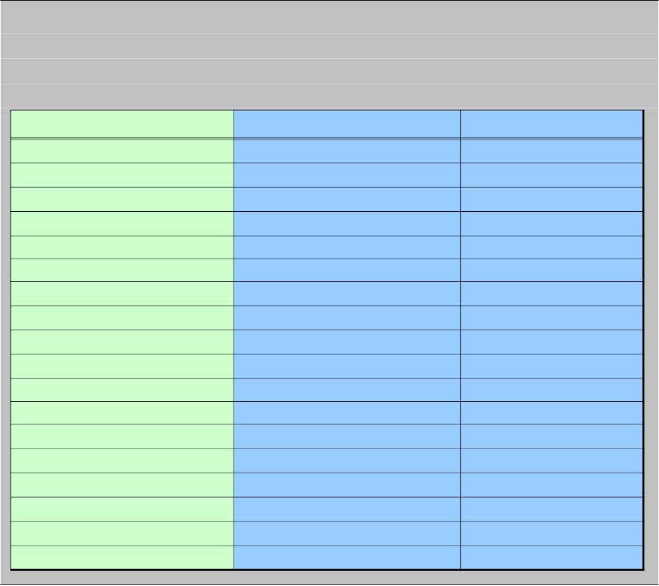
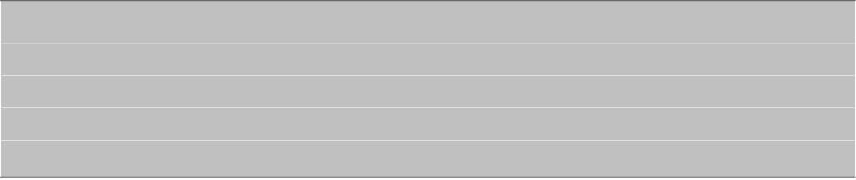
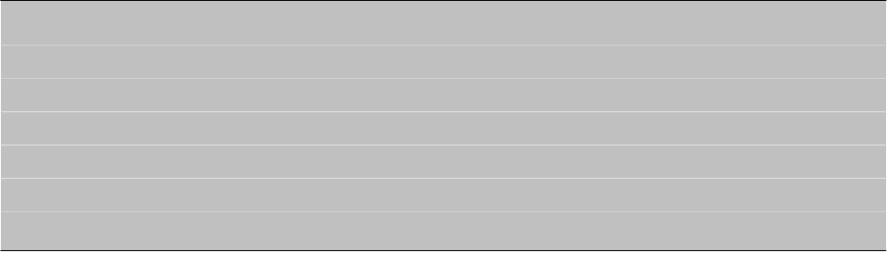
KECT200950000001
<유의 사항 1>
기본정보 내 “수정코드(AmendemntStatus. Code)”는 “KEC 표준전자(세금)계산서 v3.0”에서
선택항목으로 정의하고 있으나, “(세금)계산서 종류(Type. Code)”의 코드에 따라 사용하지 않거나
필수 항목으로 이용하여야 한다.
“(세금)계산서 종류(Type. Code)“의 코드 값
(세금)계산서 종류
일반 세금계산서
수정코드 항목 사용 여부
0101
0102
0103
0104
0105
0106
0201
0202
0203
0204
0205
0206
0301
0303
0304
0401
0403
0404
사용 안함
사용 안함
사용 안함
사용 안함
사용 안함
사용 안함
필수 항목
필수 항목
필수 항목
필수 항목
필수 항목
필수 항목
사용 안함
사용 안함
사용 안함
필수 항목
필수 항목
필수 항목
영세율 세금계산서
위수탁 세금계산서
수입 세금계산서
영세율 위수탁 세금계산서
수입납부 유예 세금계산서
수정 일반 세금계산서
수정 영세율 세금계산서
수정 위수탁 세금계산서
수정 수입 세금계산서
수정 영세율 위수탁 세금계산서
수정 수입납부 유예 세금계산서
일반 계산서
위수탁 계산서
수입 계산서
수정 일반 계산서
수정 위수탁 계산서
수정 수입 계산서
<유의 사항 2>
기본정보 내 “영수/청구 구분(Purpose. Code)”는 “KEC 표준전자(세금)계산서 v3.0”에서 선택
항목으로 정의하고 있으나, “(세금)계산서 종류(Type. Code)”가 0104(정기수입(세금)계산서),
0204(수정수입(세금)계산서), 0304(수입계산서), 0404(수정수입계산서)일 때를 제외하고 필수
항목으로 기재할 것을 권고한다.
<유의 사항 3>
기본정보 내 “승인번호(Issue. ID)”는 작성일자(예 : 20090911), 국세청등록번호(예 : 12345678),
일련번호(예 : 00000001 또는 a534eg61 또는 axyzefqg)를 조합하여 작성하여 기재하여야 한다.
작성일자는 (세금)계산서를 작성한 일자 정보를 연월일(yyyymmdd) 형식으로, 국세청등록번호는
국세청에 전자(세금)계산서 시스템사업자로 등록하였을 때 부여받은 등록번호(숫자 8자리)를
고정된 값의 형식으로, 일련번호는 알파벳 영문 소문자 a~z와 숫자 0~9를 조합한 형식으로
작성하여야만 한다. 또한 승인번호는 (세금)계산서별로 유일한 값을 가져야만 한다.
- 24 -

Slide 30
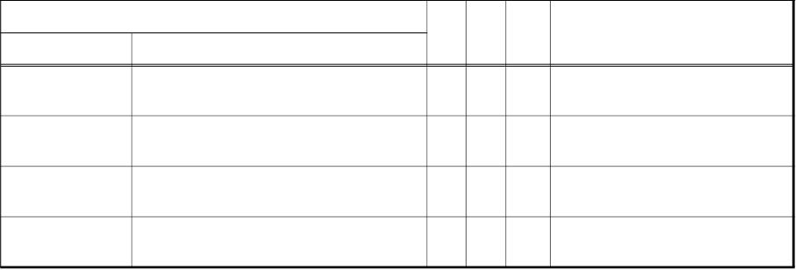
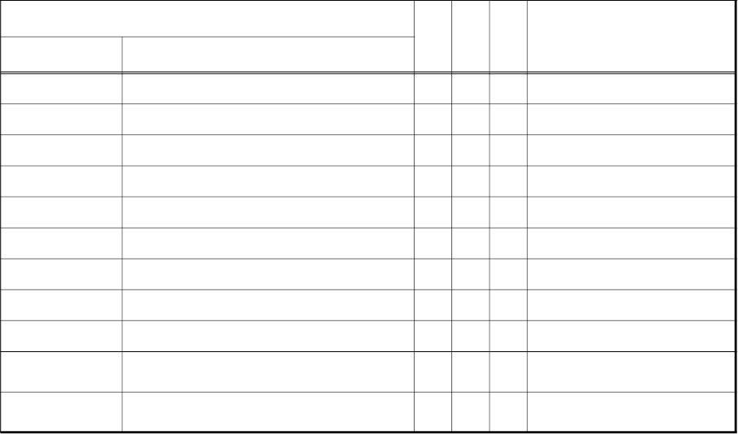
KECT200950000001
3.2.3.1. 전자(세금)계산서 전자문서 항목 “기본정보(TaxInvoiceDocument)” 중 “수입
(세금)계산서 관련 정보(ReferencedImportedDocument)"
“기본정보-수입(세금)계산서 관련 정보”는 [표 3-4]에서 설명하는 것처럼 수입신고번호
(ID) 등 수입(세금)계산서 관련 항목을 포함하고 있다.
[표 3-4] 표준전자(세금)계산서 전자문서 항목 “기본정보(TaxInvoiceDocument)” 중
“수입(세금)계산서 관련 정보(ReferencedImportedDocument)" 내 항목
항목명(경로 포함)
T
L
O
비고
국문
영문
수입신고번호 ID
S
15 0..1 수입 신고서 번호
일괄발급시작일 Acceptable. Period/Start. DateTime
일괄발급종료일 Acceptable. Period/End. DateTime
S
S
8
8
6
0..1 YYYYMMDD
0..1 YYYYMMDD
수입총건
Item. Quantity
N
0..1 일괄 발급 수입 총건
3.2.4. 전자(세금)계산서전자문서 항목 “거래처정보-공급자(InvoicerParty)”
“거래처정보-공급자”는 [표 3-5]에서 설명하는 것처럼 사업자등록번호(ID) 등 공급자
관련 항목을 포함하고 있다.
[표 3-5] 전자(세금)계산서 전자문서 항목 “거래처정보-공급자(InvoicerParty)” 내 항목
항목명(경로 포함)
T
L
O
비고
국문
영문
사업자등록번호 ID
S
N
S
S
S
S
S
S
S
13 1..1 XXXXXXXXXX 형식("-"불포함)
0..1 국세청 부여 거래처 식별 코드
종사업장번호 SpecifiedOrganization/TaxRegistration. ID
4
상호
대표자성명
주소
Name. Text
200 1..1
100 1..1
70 → 200
30 → 100
SpecifiedPerson/Name. Text
SpecifiedAddress/LineOne. Text
Type. Code
300 0..1 150 → 300
업태
100 0..1
100 0..1
100 0..1
100 0..1
40 → 100
40 → 100
40 → 100
30 → 100
업종
Classification. Code
담당부서명
담당자명
DefinedContact/DepartmentName. Text
DefinedContact/PersonName. Text
S
S
20 0..1
담당자전화번호 DefinedContact/Telephone. Communication
담당자이메일 DefinedContact/URI. Communication
100 0..1
40 → 100
- 25 -

Slide 31
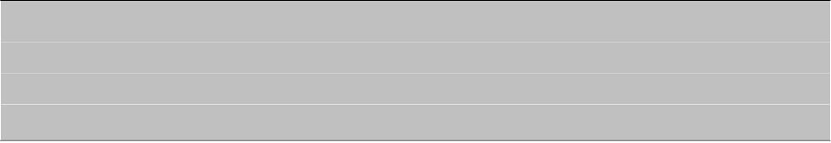
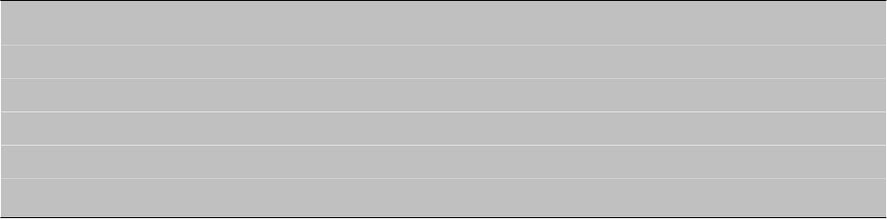
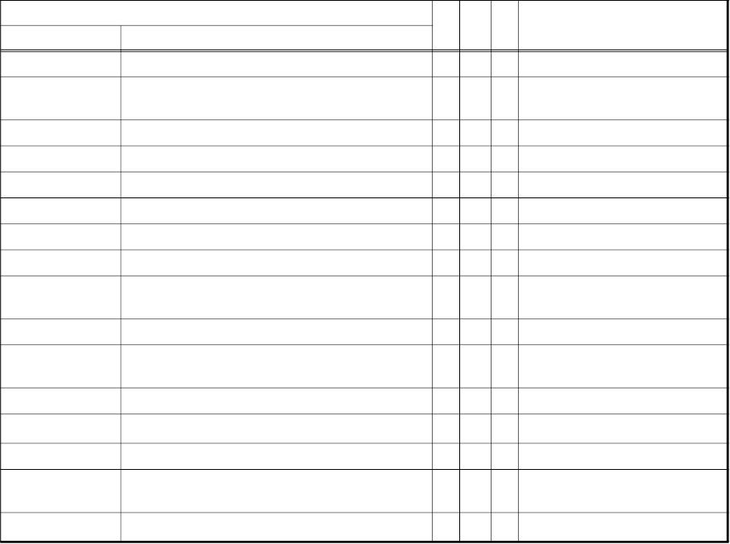
KECT200950000001
<유의 사항 1>
공급자 내 “사업자등록번호(ID)”는 KEC표준전자(세금)계산서 v3.0에서 최대 길이를 13byte로
정의하고 있으나 10byte만을 이용하여 사업자등록번호 만을 입력하여야하며, 데이터 타입을
문자열(String)으로 정의하고 있으나 숫자(Number)만을 입력하여야 한다.
<유의 사항 2>
공급자 내 “종사업장번호(SpecifiedOrganization/TaxRegistration.ID)”에는 부가가치세법 상의
“사업자 단위 과세”를 적용받는 사업자의 종사업장 구분코드로 국세청에서 관리하는 “사업자
단위승인서”, “사업자단위변경승인통지서” 상의 종사업장 일련번호 4자리를 기재하여야 한다.
(단, 2010년 1월 1일 이후 개업하는 사업자의 경우 사업자단위과세 적용을 받는 경우에는
사업자등록증 부표인 "사업자단위과세 적용 종된 사업장 명세서"상의 일련번호 4자리를 말함.
3.2.5. 전자(세금)계산서 전자문서 항목 “거래처정보-공급받는자(InvoiceeParty)”
“거래처정보-공급받는자”는 [표 3-6]에서 설명하는 것처럼 사업자등록번호(ID) 등 공급
받는자 관련 항목을 포함하고 있다.
[표 3-6] 전자(세금)계산서 전자문서 항목 “거래처정보-공급받는자(InvoiceeParty)” 내 항목
국문
항목명(경로 포함)
T
L O
비고
영문
사업자등록번호 ID
사업자등록번호
S
13 1..1 형식 : nnnnnnnnnnnnn("-"불포함)
SpecifiedOrganization/BusinessType. Code
N
N
01(사업자등록번호),
2 1..1
구분코드
종사업장번호 SpecifiedOrganization/TaxRegistration. ID
02(주민등록번호), 03(외국인)
4 0..1 국세청 부여 거래처 식별 코드
상호
대표자성명
주소
Name. Text
S 200 1..1 70 → 200
S 100 1..1 30 → 100
S 300 0..1 150 → 300
S 100 0..1 40 → 100
S 100 0..1 40 → 100
SpecifiedPerson/Name. Text
SpecifiedAddress/LineOne. Text
Type. Code
업태
업종
Classification. Code
담당부서명1
담당자명1
PrimaryDefinedContact/DepartmentName.
Text
S 100 0..1 40 → 100
S 100 0..1 30 → 100
PrimaryDefinedContact/PersonName. Text
담당자전화번호1
PrimaryDefinedContact/Telephone.
Communication
S
20 0..1
담당자이메일1 PrimaryDefinedContact/URI. Communication S 100 0..1 40 → 100
담당부서명2
담당자명2
SecondaryDefinedContact/DepartmentName. Text S 100 0..1 40 → 100
SecondaryDefinedContact/PersonName. Text S 100 0..1 30 → 100
담당자전화번호2
SecondaryDefinedContact/Telephone.
S
20 0..1
Communication
담당자이메일2 SecondaryDefinedContact/URI. Communication S 100 0..1 40 → 100
- 26 -

Slide 32
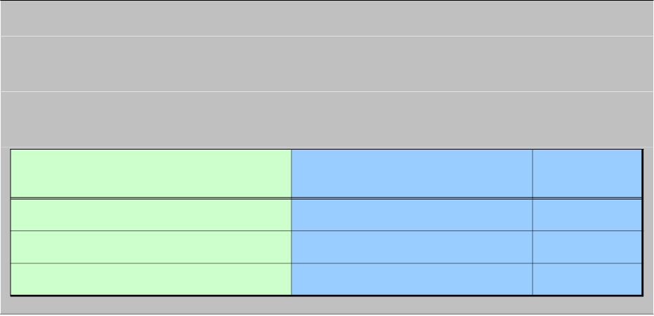
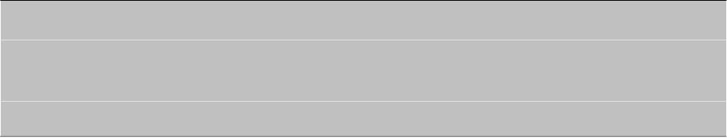
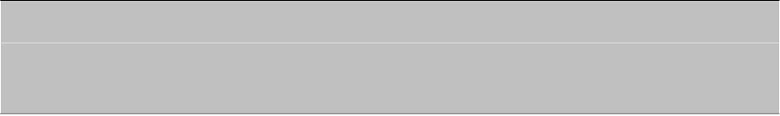
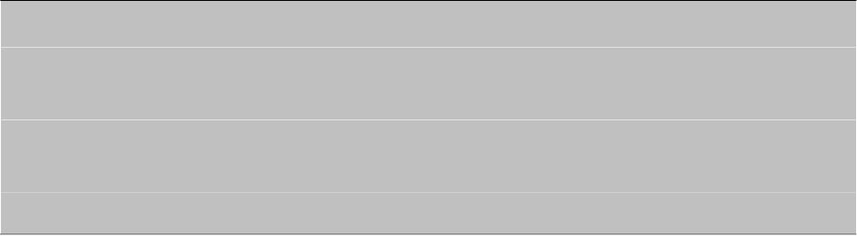
KECT200950000001
<유의 사항 1>
공급받는자 내 “사업자등록번호(ID)”는 “사업자등록구분 코드(SpecifiedOrganization/
BusinessType. Code)”에 따라 공급받는자의 정보(사업자등록번호, 개인주민등록번호, 외국인)를
입력하여야하며, 데이터 타입을 문자열(String)으로 정의하고 있으나 숫자(Number)만을 입력
하여야 한다.
사업자등록구분코드
사업자등록번호(ID) 기재 내용
최대 길이(Byte)
(SpecifiedOrganization/BusinessType. Code)
01
02
03
사업자등록번호
주민등록번호
외국인
10
13
13
<유의 사항 2>
공급받는자 내 “사업자등록구분 코드(SpecifiedOrganization/ BusinessType. Code)”가 03(외국인)인
경우, “사업자등록번호(ID)”에 “9999999999999”를 입력한 후 비고에 관련 정보(외국인 등록
번호, 여권번호 등)를 기재하여야만 한다.
<유의 사항 3>
공급받는자 연락처 정보(PrimaryDefinedContact, SecondaryDefinedContact)는 필요한 경우
2인까지 기재할 수 있다.
<유의 사항 4>
공급받는자 내 “종사업장번호(SpecifiedOrganization/TaxRegistration. ID)”에는 부가가치세법
상의 “사업자 단위 과세”를 적용받는 사업자의 종사업장 구분코드로 국세청에서 관리하는
“사업자단위승인서”, “사업자단위변경승인통지서” 상의 종사업장 일련번호 4자리를 기재하여야
한다.(단, 2010년 1월 1일 이후 개업하는 사업자의 경우 사업자단위과세 적용을 받는 경우에는
사업자등록증 부표인 "사업자단위과세 적용 종된 사업장 명세서"상의 일련번호 4자리를 말함.
3.2.6. 전자(세금)계산서 전자문서 항목 “거래처정보-수탁사업자(BrokerParty)”
“거래처정보-수탁사업자”는 [표 3-7]에서 설명하는 것처럼 사업자등록번호(ID) 등 수탁
사업자 관련 항목을 포함하고 있다.
- 27 -

Slide 33
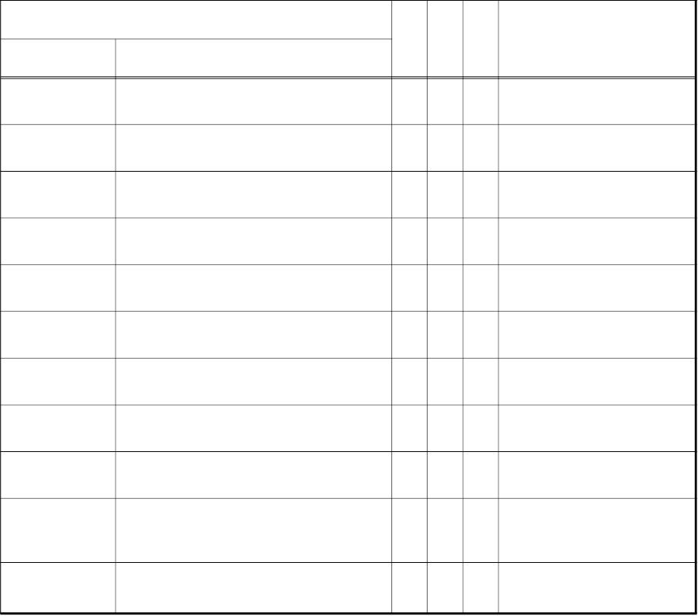
KECT200950000001
[표 3-7] 전자(세금)계산서 전자문서 항목 “거래처정보-수탁사업자(BrokerParty)” 내 항목
항목명(경로 포함)
영문
T
L
O
비고
국문
사업자등록번호 ID
S
N
S
S
S
S
S
S
S
13 1..1 XXXXXXXXXX 형식("-"불포함)
종사업장번호 SpecifiedOrganization/TaxRegistration. ID
4
0..1 국세청 부여 거래처 식별 코드
상호
대표자성명
주소
Name. Text
200 1..1
100 1..1
70 → 200
30 → 100
SpecifiedPerson/Name. Text
SpecifiedAddress/LineOne. Text
Type. Code
300 0..1 150 → 300
업태
100 0..1
100 0..1
100 0..1
100 0..1
40 → 100
40 → 100
40 → 100
30 → 100
업종
Classification. Code
담당부서명
담당자명
DefinedContact/DepartmentName. Text
DefinedContact/PersonName. Text
담당자전화번호
DefinedContact/Telephone.
Communication
S
S
20 0..1
담당자이메일 DefinedContact/URI. Communication
100 0..1
40 → 100
<유의 사항 1>
“수탁사업자(BrokerParty)" 정보는 지침 3.2.3절에서 정의하고 있는 “(세금)계산서 종류(Type. Code)”가
“0103(위수탁세금계산서), ”0203(수정위수탁세금계산서)“, ”0303(위수탁계산서)“, ”0403(수정
위수탁계산서)“인 경우에만 수탁사업자정보의 기재를 위하여 이용하여야만 한다.
<유의 사항 2>
수탁사업자 내 “사업자등록번호(ID)”는 KEC표준전자(세금)계산서 v3.0에서 최대 길이를
13byte로 정의하고 있으나 10byte만을 이용하여 사업자등록번호 만을 입력하여야하며, 데이터
타입을 문자열(String)으로 정의하고 있으나 숫자(Number)만을 입력하여야 한다.
- 28 -

Slide 34
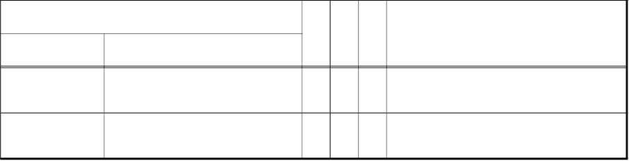
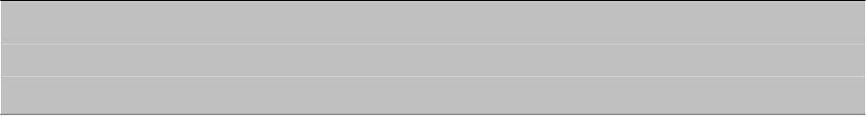
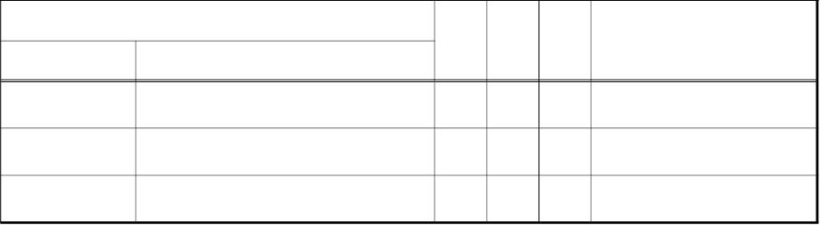
KECT200950000001
<유의 사항 3>
수탁사업자 내 “종사업장번호(SpecifiedOrganization/TaxRegistration. ID)”에는 부가가치세법 상의 “사업자
단위 과세”를 적용받는 사업자의 종사업장 구분코드로 국세청에서 관리하는 “사업자단위승인서”,
“사업자단위변경승인통지서” 상의 종사업장 일련번호 4자리를 기재하여야 한다.(단, 2010년 1월 1일
이후 개업하는 사업자의 경우 사업자단위과세 적용을 받는 경우에는 사업자등록증 부표인 "
사업자단위과세 적용 종된 사업장 명세서"상의 일련번호 4자리를 말함.
3.2.7. 전자(세금)계산서 전자문서 항목 “결제정보-결제방법별금액(SpecifiedPaymentMeans)”
“결제정보-결제방법별금액(SpecifiedPaymentMeans)”는 [표 3-8]에서 설명하는 것처럼
결제방법코드(Type. Code) 등 결제방법별 금액 관련 항목을 포함하고 있다.
[표 3-8] 전자(세금)계산서 전자문서 항목 “결제정보-결제방법별금액(SpecifiedPaymentMeans)” 내 항목
항목명(경로 포함)
T
L
2
O
비고
국문
영문
결제방법코드 Type. Code
S
0..1 10:현금, 20:수표, 30:어음, 40:외상
금액
Paid. Amount
N
18 0..1
<유의 사항>
“결제정보-결제방법별금액(SpecifiedPaymentMeans)”은 결제방법별 코드에 따라 결제 방법
횟수만큼 최대 4회 반복할 수 있다.
3.2.8. 전자(세금)계산서 전자문서 항목
“결제정보-Summary(SpecifiedMoneySummation)”
“결제정보-Summary(SpecifiedMoneySummation)”는 [표 3-9]에서 설명하는 것처럼 공급
가액합계(ChargeTotalAmount) 등 전자(세금)계산서 금액 합계 관련 항목을 포함하고 있다.
[표 3-9] 전자(세금)계산서 전자문서 항목 “결제정보-Summary(SpecifiedMoneySummation)” 내 항목
항목명(경로 포함)
T
L
O
비고
국문
영문
공급가액합계 ChargeTotal. Amount
N
N
N
18
18
18
1..1
0..1
1..1
세액합계
총금액
TaxTotal. Amount
GrandTotal. Amount
- 29 -

Slide 35

KECT200950000001
<유의 사항 1>
“결제정보-Summary(SpecifiedMoneySummation)”내 "세액합계(TaxTotal. Amount)"는 KEC표준
전자(세금)계산서 v3.0에서 선택항목으로 정의하고 있으나 “(세금)계산서 종류(Type. Code)”의
코드에 따라 사용하지 않거나 필수 항목으로 이용하여야 한다.
“(세금)계산서 종류(Type. Code)“의
(세금)계산서 종류
일반 세금계산서
세액합계 항목 사용 여부
코드 값
0101
필수 항목
필수 항목
필수 항목
0102
영세율 세금계산서
위수탁 세금계산서
0103
0104
0105
0106
0201
수입 세금계산서
필수 항목
필수 항목
필수 항목
필수 항목
영세율 위수탁 세금계산서
수입납부 유예 세금계산서
수정 일반 세금계산서
0202
0203
수정 영세율 세금계산서
수정 위수탁 세금계산서
필수 항목
필수 항목
0204
0205
0206
0301
수정 수입 세금계산서
필수 항목
필수 항목
필수 항목
사용 안함
수정 영세율 위수탁 세금계산서
수정 수입납부 유예 세금계산서
일반 계산서
0303
0304
0401
0403
0404
위수탁 계산서
사용 안함
사용 안함
사용 안함
사용 안함
사용 안함
수입 계산서
수정 일반 계산서
수정 위수탁 계산서
수정 수입 계산서
<유의 사항 2>
“결제정보-Summary(SpecifiedMoneySummation)”내 항목들은 “-” 값을 허용한다.
<유의 사항 3>
“결제정보-Summary(SpecifiedMoneySummation)”내 항목들은 지침 3.2.9절의 “상품정보
(TaxInvoiceLineItem)"의 "단가(TaxInvoice/UnitPrice/Unit. Amount)" 항목에서 허용하고 있는
원 단위 이하 금액을 허용하지 않는다.
3.2.9. 전자(세금)계산서 전자문서 항목 “상품정보(TaxInvoiceTradeLineItem)”
“상품정보(TaxInvoiceTradeLineItem)”는 [표 3-10]에서 설명하는 것처럼 상품정보 반복
- 30 -

Slide 36
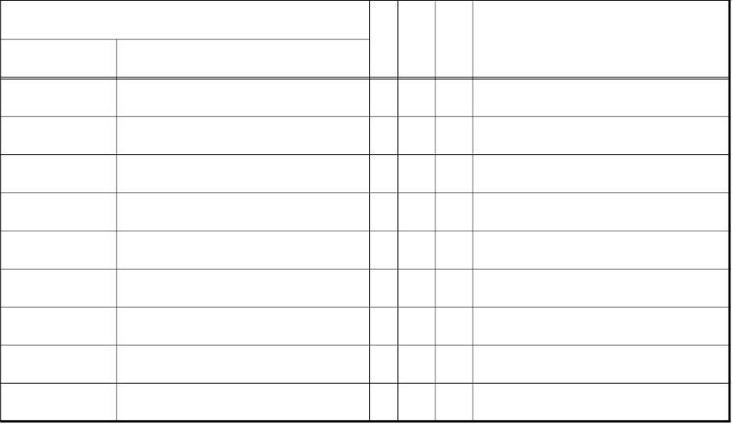
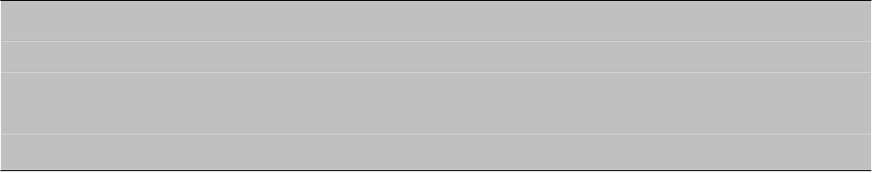
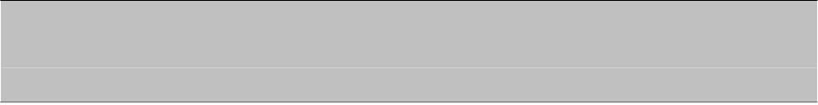
KECT200950000001
횟수를 보여주는 “일련번호(Sequence.Numeric)" 등 상품정보 관련 항목을 포함하고 있다.
[표 3-10] 전자(세금)계산서 전자문서 항목 “결제정보-상품정보(TaxInvoiceTradeLineItem)” 내 항목
항목명(경로 포함)
T
L
O
비고
국문
일련번호
공급년월일
품목명
규격
영문
Sequence. Numeric
PurchaseExpiry. DateTime
Name. Text
N
N
S
2
8
1..1 상품 정보 반복 횟수(01~99)를 표현
0..1 YYYYMMDD형식.
100 0..1
60 0..1
100 0..1
12 0..1
18 0..1
18 0..1
18 0..1
Information. Text
S
비고
Description. Text
S
수량
ChargeableUnit. Quantity
UnitPrice/Unit. Amount
Invoice. Amount
N
N
N
N
단가
공급가액
세액
TotalTax/Calculated. Amount
<유의 사항 1>
“상품정보(TaxInvoiceLineItem)” “KEC 표준전자(세금)계산서 v3.0”에서 선택항목으로 정의하고
있으나, “(세금)계산서 종류(Type. Code)”가 0104(정기수입(세금)계산서), 0204(수정수입(세금)
계산서), 0304(수입계산서), 0404(수정수입계산서)일 때를 제외하고 상품 정보의 수에 따라
1~99회까지 반복하여 기재할 것을 권고한다.
<유의 사항 2>
“수량(ChargeableUnit. Quantity)" 항목은 소수점 2자리까지의 표기를 허용(예 : 1/2 → 0.5로
표현)하며, “-” 값을 허용한다.
<유의 사항 3>
품목 단위(예 : BOX, EA 등)의 기재를 원하는 사업자는 “수량(ChargeableUnit. Quantity)" 항목의
속성(attribute) 값으로 표현한다.
<유의 사항 4>
“상품정보-단가(UnitPrice/Unit. Amount)”는 원 단위 이하 소수점 2자리까지 표현 할 수 있으며,
“-” 값을 허용한다.
<유의 사항 5>
“상품정보-공급가액(InvoiceAmount)” 및 “상품정보-세액(TotalTax/Calculated. Amount)”은 원 단위
이하 금액을 허용하지 않으며, “-” 값을 허용한다.
- 31 -

Slide 37
KECT200950000001
4. 국세청 응답문서
4.1. 개요
본 장에서는 국세청과 사업자 간 연계 중에서 국세청이 사업자에게 전송하는 문서를 정의한다.
국세청이 사업자에 전송하는 문서는 두 가지가 있는데 하나는 전자(세금)계산서 접수증
이고 나머지 하나는 접수한 전자(세금)계산서에 대한 처리결과 문서이다. 접수증은 사업자가
국세청에 전자(세금)계산서를 제출했을 때, 국세청이 전자(세금)계산서를 성공적으로 수신
했음을 알려주는 문서이다. 그리고 처리결과 문서는 국세청이 수신한 전자(세금)계산서에
대한 구조, 서명 그리고 데이터 검증을 끝낸 후 그 처리 결과를 사업자에게 알려주는 문서
이다.
국세청에서 사업자로 전달되는 모든 응답문서는 XML 형식이고 UTF-8 인코딩을 기본으로
한다. 또한 국세청 공인인증서로 전자서명을 한 후 통신규약에 따라 SOAP 메시지에 첨부
되어 전달된다. (지침 6절 전자(세금)계산서 통신 참조)
- 32 -

Slide 38

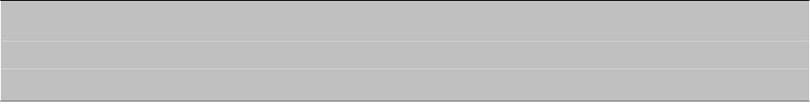
KECT200950000001
4.2. 응답문서 구조
두 가지 국세청 응답문서인 접수증과 처리결과는 하나의 응답문서 구조를 가진다. 국세청은
이러한 하나의 응답문서 구조를 바탕으로 업무에 맞게 항목을 조정하여 응답문서를 생성한다.
국세청 응답문서의 전체 구조는 다음과 같다.
[표 4-1] 국세청 응답문서 구조
국문
항목명(경로 포함)
비고
영문
§ 지침 내 “5.2 전자서명” 참조
전자서명
Signature
제출아이디
접수번호
ResultDocument/RefSubmit. ID
ResultDocument/Receipt. ID
ResultDocument/Type. Code
§ 사업자가 전자(세금)계산서를 제출했을
때 설정한 SubmitID 값
§ 전자(세금)계산서 접수 번호
§ 'NTS' + '-' + 년월일시분초 + '-' +
일련번호 5자리
§ 예> NTS-20090318094120-12345
문서종류
응답시간
§ 응답문서 구분 코드
§ (표 4-6 응답문서 코드표 참조)
§ 국세청이 응답문서를 생성한 시간
ResultDocument/Response. DateTime _{§ YYYYMMDDHHMMSS 형식}
처리상태코드
§ (세금)계산서 처리 상태코드(표 4-2
ResultDocument/ProcessStatus. Code
송수신 문서 코드표 참조)
§ 전체 처리 실패 원인(표 4-4 전송메시지
처리불가원인코드 ResultDocument/FailReasonStatus. Code
처리실패 원인 코드표 참조,)
§ 처리결과 문서이고 ProcessStatusCode가
03인 경우만 존재
총제출건수
처리성공건수
처리실패건수
승인번호
§ 수신받은 전자(세금)계산서 전체 건수
ResultDocument/TotalCount. Quanity § 처리결과 문서이고
ProcessStatusCode가 01인 경우만 존재
§ 전체 중 검증 결과 값이 성공인 것의 개수
ResultDocument/SuccessCount. Quantity § 처리결과 문서이고 ProcessStatusCode가
01인 경우만 존재
§ 전체 중 검증 결과 값이 실패인 것의 개수
ResultDocument/FailCount. Quantity § 처리결과 문서이고 ProcessStatusCode가
01인 경우만 존재
ResultDocument/ValidationDocument ^{§ 처리 결과 목록}
§ 처리결과 문서이고 ProcessStatusCode가
/Issue. ID
01인 경우만 존재
처리결과코드
비고
ResultDocument/ValidationDocument
§ 처리 결과 (표 4-5 처리 결과 코드표 참조)
/ResultStatus. Code
ResultDocument/Description. Text § 비고
<유의 사항>
“처리결과코드(ResultStatus. Code)”의 코드 값이 "SYN004(전자(세금)계산서 스키마 오류)“인 경우는 승인번호를
추출할 수 없으므로, ”승인번호(Issue. ID)"의 값이 “9999999999999999xsderror"라고 표시된다.
- 33 -

Slide 39
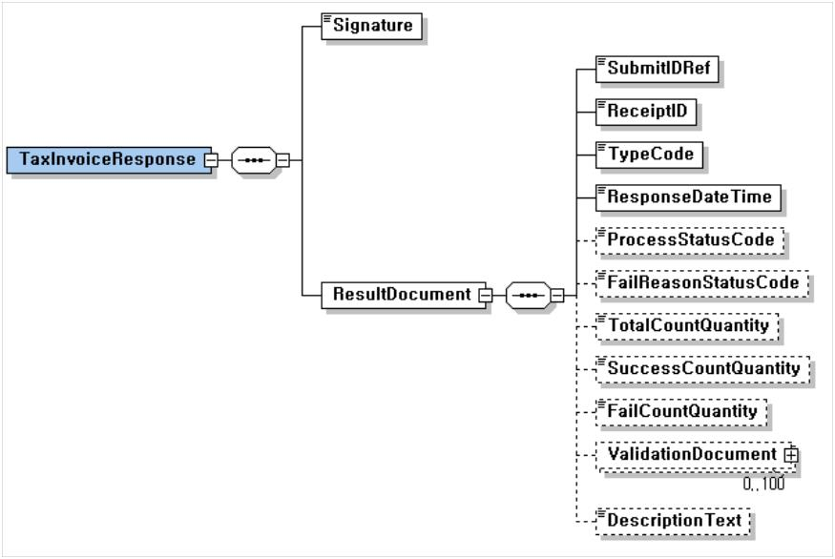
KECT200950000001
국세청 응답문서 전체 스키마 구조는 [그림 4-1]과 같다.
[그림 4-1] 국세청 응답문서 스키마
4.2.1. 전자(세금)계산서 접수증
4.2.1.1. 접수증 개요
사업자가 국세청에 전자(세금)계산서를 제출하면 국세청은 SOAP 메시지 구조를 검증하고
SOAP 메시지에 적용된 전자서명을 통해 메시지를 전송한 사업자에 대한 인증 및 SOAP
메시지 무결성을 검증한다. 이때, 수신 메시지가 정상이면 국세청은 메시지를 정상적으로
수신하였음을 확인하는 문서 즉, 접수증을 발급하여 이를 사업자에게 전달한다.
4.2.1.2. 접수증 문서 구조
접수증은 사업자가 전자(세금)계산서를 등록할 때 생성한 SOAP Body 내의 SubmitID에
대한 참조 값과 국세청이 발부한 접수번호로 구성된다. 또한 데이터 무결성과 발급 보장을
위해 국세청 전자서명이 첨부된다. 스키마 구조는 [그림 4-2]와 같다.
- 34 -

Slide 40
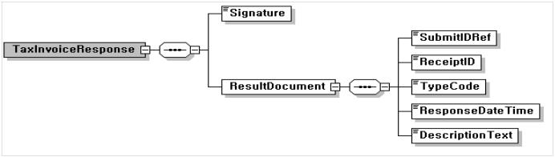
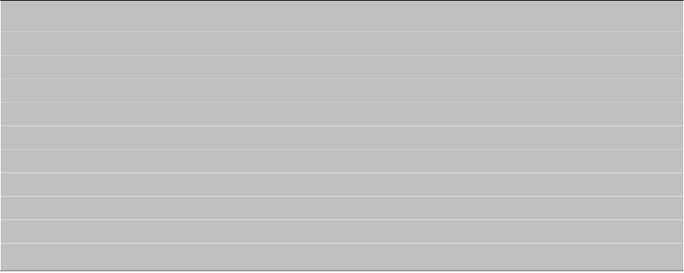
KECT200950000001
[그림 4-2] 국세청 접수증 스키마
전자서명이 생략된 접수증의 예시는 다음과 같다. 실제 접수증은 아래 예시에 전자서명이
첨부된 형식을 가진다.
<TaxInvoiceResponse>
<ResultDocument>
<RefSubmitID>12345678-20090325-be3cfa2c0b1e4e4697e8d41f3f0674cb</RefSubmitID>
<ReceiptID>NTS-20090318094120-12345</ReceiptID>
<TypeCode>01</TypeCode>
<ResponseDateTime>20090318094120</ResponseDateTime>
<DescriptionText>
성공적으로 접수 처리 되었습니다. 처리 결과는 익일 전송될 예정입니다.
</DescriptionText>
</ResultDocument>
</TaxInvoiceResponse>
4.2.2. 처리결과 문서
4.2.2.1. 처리결과 문서 개요
국세청은 사업자로부터 수신한 암호화된 전자(세금)계산서 문서(또는 문서 묶음)를 복호화한 후
구조검증, 서명검증 그리고 데이터 검증 등을 수행하고 그 결과를 다음과 같은 문서 형식
(지침 4.3.2절 처리결과 문서 구조 부분 참조)으로 작성하여 해당 사업자에 다시 전달한다.
국세청은 하나의 SOAP 메시지 내에 첨부된 전자(세금)계산서에 대한 처리가 모두 완료된 후,
각 (세금)계산서 단위로 처리결과를 작성하여 사업자에 전달한다. 즉, 모든 처리결과 문서는
처음 사업자가 전자(세금)계산서를 제출한 SOAP 메시지 단위로 작성된다. 예를 들면 사업자
A가 50건, 70건의 전자(세금)계산서를 하나로 묶어 국세청에 각각 신고한 경우, 처리결과 문서는
50건에 대한 처리결과 문서 하나 그리고 70건에 대한 처리결과 문서 하나가 사업자 A에게
각각 전달된다.
- 35 -

Slide 41
KECT200950000001
4.2.2.2. 처리결과 문서 구조
처리결과 문서는 전자(세금)계산서를 제출할 때 첨부한 전자(세금)계산서 전체 건수, 성공
및 실패 건수 그리고 각 전자(세금)계산서 별 처리결과 코드 값 등으로 구성된다. 또한 데이터
무결성을 위해 국세청 전자서명이 첨부된다.
처리결과는 크게 개별 전자(세금)계산서에 대한 검증을 수행할 수 없는 경우와 할 수 있는
경우 두 가지로 나뉜다. 개별 전자(세금)계산서에 대한 검증을 수행할 수 없는 경우는 시스템
사업자 인증 오류, 첨부 전자(세금)계산서 복호화 실패 등 개별 전자(세금)계산서 검증 단계
전에 오류가 발생하는 경우인데(표 4-4 참조) 이 경우 "처리상태코드(ProcessStatus.
Code)는 ‘처리 불가’ 코드 값인 ‘03’으로 설정되고 해당 오류 코드가 “처리불가원인코드
(FailReasonStatus. Code)"에 기록된다. 이때 개별 전자(세금)계산서에 대한 검증을 수행
할 수 없는 경우 중 ‘연계 사업자 인증 오류’는 내부 처리 전 발견되는 오류이므로 동기식으로
바로 사업자에게 전달된다.
처리 불가가 아닌 경우(표 4-5 참조) 개별 전자(세금)계산서 검증 결과가 "처리결과코드
(ResultDocument/ValidationDocument/ResultStatus. Code)" 항목에 기록된다. 케이스 별
스키마 및 예시는 아래와 같다. 실제 처리결과는 각 예시에 전자서명(지침 5.2절 문서보안
부분 참조)이 첨부된 형식을 가진다.
§ 처리 완료인 경우(ProcessStatus : 01)
- 루트 항목 TaxInvoiceResponse 하위로 필수 항목인 “전자서명(Signature)"과
ResultDocument 경로 아래의 모든 항목을 갖는다.
- ResultDocument는 하위에 필수 항목인 “제출아이디(RefSubmit. ID)”, “접수번호
(Receipt. ID)”, “문서종류(Type. Code)", "응답시간(Response. DateTime)", ”처리
상태코드(ProcessStatus. Code), “총제출건수(TotalCount. Quantity)”, “처리성공
건수(SuccessCount. Quantity)”, “처리실패건수(FailCount. Quantity)” 항목과
ValidationDocument 경로 아래의 모든 항목을 갖는다.
- ValidationDocument는 하위에 “승인번호(Issue. ID), ”처리결과코드(ResultStatus.
Code) 항목을 갖는다.
- ValidationDocument는 사업자가 제출한 전자(세금)계산서의 수만큼 반복된다.
처리 완료인 경우 문서 스키마 구조는 [그림 4-3]과와 같다.
- 36 -

Slide 42
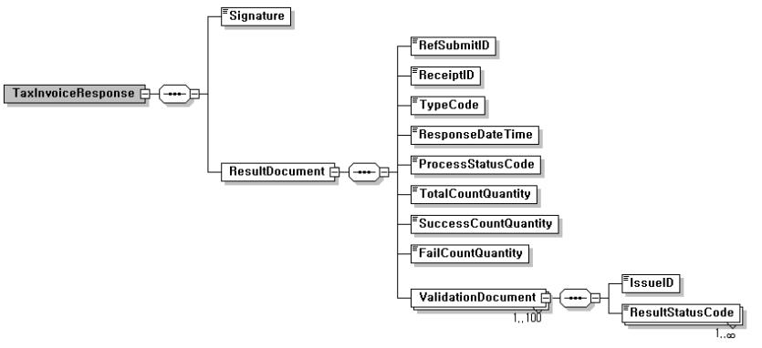

KECT200950000001
[그림 4-3] 처리 완료인 경우 처리결과 스키마
- 처리 완료인 경우 처리결과 문서의 실제 예시는 아래와 같다.
<TaxInvoiceResponse>
<ResultDocument>
<RefSubmitID>12345678-20090325-be3cfa2c0b1e4e4697e8d41f3f0674cb</RefSubmitID>
<ReceiptID>NTS-20090325094120-12345</ReceiptID>
<TypeCode>02</TypeCode>
<ResponseDateTime>20090318094120</ResponseDateTime>
<ProcessStatusCode>01</ProcessStatusCode>
<TotalCountQuantity>5</TotalCountQuantity>
<SuccessCountQuantity>3</SuccessCountQuantity>
<FailCountQuantity>2</FailCountQuantity>
<ValidationDocument>
<IssueID>200903151234567800000001</IssueID>
<ResultStatusCode>SUC001</ResultStatusCode>
</ValidationDocument>
<ValidationDocument>
<IssueID>200903151234567800000002</IssueID>
<ResultStatusCode>SUC001</ResultStatusCode>
</ValidationDocument>
<ValidationDocument>
<IssueID>200903151234567800000003</IssueID>
<ResultStatusCode>SUC001</ResultStatusCode>
</ValidationDocument>
<ValidationDocument>
<IssueID>200903151234567800000004</IssueID>
<ResultStatusCode>ERR001</ResultStatusCode>
</ValidationDocument>
<ValidationDocument>
<IssueID>200903151234567800000005</IssueID>
<ResultStatusCode>ERR001</ResultStatusCode>
</ValidationDocument>
</ResultDocument>
</TaxInvoiceResponse>
- 37 -

Slide 43
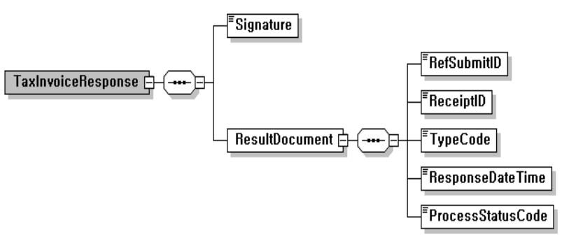
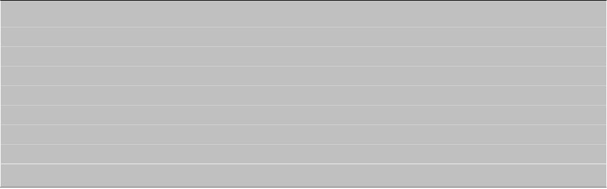
KECT200950000001
§ 처리 중인 경우(ProcessStatus : 02)
- 루트 항목 TaxInvoiceResponse 하위로 필수 항목인 “전자서명(Signature)"과
ResultDocument 경로 아래의 일부 항목을 갖는다.
- ResultDocument는 하위에 필수 항목인 “제출아이디(RefSubmit. ID)”, “접수번호
(Receipt. ID)”, “문서종류(Type. Code)", "응답시간(Response. DateTime)", ”처리
상태코드(ProcessStatus. Code)" 항목을 갖는다.
- 처리 중인 경우 문서 스키마 구조는 [그림 4-4]와 같다.
[그림 4-4] 처리 중인 경우 처리결과 스키마
- 처리 중인 경우 처리결과 문서의 실제 예시는 아래와 같다.
<TaxInvoiceResponse>
<ResultDocument>
<RefSubmitID>12345678-20090325-be3cfa2c0b1e4e4697e8d41f3f0674cb</RefSubmitID>
<ReceiptID>NTS-20090318094120-12345</ReceiptID>
<TypeCode>02</TypeCode>
<ResponseDateTime>20090318094120</ResponseDateTime>
<ProcessStatusCode>02</ProcessStatusCode>
</ResultDocument>
</TaxInvoiceResponse>
§ 처리 불가인 경우(ProcessStatus : 03)
- 루트 항목 TaxInvoiceResponse 하위로 필수 항목인 “전자서명(Signature)"과
ResultDocument 경로 아래의 일부 항목을 갖는다.
- ResultDocument는 하위에 필수 항목인 “제출아이디(RefSubmit. ID)”, “접수번호
(Receipt. ID)”, “문서종류(Type. Code)", "응답시간(Response. DateTime)", ”처리상태
코드(ProcessStatus. Code)“, ”처리불가원인코드(FailReasonStatus. Code)" 항목을 갖는다.
- 처리 불가인 경우 문서 스키마 구조는 [그림 4-5]와 같다.
- 38 -

Slide 44
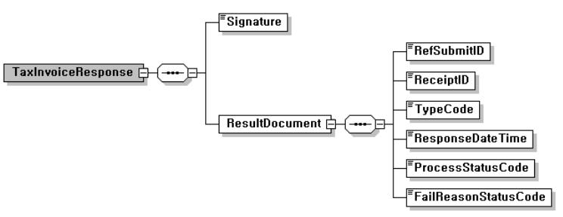
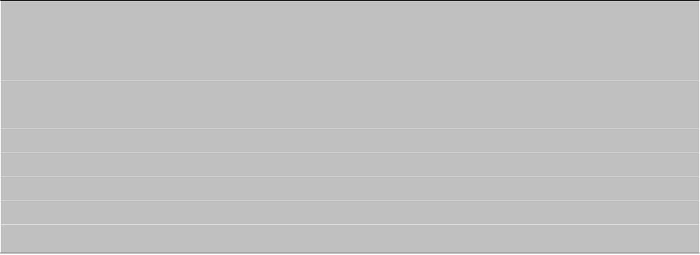
KECT200950000001
[그림 4-5] 처리 불가인 경우 처리결과 스키마
- 처리 불가인 경우 처리결과 문서의 실제 예시는 아래와 같다.
<TaxInvoiceResponse>
<ResultDocument>
<RefSubmitID>12345678-20090325-be3cfa2c0b1e4e4697e8d41f3f0674cb</RefSubmitID>
<ReceiptID>NTS-20090318094120-12345</ReceiptID>
<TypeCode>02</TypeCode>
<ResponseDateTime>20090318094120</ResponseDateTime>
<ProcessStatusCode>03</ProcessStatusCode>
<FailReasonStatusCode>SYN001</FailReasonStatusCode>
</ResultDocument>
</TaxInvoiceResponse>
- 39 -

Slide 45
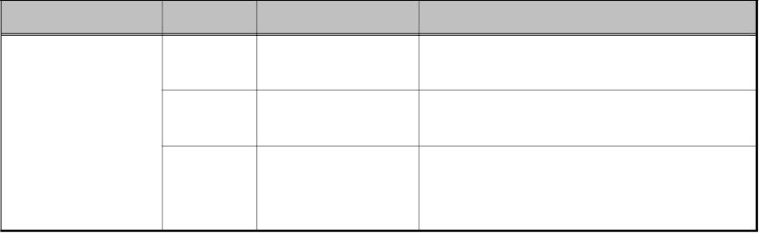
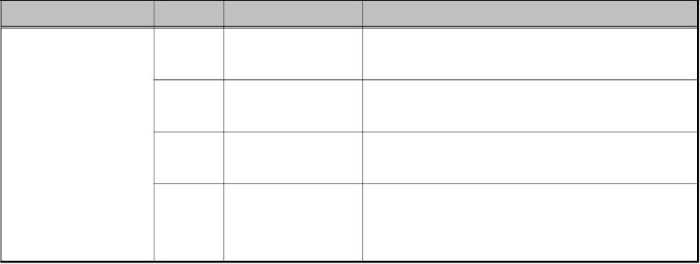
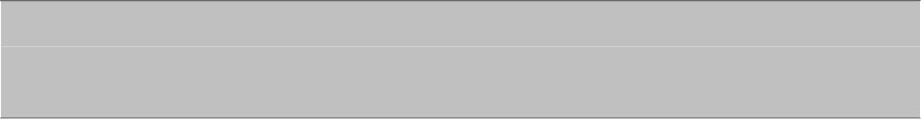
KECT200950000001
4.3. 국세청 응답문서 코드표
4.3.1. 처리상태 코드
국세청이 먼저 사업자에 처리결과를 전달할 때는 수신한 전자(세금)계산서가 모두 처리된
후이므로 이 값은 항상 처리완료를 의미하는 '01'값을 갖는다. 반면에 사업자가 처리결과를
요청하는 경우에는 해당 전자(세금)계산서의 처리 상태에 따라 [표 4-2]와 같은 코드 값을
갖는다.
[표 4-2] 처리상태 코드표
식별 코드 항목 명 코드 값
01
코드 값 정의
처리 완료
설명
사업자가 제출한 전자(세금)계산서에 대한
모든 검증 작업이 끝난 경우
02
처리 중
사업자가 제출한 전자(세금)계산서에 대한
검증 작업이 진행 중인 경우
ProcessStatus. Code
사업자가 제출한 전자(세금)계산서가
복호화 오류, 건수 오류 그리고 연계기관
인증 오류 등의 사유로 처리가 불가능한 경우
03
처리 불가
4.3.2. 전송메시지 처리실패 원인 코드
국세청에서 전송메시지를 처리하는 과정에서 인증 받지 않은 연계 사업자가 메시지를
전송 하거나 첨부된 전자(세금)계산서에 대한 복호화를 수행할 수 없는 경우 등 개별 전자
(세금)계산서에 대한 검증 작업을 수행할 수 없는 경우 처리결과 문서의 처리실패 원인 항목에
[표 4-3]과 같은 코드 값을 기록한다.
[표 4-3] 전송메시지 처리실패 원인 코드표
식별 코드 항목 명 코드 값 코드 값 정의
설명
SYS001
연계 사업자 인증 국세청이 승인하지 않은 사업자가 전자(세금)계산서를
오류
제출하는 경우, 동기식으로 처리불가사유가 바로 전달됨
사업자가 동일한 SubmitID로 전자(세금)계산서를
제출하는 경우, 동기식으로 처리불가사유가 바로 전달됨
FailReasonStatus.
Code
SYS002 중복된 SubmitID
SYS003
SYN001
존재하지 않는 사업자가 존재하지 않는 SubmitID로 결과전송 요청을
SubmitID
하는 경우, 동기식으로 처리 불가 사유가 바로 전달됨
사업자가 제출한 암호화된 전자(세금)계산서에
대한 복호화를 실패한 경우, 비동기식으로 처리
불가 사유가 전달됨
복호화 실패
<유의 사항>
“처리불가원인코드(FailReasonStatus. Code)”의 코드 값이 “SYS001(연계기관 인증 오류)”인 경우는
동기식으로 바로 오류가 통보되며, “SYN001(복호화실패)”인 경우는 비동기식으로 오류가 통보된다.
- 40 -

Slide 46

KECT200950000001
4.3.3. 처리결과 코드
국세청에서는 사업자가 제출한 전자(세금)계산서를 처리한 후, 그 결과를 처리결과문서의
처리결과 항목에 처리결과 코드 속성 값으로 [표 4-4]와 같은 코드 값을 기록한다.
[표 4-4] 처리결과 코드표
식별 코드
코드 값
코드 값 정의
설 명
SUC001 성공
모든 검증 과정을 통과한 경우
SYN002
공급사업자,
공급사업자 전자서명 또는 위수탁(세금)계산서의
경우 수탁자 전자서명이 유효하지 않은 경우
수탁자 전자서명 오류
승인번호가 국세청에 정상적인 (세금)계산서로
기 등록되어 있는 경우
SYN003 승인번호 중복 오류
1. 유효하지 않은 전자(세금)계산서 구조(엘리먼트
중복, 필수 엘리먼트 미존재, 코드오류, 데이터
유형 오류, 승인번호 형식 오류 등)을 가진 경우
2. 계산서의 종류 코드가 영세율일 경우
SYN004 전자(세금)계산서 스키마 오류
ERR001 공급사업자사업자번호 오류
ERR002 공급받는자사업자번호 오류
국세청 미등록 사업자
국세청 미등록 사업자 또는 미등록 주민등록
번호인 경우
ERR003 수탁사업자등록번호 오류
ERR005 발급일시 오류
수탁사업자 존재 시 국세청 미등록사업자
1. 발급일시가 유효하지 않은 경우
2. 발급일시가 전송일시 이후인 경우
ERR006 작성일자 오류
1. 작성일자가 유효하지 않은 경우
2. 작성일자가 발급일시 이후인 경우
4. 승인번호 내의 작성일자와 작성일자가 다른 경우
ResultStatus.
Code
1. 공급가액과 세액의 부호가 다른 경우
2. 수정(세금)계산서의 환입 또는 계약의 해제 시
금액이 정(+)의 값인 경우
3. 영세율(위수탁)세금계산서일 때 세액이 “0”이
ERR007 공급가액, 세액 오류
아닌 경우
4. 계산서일 때 세액이 “0”이 아닌 경우
5. 세액 합계액이 공급가액 합계액의 10%가
아닌 경우
(단, 단수조정으로 공급가액의 합계액과
세액의 합계액을 각각 (+),(-)10원 이내의
금액은 허용)
ERR008 코드 유형 오류
(세금)계산서 종류, 공급받는자 사업자등록번호
구분 코드, 수정세금계산서일 때 수정 코드에
오류가 있는 경우
ERR009 폐업사업자 발급 오류
공급사업자가 폐업신고일자 이후 계산서를
발급한 경우
ERR010 국세청 등록번호 오류
ERR999 정의되지 않은 기타오류
발급시스템 승인번호의 국세청등록번호와 전송
시스템의 국세청등록번호가 다른 경우
수정계산서의 사유가 내국신용장 사후개설인 경우
ERR011 당초승인번호 오류
1. 수정세금계산서에 입력된 당초승인번호가 존재하지
않거나, 공급자의 당초승인번호가 아닌 경우
2. 일반세금계산서일 때 당초승인번호가 입력된 경우
- 41 -

Slide 47
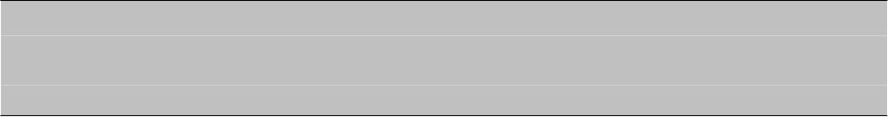
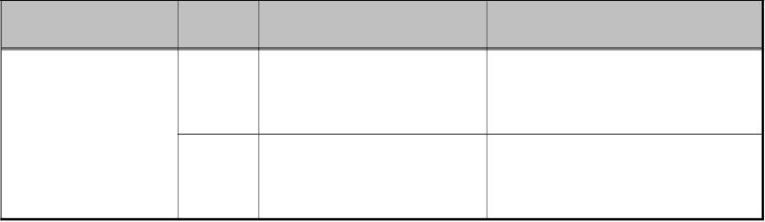
KECT200950000001
<유의 사항>
“처리결과코드(ResultStatus. Code)”의 코드 값이 “ERR010(국세청 등록번호 오류)”인 경우는 전자(세금)
계산서를 교부시스템(ERP) 또는 교부를 대행한 시스템(ASP)과 국세청에 전송한 시스템이 불일치 한
경우 발생하며, 비동기식으로 오류가 통보된다.
4.3.4. 응답문서 코드
국세청이 보내는 응답문서는 크게 접수증과 처리결과문서로 나뉜다. 각 문서 별 코드 값은
[표 4-5]와 같다.
[표 4-5] 응답문서 코드표
식별 코드 항목 명 코드 값
코드 값 정의
접수증
설명
01
사업자가 전송한 메시지를 정상적으로
수신했음을 알리는 접수증 코드 값
Type. Code
사업자가 전송한 전자(세금)계산서에
대한 처리 결과를 알리는 처리결과
문서 코드 값
02
처리결과 문서
- 42 -

Slide 48
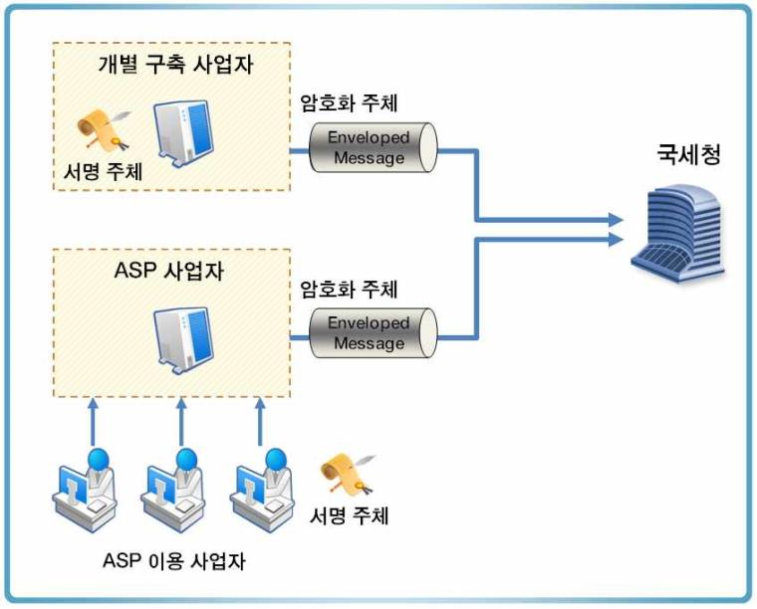
KECT200950000001
5. 문서 보안
5.1. 개요
사업자가 국세청에 전자(세금)계산서를 전송하기 위한 프로세스 중 문서 보안을 위해 다음과
같은 문서보안 과정을 필요로 한다.
첫째, 전자(세금)계산서를 발급한 발급자의 전자서명이 필요하며, 둘째, 온라인 데이터에
대한 보안을 위한 암호화 과정을 필요로 한다.
본 절에서는 이를 위한 절차와 메시지 규격 그리고 표준의 이용방법 등을 제시하고 이를
구현하기 위한 지침을 제시한다.
5.1.1. 수행 주체
전자서명의 목적은 전자(세금)계산서에 대한 공급사업자 본인확인, 무결성 확보 및 부인
방지 이며 따라서 전자서명의 주체는 전자(세금)계산서를 발급하는 공급사업자(또는 위수탁
(세금)계산서의 경우 “수탁사업자”) 이다.
암호화의 목적은 전송사업자와 국세청 간의 온라인 전송 시 안전한 데이터의 전달이므로
암호화의 주체는 실제 국세청과 연계되는 전송사업자이다.
[그림 5-1] 전자서명 및 암호화 수행 주체
- 43 -

Slide 49

KECT200950000001
5.1.2. 주요 표준
전자(세금)계산서를 생성하기 위해 [표 5-1]과 같은 표준을 이용한다.
[표 5-1] 전자(세금)계산서 보안 적용 표준 목록
용도
표준
사용 목적
W3C “XML Signature Syntax and Processing" (RFC3275)
XML 전자서명
국제표준
TTAS.IF-RFC3075 ”확장성 생성 언어 전자서명 구문과
처리 (XML-Signature Syntax and Processing)“
(한국정보통신기술협회, 2004년)
XML 전자서명
국내표준
전자서명
TTAS.IF-RFC3076(제정일: 2004년 12월 23일, [정규화
XML 버전 1.0(Canonical XML version 1.0]")
전자서명 전 XML
문서에 대한 정규화
수행
전자(세금)계산서
KCAC.TS.SIVID “식별번호를 이용한 본인확인 기술규격” 발급자와
(Subscriber Identification Based on Virtual ID) v1.11 전자서명인증서간의
일치성 확인
IETF RFC 3852 CMS (Cryptographic Message Syntax) 암호문 구성
암호화
IETF RFC 3370 Cryptographic Message Syntax (CMS) 암호문 구성 시
Algorithm
알고리듬 정의
IETF RFC 4010 Use of the SEED Encryption Algorithm 암호문 구성 시 SEED
in Cryptographic Message Syntax (CMS) 알고리듬 정의
5.1.3. 본인 확인 방법
전자(세금)계산서의 법적 효력 발생을 위해 전자서명을 수행한다. 그러나 전자(세금)계산서에
있어서 단지 검증이 된다고 이를 유효한 문서라고 볼 수 없다. 즉, 전자서명 검증 후 전자
(세금)계산서의 공급사업자와 전자서명문 생성자가 일치하는 지를 확인하여야 하는 과정이
필요하며 이는 vID 검증 방법을 통해 수행하게 된다.
§ vID 검증을 통한 본인 확인
전자(세금)계산서의 공급사업자와 전자서명 인증서의 소유자가 일치하는 지를 확인하기
위하여 vID 검증을 수행하여야 한다. 단, 행정전자서명용 인증서는 이를 검증할 수 있는 방법이
현재 없으므로 본인 확인 절차를 수행하지 않는다.
검증 절차는 한국인터넷진흥원 규격인 “식별번호를 이용한 본인확인 기술규격
(Subscriber Identification Based on virtual ID) v1.11”을 따른다.
- 44 -

Slide 50

KECT200950000001
상기 규격에 따라 전자(세금)계산서에 대해 전자서명 수행 후 수신자 측에서 이를 검증하기
위해 필요한 난수 정보(해당 규격 상의 “R 정보”)는 암호화하여 전달하여야 하므로 아래
“5.3.2 암호화 대상 데이터”에 포함하여 암호화하여 전달하도록 한다.
[표 5-2]는 본인확인 기술규격에 제시된 본인확인 방법이다.
[표 5-2] 본인 확인 방법
위 방법을 통해 R 정보가 안전한 방법으로 전송되면 전자(세금)계산서에 포함된 IDN
(사업자번호 또는 주민등록번호)을 추출하여 vID'를 생성한 후 인증서에 포함된 vID 값과
비교하여 동일 여부를 확인하는 절차를 거친다. 공인인증서는 전자(세금)계산서의 XML
Digital Signature 형식에 포함된 인증서를 이용하게 된다.
5.1.4. 전자(세금)계산서 서명 및 암호화 업무 흐름
[그림 5-2]는 전자(세금)계산서에 대한 전자서명 수행 및 암호화에 대한 전체적인 절차를
나타내었다. 실제 상세한 내용은 이후 지침에서 상세하게 설명한다.
전체적인 흐름은 크게 두 가지로 나누어진다.
첫 번째는 전자서명 수행 과정이다. 전자문서에 대한 정규화 및 전자서명 대상 정보 추출로
부터 최종 생성된 Signature를 XML에 삽입하는 과정에 대한 순서이다.
두 번째는 암호화 과정으로 생성된 전자(세금)계산서에 대해 100개 내의 데이터로 패키징을
수행하고 암호화하는 과정에서 최종 전송용 암호문인 EnvelopedData의 생성까지의 순서
이다.
- 45 -

Slide 51

KECT200950000001
[그림 5-2] 전자서명 및 암호화 프로세스
- 46 -

Slide 52

KECT200950000001
5.2. 전자서명
5.2.1. 개요
전자(세금)계산서의 법적 효력 발생을 위해 전자서명을 수행한다. 전자서명의 방법은
W3C에서 권고하는 “XML Signature Syntax and Processing" 규약을 준수하고, detached
signature 형식으로 생성 하여야 하며 관련된 국내 표준을 따라야 한다. 또한 처리에 있어
모호한 상황을 줄이고 처리 방법을 명확히 규정하기 위해 이용할 수 있는 알고리듬, 처리
방법의 선택 등은 본 지침에서 정한 것만을 이용할 수 있다.
사업자 및 국세청은 전자서명 시 법적 효력을 위해 공인인증기관에서 발급한 전자서명용
인증서(NPKI)만을 이용하여야 한다.
§ XML Signature의 구성
다음 그림은 XML Signature의 스키마 구조이다. SignedInfo는 전자서명의 대상이 되는
정보를 가져오기 위한 각종 알고리듬과 대상 데이터를 해시(Digest)한 값이 들어가며
SignatureValue는 실제 전자서명한 값이 들어가고 서명자의 인증서는 KeyInfo의
X509Data에 들어간다.
[그림 5-3] XML Signature의 구성
- 47 -

Slide 53
KECT200950000001
5.2.2. XML 정규화
XML 전자서명은 반드시 정규화 과정을 거친 후 수행해야 한다.
전자서명의 대상이 되는 전자(세금)계산서는 XML 구조를 가지고 있으며, 이러한 XML
문서는 다음과 같은 이유로 정규화 과정이 필요하다.
§ 논리적으로 동일한 문서에 대해 물리적으로 여러 가지 표현이 가능
§ 논리적으로 동일한 XML 문서에 대한 해시 값이 항상 같음을 보장할 수 없음
§ 논리적으로 동일한 XML 문서가 하나의 물리적인 데이터로 변환하는 정규화 필요
정규화의 방법은 정보통신단체표준인 TTAS.IF-RFC3076(제정일: 2004년 12월 23일,
[정규화 XML 버전 1.0(Canonical XML version 1.0]")을 이용하도록 한다.
정규화의 방법을 요약하면 다음과 같다.
§ 문서는 UTF-8로 인코딩 된다.
§ 행 종료는 구문분석 (parsing) 전에 입력 시 #xA로 정규화 된다.
§ 속성 값들은 검증 처리기 (validating processor)에서와 같이 정규화 된다.
§ 문자 참조 (character references)와 파싱된 개체 참조 (parsed entity references)는
대치된다.
§ CDATA 구역은 문자 콘텐트로 대치된다.
§ XML 선언과 DTD (document type declaration)는 제거된다.
§ 비어 있는 요소는 시작/종료 태그 쌍으로 변환된다.
§ 문서 요소 (document element)밖의 공백 문자 (whitespace)와 시작 태그와 종료 태
그 사이의 공백 문자는 정규화된다.
§ 문자 콘텐트 안의 모든 공백 문자는 보존된다(행 종료 정규화 (line feed
normalization) 동안에 제거되는 문자들은 제외함).
§ 속성 값 구분자는 인용 부호("; double quote)로 설정된다.
§ 속성 값과 문자 콘텐트의 특수 문자들은 문자 참조로 대치된다.
§ 잉여 (superfluous) 이름 공간 선언은 각 요소에서 제거된다.
§ 기본 (default) 속성들이 각 요소에 추가된다.
§ 각 요소의 이름 공간 선언과 속성들을 사전 순서로 정렬한다.
5.2.3. 알고리듬
전자(세금)계산서에 이용되는 주요 알고리듬은 다음과 같다. 알고리듬은 W3C
“XML-Signature Syntax and Processing“ (RFC3275)의 알고리듬 부분(6.0 Algorithms)을
기본적으로 따른다. 또한 국내 고유 알고리듬을 지원하기 위해 TTAS.IF-RFC3075 ”확장성
생성 언어 전자서명 구문과 처리 (XML-Signature Syntax and Processing)“ (한국정보통신
기술협회, 2004년)에서 정의된 알고리듬을 이용한다.
- 48 -

Slide 54

KECT200950000001
다음은 전자(세금)계산서에서 이용하는 알고리듬 목록이다. 이 외의 알고리듬은 제한함으로써
전자(세금)계산서 생성 및 검증 시의 모호성을 없애도록 한다.
§ 전자서명 NameSpace
<... xmlns:ds="http://www.w3.org/2000/09/xmldsig#" ... >
§ 해시 (Digest)
데이터를 축약하는 데 이용되는 해시 알고리듬은 기존 공인인증서를 사용하는 경우에는
SHA1 알고리듬을, 신규 공인인증서를 사용하는 경우에는 SHA256을 반드시 이용해야 한다.
<ds:DigestMethod Algorithm="http://www.w3.org/2000/09/xmldsig#sha1"/>
또는 <ds:DigestMethod Algorithm="http://www.w3.org/2001/04/xmlenc#sha256"/>
§ 전자서명(Signature)
전자(세금)계산서에 대해 서명자에 대한 본인확인, 데이터의 무결성 검증 및 부인방지 기능을
위해 전자서명을 수행한다. 사용되는 알고리듬은 기존 공인인증서를 사용하는 경우에는
RSAwithSHA1 알고리듬을, 신규 공인인증서를 사용하는 경우에는 RSAwithSHA256을 반드시
이용해야 한다.
<ds:SignatureMethod Algorithm="http://www.w3.org/2000/09/xmldsig#rsa-sha1"/>
또는 <ds:SignatureMethod Algorithm="http://www.w3.org/2001/04/xmldsig-more#rsa-sha256"/>
<유의 사항>
2011년 12월 까지 갱신 및 발급되는 기존 공인인증서는 SHA1으로 전자서명 된 형태의
공인인증서이고, 2012년 1월 이후 갱신 및 발급되는 신규 공인인증서는 SHA256으로 전자
서명 된 형태의 공인인증서이기 때문에, 2012년 1년 간 두 종류의 공인인증서가 혼용되는
것에 주의하여야 하며, 2013년 이후는 신규 공인인증서만 이용 할 수 있으므로 2013년
이후에는 SHA256 해시 알고리듬과, RSAwithSHA256 전자서명 알고리듬만을 이용하여야
한다.
§ 정규화(Canonicalization)
논리적으로 동일한 문서에 대해 물리적으로 여러 가지 표현이 가능 방식한 XML의 특성
으로 인해 같은 문서에 대해 전자서명 값이 다르게 나올 수 있다. 이러한 현상을 방지하기
위해 반드시 정규화 과정을 거쳐야 한다. 정규화는 주석없는 정규 XML(Canonical XML,
omits comments)을 사용하도록 한다. 정규화는 반드시 국내규격인 TTAS.IF-RFC3076을
준수하여야 한다.
<ds:CanonicalizationMethod Algorithm="http://www.w3.org/TR/2001/REC-xml-c14n-20010315"/>
- 49 -

Slide 55



KECT200950000001
§ 변환(Transform)
전체 XML 데이터 중에서 실제 서명 대상이 되는 데이터를 가공하고 선택하는 과정을 거치는
알고리듬으로 다양한 변환 알고리듬이 존재하나 그 중에서 2가지만을 이용하도록 한다.
첫째는 상기 설명한 정규화(Canonicalization)와 서명 대상 정보를 선택하는 XPath 필터링
(XPath Filtering)이다. 또한 전자(세금)계산서는 detached signature를 이용하므로
Enveloped Signature(http://www.w3.org/2000/09/xmldsig#enveloped-signature) 알고리듬은
사용해서는 안된다.
<ds:Transform Algorithm="http://www.w3.org/TR/2001/REC-xml-c14n-20010315"/> 및
<ds:Transform Algorithm="http://www.w3.org/TR/1999/REC-xpath-19991116">
<ds:XPath>not(self::*[name() = 'TaxInvoice'] | ancestor-or-self::*[name() =
'ExchangedDocument'] | ancestor-or-self::ds:Signature)</ds:XPath>
</ds:Transform>
5.2.4. 전자서명의 대상
§ 전자서명의 대상
전자(세금)계산서에 생성 시 전자서명의 대상이 되는 부분은 기본정보(TaxInvoiceDocument),
계산서 정보(TaxInvoiceTradeSettlement) 및 상품정보(TaxInvoiceTradeLineItem)이며
변환(Transform) 알고리듬 내에 XPath로 정의되어 있어야 한다.
하나의 전자서명 대상에 대해서 다양한 XPath 표현이 존재할 수 있지만 각 전자서명 모듈 간
상호운용성 보장을 위하여 반드시 아래에 나타난 XPath만을 사용해야 한다.
<ds:Transform Algorithm="http://www.w3.org/TR/1999/REC-xpath-19991116">
<ds:XPath>not(self::*[name() = 'TaxInvoice'] | ancestor-or-self::*[name() =
'ExchangedDocument'] | ancestor-or-self::ds:Signature)</ds:XPath>
</ds:Transform>
<유의 사항>
XPath 표현식 중 default namespace를 가지는 XML 문서의 null prefix를 XPath 형식으로
표현하고자 할 때, XPath 규격의 모호성으로 인해 전자서명 모듈 간 해석의 차이가 발생하여
"not(self:::TaxInvoice | ancestor-or-self:::ExchangedDocument | ancestor-or-self::ds:Signature)"
표현식의 경우 일부 전자서명 모듈을 제외한 대다수 전자서명 모듈에서는 처리가 불가능한
것으로 확인되었음. 따라서 전자서명 모듈 간 상호운용성 보장을 위하여 XPath 규격 상 논란의
소지가 없는 "not(self::*[name() = 'TaxInvoice'] | ancestor-or-self::*[name() =
'ExchangedDocument'] | ancestor-or-self::ds:Signature)" 표현식만을 사용해야 함
- 50 -

Slide 56

KECT200950000001
5.2.5. 전자서명 수행 및 검증 정보 추가
최종 전자서명은 <SignedInfo> 노드에 대해 전자서명 알고리듬에 따라 전자서명을 수행한 후
결과값을 <SignatureValue>에 Base64 인코딩하여 저장하도록 한다.
수신자측인 국세청에서 해당 전자서명을 검증하기 위해 전자서명자의 인증서가 필요하며
이에 따라 인증서 정보는 W3C “XML-Signature Syntax and Processing“ (RFC3275)에
정의된 KeyInfo 구조체(”그림5-4, KeyInfo의 구조“ 참조) 중 X509Data 내의 X509Certificate
부분에 넣어주어야 한다.
[그림 5-4] KeyInfo의 구조
X509Data(“그림 5-5, X509Data의 구조” 참조)는 X509Certificate외에 X509
IssuerSerial, X509SubjectName 등이 있으며 이 부분에 해당 값을 넣어주는 것은 상관없다.
또한 [그림 5-5]의 다른 부분, 예를 들어 KeyValue 등에 값을 넣어주는 것은 관계없으나,
국세청에서는 X509Data 내의 X509Certificate 내에 포함된 인증서를 이용하여 데이터를
검증할 것이다.
인증서는 최상위 인증기관 인증서로부터 인증기관 인증서, 실제 사용자(사업자) 인증서까지의
체인 구성을 가지고 있으며 검증을 위해서는 이를 모두 필요로 한다. 하지만 최상위 및 인증
기관 인증서는 국세청에서 관리할 것이므로 실제 X509Certificate에는 서명자 인증서1개만
넣어주면 된다.
- 51 -

Slide 57


KECT200950000001
[그림 5-5] X509Data의 구조
5.2.6. XML 전자서명의 예
[그림 5-6]은 실제 전자서명을 수행한 값의 예이다.
전자서명의 예를 보여 주기 위한 표현이므로 Name Space, 해시 값, 인증서 등은 실제
값과는 다를 수 있다.
전자서명 정보는 Signature 아래 노드에 저장이 된다.
[그림 5-6] XML 전자서명의 예
- 52 -

Slide 58
KECT200950000001
5.2.7. 전자서명의 검증
국세청에서 사업자에게 발급되는 전자서명 또한 위 전자서명의 절차 및 기준과 동일하게
전자서명 된 문서이며 사업자는 이에 대해 필요 시 검증을 수행한다.
또한 전자서명 시 이용된 전자서명 인증서의 검증은 해당 인증서를 발급한 인증체계의
인증서 검증 방법을 따르도록 하며 본 개발 지침에서는 별도로 정의하지 않는다.
- 53 -

Slide 59
KECT200950000001
5.3. 암호화
5.3.1. 개요
국세청에 전송되는 전자(세금)계산서는 반드시 기밀성을 확보하여야 하며 이를 위해
다음과 같은 암호화 과정을 준수해야 한다.
암호문은 국내외에서 각종 표준으로 이용되는 IETF RFC 3852 “CMS(Cryptographic
Message Syntax)”에서 제시하는 ContentInfo 구조체로 표현된 Enveloped-Data
Content Type을 사용한다.
§ RFC 3852 CMS
IETF는 TCP/IP와 같은 인터넷 운영 프로토콜의 표준을 정의하는 주체이다. IETF는
IAB(Internet Architecture Board, 인터넷의 기술적 진화에 대한 Internet Society의 감독
기구)의 감독을 받으며, IETF 구성원들은 Internet Society의 개인 또는 조직의 구성원들로부터
선발된다. IETF에서 제작된 표준들은 RFC의 형태로 나타내어지며 국내외 많은 PKI 기반
솔루션(각종 인증시스템, 타임스탬프, 공인전자문서보관소 규격 등)은 이러한 RFC 표준 문서를
기반으로 만들어진다.
CMS(Cryptographic Message Syntax)는 최초 RSA 사에 작성한 “PKCS#7 v1.5”를 근간
으로 만들어졌으며, 이를 IETF에서 규격화한 RFC 표준으로 작성한 것이 RFC2630이다.
최초 PKCS#7에는 key transfer(암호화에 이용된 대칭키를 RSA를 이용하여 상대방에게
전달) 방식만이 있었으나 RFC2630의 CMS에서는 key agreement(DH 알고리듬을 이용하
여 키를 전달하는 방식) 등이 추가되었다.
후에 알고리듬부분을 별도 분리 및 다양한 키 관리 기법을 적용한 RFC3369가 2002년도에
제정되었으며, RFC3369의 내용 중 문제가 되는 부분이 많이 보고되었고 이를 최종 수정한
버전이 본 지침에서 적용한 RFC 3852이다.
§ 추가 적용 표준
암호문 생성 시 Content Encryption(실제 전송되는 전자(세금)계산서패키지, 지침 5.3.2절 참조) 시
사용되는 알고리듬 및 알고리듬에 해당하는 파라미터 등은 IETF RFC 3370
“Cryptographic Message Syntax(CMS) Algorithm” 및 IETF RFC 4010 “Use of the
SEED Encryption Algorithm in Cryptographic Message Syntax(CMS)”을 따른다.
5.3.2. 암호화 대상 데이터
암호화하는 대상은 전자서명된 전자(세금)계산서인 XML 형태의 데이터이며, 단일 또는 복수의
데이터를 처리할 수 있도록 하며 최소 1개 이상의 전자(세금)계산서를 포함하여야 한다.
전자서명을 생성한 서명자가 전자(세금)계산서 공급사업자 본인인지 확인을 할 수 있어야
하며, 이를 위해 vID 검증 정보(R value)가 전송되어야 한다. vID 검증정보는 개별 전자
(세금)계산서마다 해당 vID 검증정보가 세트로 구성되고 넣을 수 있는 최대 세트의 개수는 100개이다.
- 54 -

Slide 60


KECT200950000001
다음은 대상 데이터의 구성 방법이다. 데이터는 ASN.1 Basic Encoding Rules(BER)을
따르며 Distinguished Encoding Rules(DER)를 준수하도록 한다.
TaxInvoicePackage ::= SEQUENCE {
count InvoiceCount,
taxInvoiceSet TaxInvoiceSet }
InvoiceCount ::= INTEGER
TaxInvoiceSet ::= SET SIZE (1..100) OF TaxInvoiceData
TaxIvnoiceData ::= SEQUENCE {
rvalue SignerRvalue,
taxInvoice TaxInvoice }
TaxInvoice ::= OCTET STRING
SignerRvalue ::= OCTET STRING
§ count에는 TaxInvoice의 개수를 넣어준다.
§ taxInvoice는 개별 전자(세금)계산서의 XML 데이터이다.
§ rvalue는 해당하는 taxInvoice 서명 검증 시 본인 확인을 위한 vID 검증용 값이다. (지침
5.1.3절 참조)
5.3.3. EnvelopedData의 구성
다음은 RFC 3852의 EnvelopedData의 구성이다.
EnvelopedData ::= SEQUENCE {
version CMSversion,
originatorInfo [0] IMPLICIT OriginatorInfo OPTIONAL,
recipientInfos RecipientInfos,
encryptedContentInfo EncryptedContentInfo,
unprotectedAttrs [1] IMPLICIT UnprotectedAttributes OPTIONAL }
§ version은 RFC 3852의 syntax version number 구성을 따른다.
§ originatorInfo는 key management 알고리듬을 이용하지 않고 CRL을 전송할 필요가
없으므로 사용하지 않는다. (RFC 3852에 정의되어 있음)
§ 현재 이용할 수 있는 암호용 인증서의 알고리듬이 RSA이므로 RecipientInfos의
KeyTransRecipientInfo를 통해 수신자가 복호화할 수 있는 키(content-encryption
key)를 전달한다.
§ encryptedContentInfo에는 내부에 정의된 Algorithm Identifier의 알고리듬을 기반으로
암호화한 TaxInvoicePackage를 넣어준다.
§ unprotectedAttrs는 이 버전에서는 별도로 이용하지 않으므로 송신자측에서 관리의
목적으로 값을 넣어줄 수 있으나 수신자 측에서는 이를 풀어보거나 값을 이용할 필요는
없다.
- 55 -

Slide 61



KECT200950000001
5.3.4. EnvelopedData의 생성
다음은 RFC 3852의 EnvelopedData의 생성에 있어 주요 부분에 대한 설명이다.
§ encryptedContentInfo의 생성
EncryptedContentInfo ::= SEQUENCE {
contentType ContentType,
contentEncryptionAlgorithm ContentEncryptionAlgorithmIdentifier,
encryptedContent [0] IMPLICIT EncryptedContent OPTIONAL }
- ContentType은 id-data(암호화된 데이터가 어떤 정보인지를 알려주는 구분자
-OID- 정보임)를 넣는다.
- contentEncryptionAlgorithm은 지침 5.3.6절에 정의된 알고리듬 중 실제 암호화에
이용된 대칭키 알고리듬 정보를 넣는다.
- encryptedContent의 입력은 위 정의된 TaxInvoicePackage의 DER 인코딩된 값을
contentEncryptionAlgorithm에 정의된 알고리듬 방식으로 암호화한 OCTET
STRING(Binary 값)이다.
§ recepientInfo의 생성
RecipientInfos ::= SET SIZE (1..MAX) OF RecipientInfo
RecipientInfo ::= CHOICE {
ktri KeyTransRecipientInfo,
kari [1] KeyAgreeRecipientInfo,
kekri [2] KEKRecipientInfo,
pwri [3] PasswordRecipientInfo,
ori [4] OtherRecipientInfo }
- 수신 대상이 하나이므로 실제 RecipientInfos는 하위에 RecipientInfo를 하나만 가진다.
- 암호용 인증서가 RSA를 이용하므로 ktri(상대방 RSA 공개키 등을 이용하여 데이터를
암호화한 대칭키를 보내는 방식)만을 이용하여 구성하도록 한다.
5.3.5. 메시지에 대한 OID 정의
메시지 구성을 위한 Object Identifier는 다음과 같다.
§ EnvelopedData Type
RFC3852 CMS에서 실제 데이터를 전달하는 포맷은 ContentInfo라는 구조체이며 내부에
있는 데이터가 어떤 데이터인지를 확인할 수 있도록 ContentType에 넣어주는 정보이다.
- id-envelopedData
- OBJECT IDENTIFIER ::= { iso(1) member-body(2) us(840) rsadsi(113549) pkcs(1)
pkcs7(7) 3 }
- 56 -

Slide 62


KECT200950000001
§ EncryptedContentInfo의 ContentType
암호화된 데이터를 넣는 구조체인 EncryptedContentInfo 구조체에서 내부에 있는 데이터가
어떤 데이터인지를 확인할 수 있도록 ContentType에 넣어주는 정보이다.
- id-data
- OBJECT IDENTIFIER ::= { iso(1) member-body(2) us(840) rsadsi(113549) pkcs(1)
pkcs7(7) 1 }
5.3.6. 암호화 알고리듬
암호화에서 이용되는 알고리듬은 크게 두 가지로 구분된다. 대상 데이터를 직접 암호화하는데
이용하는 대칭키 알고리듬과 대칭키를 수신자만 복호화할 수 있게 전달하는 공개키 알고리듬
이다. 공개키 알고리듬은 이용되는 인증서는 NPKI 체계의 암호용 인증서이므로 RSA 기반
알고리듬을 이용하게 되며, 대칭키 알고리듬에 대해서는 반드시 아래에 속한 대칭키 암호
알고리듬 세 가지(SEED, ARIA, 3DES) 중 하나를 택해서 사용해야 한다.
송신자측은 대칭키 암호알고리듬 세 가지 중 한 가지만 지원해도 관계 없으나, 수신자측은
세 가지 알고리듬에 대해 모두 지원이 가능하여야 한다.
§ 비대칭키 알고리듬
비대칭키 알고리듬(RSA)은 랜덤하게 생성되어 데이터를 암호화한 대칭키 정보를 상대방
에게 안전하게 암호화하여 전달하는 데 이용된다.
RSA Encryption
- rsaEncryption
- OBJECT IDENTIFIER ::= { iso(1) member-body(2) us(840) rsadsi(113549) pkcs(1)
pkcs-1(1) 1 }
§ 대칭키 알고리듬
대칭키 알고리듬(SEED, ARIA, 3DES)은 랜덤하게 생성되어 실제 전달 데이터를 암호화
하는데 이용된다.
- 57 -

Slide 63

KECT200950000001
Triple-DES CBC
- des-ede3-cbc
- OBJECT IDENTIFIER ::=
encryptionAlgorithm(3) 7 }
{
iso(1) member-body(2) us(840) rsadsi(113549)
- Algorithm의 파라미터는 반드시 존재해야하며 parameters는 반드시 CBCParameter를
가지고 있어야 한다.
또는
SEED CBC
- id-seedCBC
- OBJECT IDENTIFIER ::= { iso(1) member-body(2) korea(410) kisa(200004) algorithm(1)
seedCBC(4)
- Algorithm의
SeedCBCParameter를 가지고 있어야 한다.
또는
ARIA CBC
- id-aria128-cbc OBJECT IDENTIFIER ::=
파라미터는
반드시
존재해야하며
parameters는
반드시
{ iso(1) member-body(2) korea(410) gcma(100001) gpki-alg(1)
aria128-cbc(20) }
- id-aria192-cbc OBJECT IDENTIFIER ::=
{ iso(1) member-body(2) korea(410) gcma(100001) gpki-alg(1)
aria192-cbc(21) }
- id-aria256-cbc OBJECT IDENTIFIER ::=
{ iso(1) member-body(2) korea(410) gcma(100001) gpki-alg(1)
aria256-cbc(22) }
Algorithm의 파라미터는 반드시 존재하여야 하며 parameters는 반드시
ARIACBCParameter를 가지고 있어야 한다.
ARIACBCParameter::= ARIAIV -- Initialization Vector
ARIAIV ::= OCTET STRING(SIZE(16))
5.3.7. 국세청 인증서의 획득과 검증
§ 국세청 인증서의 획득
암호문 생성을 위해서는 실제 데이터를 복호화하려는 수신자측의 인증서를 획득하여야만
가능하다. 인증서의 획득은 웹에 게시된 인증서를 이용하거나 LDAP 서버 등 인증서가 게시된
곳에서 가져오거나 또는 프로토콜 상에서 상대방 인증서를 획득할 수 있는 방법이 있다.
사업자는 위의 다양한 방법 중 향후 국세청에서 지정한 방법을 통해 인증서를 획득하여야
한다.
§ 국세청 인증서의 검증
정보 보호를 위해 상대방의 인증서가 유효한지 상태 확인을 수행하여야 한다.
상태 확인 시기는 최초 시점 및 CRL 등 인증서 유효를 확인하는 정보의 유효기간 만료
시각 후 최초 이용 시점이다.
- 58 -

Slide 64

KECT200950000001
5.3.8. EnvelopedData의 구성
[그림 5-7]은 실제 국세청에 전달해야 할 암호화된 (세금)계산서의 구성이다. [그림5-7]을
통해 실제 값들의 연계 관계에 대해 보다 정확하게 파악할 수 있을 것이다.
[그림 5-7] EnvelopedData의 구성
§ ContentInfo
ContentInfo는 RFC 3852에 표현된 것으로 RFC 3852의 구성 데이터인 SignedData,
EnvelopedData, EncryptedData 등을 넣어주는 일종의 컨테이너이다. 구조체의
contentType은 content가 어떤 정보인지를 가리킨다. 본 지침에서는 id-envelopedData
라는 구분자(Object Identifier)를 넣어주어야 한다.
§ EnvelopedData
암호화 정보를 전달하기 위한 구조체(본 절의 설명 참조)
- 59 -

Slide 65
KECT200950000001
§ EncryptedContentInfo
암호화된 정보를 보관하는 구조체이다. 구조체의 contentType은 encryptedContent가
어떤 정보인지를 가리킨다. 본 지침에서는 id-data 라는 구분자(Object Identifier)를 넣어
주어야 한다. contentEncryptionAlgorithm은 SEED, ARIA, 3DES 중의 하나에 대한 구분자
(OID)를 넣어주어야 하며 encryptedContent에 랜덤하게 생성된 비밀키를 이용하여 해당
알고리듬으로 암호화한 데이터를 OCTET STRING(바이너리 데이터)으로 넣어준다.
§ TaxInvoicePackage
실제 국세청에 암호화하여 전달할 전자(세금)계산서 리스트이다. 포함되는 값은 전체 개수와
전자(세금)계산서 및 해당 전자(세금)계산서에 대한 본인 확인을 위한 정보들의 SET로 구성
된다.
§ RecipientInfo
어떤 방법을 이용하여 수신자가 복호화할 지를 선택하는 구조체이다. 본 지침에서는
KeyTransRecipientInfo를 이용해야 한다.
§ KeyTransRecipientInfo
수신자(국세청)이 복호화할 수 있도록 위에서 서술한 encryptedContent를 암호화한 랜덤한
비밀키를 수신자의 공개키를 이용하여 암호화하여 전달하는 데 이용하는 구조체이다. 암호화한
비밀키는 encryptedKey에 넣어 주며, 누구의 공개키를 이용하였는지에 대한 정보인
RecipientIdentifier
및
비밀키를
암호화하는데
이용한
알고리듬
정보인
KeyEncryptionAlgorithmIdentifier 등을 포함한다.
- 60 -

Slide 66
KECT200950000001
6. 전자(세금)계산서 통신
6.1. 개요
사업자가 국세청에 전자(세금)계산서를 온라인으로 전송하기 위해서는 전송 및 응답을
위한 기본 통신규약이 필요하다. 본 절에서는 이를 위한 (세금)계산서 통신프로토콜, 메시지
교환 패턴(MEP: Message Exchange Pattern), 메시지 구조 및 전송보안에 대해서 표준을
제시하고 이를 구현하기 위한 지침을 제시한다.
6.1.1. 통신규약 표준의 범위
사업자가 국세청에 전자(세금)계산서를 전송하고, 전송결과에 대한 응답을 받기 위해서는
전달하고자 하는 문서를 싸고 있는 메시지 봉투, 전송프로세스 및 전송처리 방식에 대해서
통신 표준을 제시하여야 한다. 본 지침에서는 이러한 통신표준으로는 기본적으로 다음과
같은 국제 e-비즈니스 표준규약을 기본으로 한다.
§ SOAP v1.1 또는 v1.2
§ SOAP Messages with Attachment
§ WS-Security v1.1
§ WS-Addressing v1.0
본 지침에서는 이러한 규약을 기반으로 국세청과 연계를 위한 상세 통신 프로세스 및 전송
메시지 구조, 전송보안 등의 방안 등을 제시한다.
- 61 -

Slide 67

KECT200950000001
6.2. 통신 프로세스 및 메시지 구조
6.2.1. 통신 프로세스 개요
국세청에 전자(세금)계산서를 전송하기 위해서 가장 중심이 되는 프로세스는 (세금)계산서
전송과 이에 대한 처리 결과를 수신하는 것이다. 이를 위해 사업자들은 메시지 통신 프로토콜로
SOAP v1.1 또는 SOAP v1.2를 채택하여 국세청과 연계하여야 하며, 세부적인 메시지
교환은 1) 사업자가 국세청에 전자(세금)계산서를 전송하는 단계, 2) 사업자가 국세청으로
부터 처리결과를 수신하는 단계로 처리되는 것이 일반적이다. 만약 사업자가 처리결과를
국세청으로부터 직접 수신할 수 없는 경우나 처리결과 수신에 실패한 경우에는 선택적 방안
으로 3) 사업자가 국세청에 처리결과를 보내줄 것을 요청하고 처리결과문서를 수신하는
단계를 추가할 수 있다.
각 단계는 SOAP Request-Response 메시지교환양식(MEP: Message Exchange Pattern)에
따라 동기식 요청과 응답메시지로 구성되며, 각 단계들 간에는 비동기식으로 처리가 이루어진다.
전송 프로세스에 대한 전체 흐름은 “[그림 2-7] 전자(세금)계산서 전송 프로세스”을 참조한다.
6.2.2. 전자(세금)계산서 송/수신 처리 절차
1) 전송 처리 절차
사업자가 전자(세금)계산서를 국세청에 전송하기 위한 상세절차는 [그림 6-1]과 같다.
[그림 6-1] 전자(세금)계산서 전송절차
- 62 -

Slide 68

KECT200950000001
2) 처리결과 메시지 수신 절차
사업자가 국세청으로부터 전자(세금)계산서 처리 후 처리결과를 수신하기 위한 상세절차는
[그림 6-2]와 같다.
[그림 6-2] 처리결과 수신절차
6.2.3. 메시지 기본구조
국세청과 사업자간의 연계를 위한 요청 및 응답 메시지는 SOAP v1.1 또는 v1.2 규약을
준수해야 한다. 사업자 측에서 보내는 전송메시지가 SOAP v1.1인 경우에는 국세청이 보내는
응답메시지도 v1.1로 생성되고, 전송메시지가 SOAP v1.2인 경우에는 응답메시지도 v1.2로
생성되어 전달된다. SOAP메시지의 상세한 구조 및 항목은 w3.org에서 제시하는 표준규약을
참조하면 되는데, SOAP v1.1은 “http://www.w3.org/TR/2000/NOTE-SOAP-20000508/”
에서 SOAP v1.2는 “http://www.w3.org/TR/soap12”를 통해 확인할 수 있다.
요청 및 응답 메시지는 "SOAP Messages with Attachments"(http://www.w3.org/TR/SOAP-attachments)
규약에 따라 기본적으로 Multipart-MIME 형식으로 구성된다. 첫 번째 MIME Part에는
SOAP Envelope 메시지가 들어가고 두 번째 MIME Part에는 전자(세금)계산서, 접수증
그리고 처리결과와 같은 업무 문서가 들어간다. 두 번째 MIME의 Content-Type은
“application/octet-stream"으로 설정하고 첨부문서는encoding하지 않은 binary형태로
첨부한다. 업무에 따라 첨부문서가 없는 처리결과요청 메시지나 처리결과 수신확인메시지와 같은
경우에는 두 번째 MIME이 없이 메시지가 구성된다.
- 63 -

Slide 69


KECT200950000001
SOAP Envelope 메시지는 전송을 위한 메타 데이터를 담고 있는 SOAP Header와 업무
정보를 담고 있는 SOAP Body로 구성된다.
국세청과 사업자간의 연계 시 일어나는 모든 업무는 본장에서 제시하는 메시지 구조를 통해
정의되며 모든 메시지는 UTF-8 인코딩을 기본으로 한다.
§ 요청 및 응답 메시지 기본 구성
[그림 6-3] 메시지 구조
6.2.3.1. SOAP Envelope
SOAP Envelope은 SOAP 메시지의 Root 항목으로 SOAP 메시지 내의 각종
Namespace 들을 선언한다. 선언해야 할 Namespace는 [표 6-1]과 같다.
[표 6-1] Namespace 항목
항목
Namespace URL
http://schemas.xmlsoap.org/soap/envelope/
http://www.w3.org/2000/09/xmldsig#
http://www.w3.org/2005/08/addressing
SOAP
Digital Signature
WS-addressing
Web Services Security
Web Services Security Utility
XML Schema
http://docs.oasis-open.org/wss/2004/01/oasis-200401-wss-wssecurity
-secext-1.0.xsd
http://docs.oasis-open.org/wss/2004/01/oasis-200401-wss-wssecurity
-utility-1.0.xsd
http://www.w3.org/2001/XMLSchema
http://www.w3.org/2001/XMLSchema-instance
http://www.kec.or.kr/standard/Tax/
XML Schema Instance
KEC
- 64 -

Slide 70


KECT200950000001
SOAP Envelope의 실제 예시는 다음과 같다.
<SOAP:Envelope xmlns:SOAP="http://schemas.xmlsoap.org/soap/envelope/"
xmlns:ds="http://www.w3.org/2000/09/xmldsig#"
xmlns:wsa="http://www.w3.org/2005/08/addressing"
xmlns:wsse="http://docs.oasis-open.org/wss/2004/01/oasis-200401-wss-wssecurity-secext-1.0.xsd"
xmlns:wsu="http://docs.oasis-open.org/wss/2004/01/oasis-200401-wss-wssecurity-utility-1.0.xsd"
xmlns:xsd="http://www.w3.org/2001/XMLSchema"
xmlns:xsi="http://www.w3.org/2001/XMLSchema-instance"
xmlns:kec="http://www.kec.or.kr/standard/Tax/"
xsi:schemaLocation="http://schemas.xmlsoap.org/soap/envelope/
http://www.oasis-open.org/committees/ebxml-msg/schema/envelope.xsd">
</SOAP:Envelope>
6.2.3.2. SOAP Header
SOAP Header는 내부적으로 WS-Addressing, Message Header 그리고 Security 로
구성되는데 세부 구성은 [표 6-2]와 같다. 이때 각 항목들은 반드시 [표 6-2]에 기술된 순서대로
구성되어야 한다.
[표 6-2] SOAP Header 엘리먼트 구조
반복
항목 명
설명
회수
유형 길이
§ 메시지 전송 시 Unique하게 생성되어 메시지를 식별하는 ID값
§ 생성규칙: 생성 년월일시분초(millisecond까지) + '-' + (0, 1, 2,
3, 4, 5, 6, 7, 8, 9, a, b, c, d, e, f) 중 임의로 하나를
MessageID
1..1
S
50
선택한 것을 32번 반복, 즉 16진수 형식으로 32자리 기재
§ 예> YYYYMMDDHHmmssSSS-be3cfa2c0b1e4e4697e8d41f3f0674cb
RelatesTo
§ 요청에 대한 응답 메시지에만 필요한 항목
§ 이전 요청 메시지의 MessageID 값을 설정
§ 메시지 수신자의 주소정보
0..1
1..1
S
S
50
§ 예1> 사업자가 국세청으로 메시지를 보내는 경우 국세청의
메시지 수신 Endpoint를 입력
To
최대 256
§ 예2> 국세청이 사업자로 메시지를 보내는 경우 사업자의
메시지 수신 Endpoint를 입력
§ 필수항목으로서 반드시 기술되어야 함
§ 전송 메시지유형별로 정의된 action값을 기술
§ 기 정의된 action
Action
‐
전자(세금)계산서 전송:
1..1
S
최대 256
‐
http://www.kec.or.kr/standard/Tax/TaxInvoiceSubmit
전자(세금)계산서 수신확인:
http://www.kec.or.kr/standard/Tax/TaxInvoiceRecvAck
- 65 -

Slide 71



KECT200950000001
‐
‐
‐
‐
전자(세금)계산서 처리결과 전송:
http://www.kec.or.kr/standard/Tax/ResultsSubmit
처리결과에 대한 수신확인:
http://www.kec.or.kr/standard/Tax/ResultsRecvAck
처리결과 전송요청:
http://www.kec.or.kr/standard/Tax/ResultsReqSubmit
처리결과 전송요청에 대한 수신확인:
http://www.kec.or.kr/standard/Tax/ResultsReqRecvAck
Message
Header
§ 전송하는 메시지에 대한 추가 정보를 담아서 기술함
§ MessageHeader의 하위 엘리먼트에 대한 상세 구조는 [표
6-3]에서 상세하게 기술
1..1
Security
§ WS-Security 규약에 의해 메시지에 대한 전자서명정보를 기술함
§ 이 항목에 대한 상세정보는 “지침 6.3.2절 전자서명”부분 참조
1..1
SOAP Header의 실제 예시는 다음과 같다.
<SOAP:Header>
<wsa:MessageID>20090316093020111-be3cfa2c0b1e4e4697e8d41f3f0674cb</wsa:MessageID>
<wsa:To>http://nts.go.kr/8080/eTaxService</wsa:To>
<wsa:Action>http://www.kec.or.kr/standard/Tax/TaxInvoiceSubmit</wsa:Action>
<kec:MessageHeader>
~~~~
</kec:MessageHeader>
<Security>
~~~~
</Security>
</SOAP:Header>
6.2.3.3. Message Header
Message Header는 메시지에 대한 추가적인 정보로 구성되어 있다. 상세 구조는 [표 6-3]과 같다.
이때 각 항목들은 반드시 [표 6-3]에 기술된 순서대로 구성되어야 한다.
[표 6-3] Message Header 엘리먼트 구조
항목 명
설명
반복
유형 길이
회수
1..1
1..1
1..1
Version
From
§ 전자(세금)계산서 통신규약 버전
S
3
§ 이번 지침에서는 ‘3.0’으로 설정
§ 메시지 전송 사업자의 정보를 기술
§ 전송하는 측의 사업자등록번호(국세청 또는 사업자)
§ 사업자등록번호의 경우 '-' 제외
PartyID
S
S
10
PartyName § 전송하는 측의 사업자명
1..1
최대 200
- 66 -

Slide 72


KECT200950000001
To
§ 메시지 수신 사업자의 정보를 기술
1..1
PartyID
§ 수신하는 측의 사업자등록번호(국세청 또는 사업자)
§ 사업자등록번호의 경우 '-' 제외
1..1
1..1
S
S
10
PartyName § 수신하는 측의 사업자명
§ 전자(세금)계산서 처리 결과를 비동기식으로
200
ReplyTo
받을 사업자의 메시지 수신 Endpoint
§ 사업자가 전자(세금)계산서를 국세청에 전송할
때는 반드시 이 정보를 기술하여야 함
0..1
S
최대 256
OperationType
MessageType
§ 메시지 송/수신 업무명( 표 6-12 송수신 문서 코드표 참조) 1..1
§ SOAP Request-Response MEP기준으로 봤을 때
요청메시지인지, 응답메시지인지 여부를 기술(표 1..1
N
N
2
2
6-12 송수신 문서 코드표 참조)
§ 메시지 전송시간을 기술
TimeStamp
§ UTC 형식으로 입력
1..1
S
24
§ 예> 2009-02-06T09:30:05.801Z
Message Header의 실제 예시는 다음과 같다.
<kec:MessageHeader wsu:Id="msgHeader">
<kec:Version>3.0</kec:Version>
<kec:From>
<kec:PartyID>1234512345</kec:PartyID>
<kec:PartyName>한국인터넷진흥원</kec:PartyName>
</kec:From>
<kec:To>
<kec:PartyID>5678956789</kec:PartyID>
<kec:PartyName>국세청</kec:PartyName>
</kec:To>
<kec:ReplyTo>http://kiec.or.kr/business/client1</kec:ReplyTo>
<kec:OperationType>01</kec:OperationType>
<kec:MessageType>01</kec:MessageType>
<kec:TimeStamp>2009-02-06T09:32:05.801Z</kec:TimeStamp>
</kec:MessageHeader>
6.2.3.4. SOAP Body
SOAP Body는 요청/응답에 따라 Request/Response 또는 Fault 메시지로 구성된다.
Request/Response 에 대한 상세구조는“지침 6.2.4 절 업무 별 Request, Response data
및 첨부문서 구조” 에서 기술하고 있으며, Fault 구조는 “지침 6.2.3.5 SOAP Fault”에서
기술하고 있다.
- 67 -

Slide 73


KECT200950000001
6.2.3.5. SOAP Fault
국세청이나 사업자는 SOAP 통신 오류가 발생하거나, 수신한 메시지가 SOAP 메시지의
기본구조에 맞지 않거나, WS-Security 규약에 따라 SOAP 메시지에 추가된 전송사업자의
전자서명이 유효하지 않은 경우 SOAP Fault 오류를 생성하여 전송사업자에게 다시 전달한다.
SOAP 오류가 발생한 경우에는 SOAP Fault 메시지는 SOAP Body 안에 포함되어 전송
되며, SOAP Fault 엘리먼트는 SOAP Body 엘리먼트 하위에 한번만 존재한다. SOAP 규약
버전에 따라 다음과 같은 구조를 갖는다.
1) SOAP Fault - v1.1
SOAP 규약 v1.1인 경우에는 [표 6-4]와 같이 구성되어야 한다.
[표 6-4] SOAP Fault 구조-v1.1
항목 명
설명
반복
유형 길이
횟수
Fault
§ SOAP Fault 메시지의 루트
1..1
faultcode
faultstring
§ Fault를 식별하는 코드로서 code 값은 “3) SOAP
Fault Code 및 설명” 부분을 참조
1..1
1..1
S
S
6
§ 이용자가 인지할 수 있도록 Fault를 설명하는 스트링
최대 50
으로 “3) SOAP Fault Code 및 설명” 부분을 참조
2) SOAP Fault - v1.2
SOAP 규약 v1.2인 경우에는 [표 6-5]와 같이 구성되어야 한다.
[표 6-5] SOAP Fault 구조-v1.2
항목 명
설명
§ SOAP Fault 메시지의 루트
§ SOAP Fault 코드 정의
반복
횟수
유형 길이
Fault
1..1
1..1
Code
Value
§ Fault를 식별하는 주코드 SOAP Version 1.2 Part
1..1
1..1
1..1
S
S
S
최대 30
6
1: Messaging Framework (Second Edition) 참조
Subcode
§ Fault를 식별하는 세부 코드. code 값 “3) SOAP
Fault Code 및 설명” 부분을 참조
Reason
§ 이용자가 인지할 수 있도록 Fault를 설명하는 스트링
최대 50
으로 “3) SOAP Fault Code 및 설명” 부분을 참조
- 68 -

Slide 74

KECT200950000001
3) SOAP Fault Code 및 설명
SOAP Fault 메시지는 [표 6-6]과 같은 코드값과 설명을 위한 값을 갖는다.
[표 6-6] SOAP Fault Code 및 설명
faultcode(Value)
WSM001
faultstring(Reason)
설명
§ SOAP Message 통신오류
VersionMismatch
MustUnderstand
§ SOAP 메시지 처리 도중 유효하지 않은 SOAP
Envelope namespace 발견 시
§ SOAP 헤더 중 mustUnderstand 값이 “1”로
설정되었으나 이 항목을 수신측에서 이해하지
못하거나 처리하지 못하는 경우
WSM002
§ SOAP Message 구조 오류
DataEncodingUnknown
§ Soap header나 body내에 받는 쪽 노드가
지원하지 않는 data encoding을 요구하는
엘리먼트가 있는 경우 발생
InvalidSOAPHeader § SOAP Header 구조가 규격에 맞지 않는 경우
InvalidSOAPBody
§ SOAP Body 구조가 규격에 맞지 않는 경우
§ SOAP Message 전자서명 오류
WSM003
InvalidSignature
§ 서명검증에서 검증값이 유효하지 않은 경우
6.2.4. 업무 별 Request, Response data 및 첨부문서 구조
국세청과 사업자간의 연계 업무는 크게 전자(세금)계산서 제출, 처리결과 전송 그리고 처리
결과 요청으로 나눌 수 있고, 각 업무 별로 SOAP Body 및 첨부 문서는 다른 구조를 가진다.
6.2.4.1. 전자(세금)계산서 제출 업무
전자(세금)계산서 제출 업무는 사업자가 국세청에 전자(세금)계산서를 전송하는 업무이다.
본 업무는 사업자가 국세청으로 전자(세금)계산서를 보내는 요청 업무와 국세청이 해당 전자
(세금)계산서 제출에 대한 접수증을 보내는 응답 업무로 구성된다. 이러한 전자(세금)계산서
전송(요청)/접수증 교부(응답) 업무는 동기식 메시지 교환 방식으로 이루어진다.
1) 요청 메시지 구조
가) SOAP Body
사업자가 국세청에 전자(세금)계산서를 제출할 때 SOAP Body는 [표 6-7]과 같이 구성
되어야 한다.
- 69 -

Slide 75



KECT200950000001
[표 6-7] 전자(세금)계산서 제출업무 요청메시지의 SOAP Body 구조
항목 명
설명
반복
회수
유형 길이
RequestMessage
§ 요청 메시지 루트
1..1
§ 제출, 수신확인 및 처리결과 수신을 포함하여
한 번의 제출에 따른 전체 프로세스를
구분하기 위한 ID
§ 제출 단위로 unique한 값 부여
§ 국세청 등록번호 + '-' + 년월일 + '-' + (0, 1,
2, 3, 4, 5, 6, 7, 8, 9, a, b, c, d, e, f) 중
임의로 하나를 선택한 것을 32번 반복, 즉
16진수 형식으로 32자리 기재
SubmitID
1..1
S
50
§ 예>12345678-yyyymmdd-be3cfa2c0b1e4e4697
e8d41f3f0674cb
TotalCount § 첨부 전자(세금)계산서의 총 개수
ReferenceID § 첨부 MIME Header의 Content-ID 값
1..1
1..1
N
S
3
최대 50
실제 예시는 다음과 같다.
<kec:RequestMessage>
<kec:SubmitID>12345678-20090325-be3cfa2c0b1e4e4697e8d41f3f0674cb</kec:SubmitID>
<kec:TotalCount>100</kec:TotalCount>
<kec:ReferenceID>0987654321</kec:ReferenceID>
</kec:RequestMessage>
나) 첨부 문서
전자(세금)계산서 제출 업무에 대한 첨부 문서는 암호화된 전자(세금)계산서 파일이다.
암호화하는 방식 및 방법에 대해서는 “지침 5.3절 암호화”에서 상세하게 기술하고 있다.
2) 응답 메시지 구조
가) SOAP Body
사업자가 국세청에 전자(세금)계산서를 제출하면 국세청은 접수증을 교부하는데 이때 응답
메시지의 SOAP Body는 [표 6-8]과 같이 구성되어야 한다.
[표 6-8] 전자(세금)계산서 제출업무 응답메시지의 SOAP Body 구조
반복
항목 명
설명
회수
유형 길이
ResponseMessage
§ 응답 메시지 루트
1..1
RefSubmitID
§ 사업자가 전자(세금)계산서를 제출했을 때
1..1
S
50
설정한 SubmitID 값
- 70 -

Slide 76



KECT200950000001
실제 예시는 다음과 같다.
<kec:ResponseMessage>
<kec:RefSubmitID>12345678-20090325-be3cfa2c0b1e4e4697e8d41f3f0674cb</kec:RefSubmitID>
</kec:ResponseMessage>
나) 첨부 문서
접수증 교부 메시지에 대한 첨부 문서는 전자서명된 접수증이다. 접수증의 구조는 “지침
4.2.1절 전자(세금)계산서 접수증”에서 상세하게 기술하고 있다.
6.2.4.2. 처리결과 전송업무
처리결과 전송 업무는 국세청이 사업자에 전자(세금)계산서 처리결과를 전송하는 업무이다.
본 업무는 국세청이 사업자에 처리결과 메시지를 보내는 요청 업무와 사업자가 처리결과
수신확인 메시지를 보내는 응답 업무로 구성된다. 이러한 처리결과 전송(요청)/수신확인(응답)
업무는 동기식 메시지 교환 방식으로 이루어진다.
1) 요청 메시지 구조
가) SOAP Body
국세청이 사업자에 처리결과를 전송할 때 SOAP Body는 [표 6-9]와 같이 구성되어야 한다.
[표 6-9] 처리결과 전송업무 요청메시지의 SOAP Body 구조
항목 명
설명
반복
유형 길이
회수
1..1
RequestMessage § 요청 메시지 루트
§ 처리결과 송수신을 구분하기 위한 ID
§ 제출 전자(세금)계산서 단위로 unique한 값 부여
§ 년월일 + (0, 1, 2, 3, 4, 5, 6, 7, 8, 9, a, b, c, d, e,
f) 중 임의로 하나를 선택한 것을 32번 반복, 즉
16진수 형식으로 32자리 기재
ResultID
1..1
1..1
S
S
40
§ 예>yyyymmddb93fc588ad141b58cf9f063a22111278
ReferenceID § 페이로드 MIME Header의 Content-ID 값
최대 50
실제 예시는 다음과 같다.
<kec:RequestMessage>
<kec:ResultID>20090325b93fc588ad141b58cf9f063a22111278</kec:ResultID>
<kec:ReferenceID>0987654321</kec:ReferenceID>
</kec:RequestMessage>
- 71 -

Slide 77



KECT200950000001
나) 첨부 문서
처리결과 전송 업무에 대한 첨부 문서는 전자서명이 적용된 결과 목록으로 구성되어야
한다. 세부 구성은 “지침 4.2.2절 처리결과 문서”에서 상세하게 기술하고 있다.
2) 응답 메시지 구조
가) SOAP Body
국세청이 사업자에 처리결과를 전송하면 사업자는 응답으로 수신확인 메시지를 보내야하는데
이 응답 메시지의 SOAP Body는 [표 6-10]과 같이 구성되어야 한다.
[표 6-10] 처리결과 전송 업무 응답메시지의 SOAP Body 구조
항목 명
설명
반복
유형 길이
회수
1..1
ResponseMessage § 응답 메시지 루트
RefResultID § 국세청이 처리결과를 보냈을 때 설정한 ResultID 값
1..1
S
40
실제 예시는 다음과 같다.
<kec:ResponseMessage>
<kec:RefResultID>20090325b93fc588ad141b58cf9f063a22111278</kec:RefResultID>
</kec:ResponseMessage>
나) 첨부 문서
첨부 문서 없음
6.2.4.3. 처리결과 요청 업무
처리결과 요청 업무는 사업자가 제출한 전자(세금)계산서의 처리결과 전송을 국세청에
요청하는 업무이다. 본 업무는 사업자가 국세청에 처리결과 요청 메시지를 보내는 요청 업무와
국세청이 처리결과 메시지를 보내는 응답 업무로 구성된다. 이러한 처리결과 요청 전송(요청)/
처리결과 전송(응답) 업무는 동기식 메시지 교환 방식으로 이루어진다.
1) 요청 메시지 구조
가) SOAP Body
사업자가 국세청에 전자(세금)계산서 처리결과를 요청할 때 SOAP Body는 [표 6-11]과
같이 구성되어야 한다.
[표 6-11] 처리결과 요청 업무 요청메시지의 SOAP Body 구조
항목 명
설명
반복
유형 길이
회수
1..1
RequestMessage § 응답 메시지 루트
RefSubmitD
§ 사업자가 전자(세금)계산서를 제출했을 때 설정한
1..1
S
50
SubmitID 값
- 72 -

Slide 78



KECT200950000001
실제 예시는 다음과 같다.
<kec:RequestMessage>
<kec:RefSmitID>12345678-20090325-be3cfa2c0b1e4e4697e8d41f3f0674cb</kec:RefSubmitID>
</kec:RequestMessage>
나) 첨부 문서
첨부 문서 없음
2) 응답 메시지 구조
가) SOAP Body
국세청이 사업자에 처리결과를 전송할 때 SOAP Body는 [표 6-12]와 같이 구성되어야
한다.
[표 6-12] 처리결과 요청업무 응답메시지의 SOAP Body 구조
반복
항목 명
설명
회수
유형 길이
ResponseMessage 요청 메시지 루트
1..1
처리결과 송수신을 구분하기 위한 ID
제출 전자(세금)계산서 단위로 unique한 값 부여
ResultID
연월일 + (0, 1, 2, 3, 4, 5, 6, 7, 8, 9, a, b, c, d, e, f) 중 1..1
임의로 하나를 선택한 것을 32번 반복, 즉 16진수
형식으로 32자리 기재
S
S
40
예>yyyymmddb93fc588ad141b58cf9f063a22111278
ReferenceID
페이로드 MIME Header의 Content-ID 값
1..1
최대50
실제 예시는 다음과 같다.
<kec:ResponseMessage>
<kec:ResultID>20090325b93fc588ad141b58cf9f063a22111278</kec:ResultID>
<kec:ReferenceID>0987654321</kec:ReferenceID>
</kec:ResponseMessage>
나) 첨부 문서
처리결과 전송 업무에 대한 첨부 문서는 전자서명이 적용된 결과 목록으로 구성되어야
한다. 세부 구성은 “지침 4.2.2절 처리결과 문서”에서 상세하게 기술하고 있다.
- 73 -

Slide 79

KECT200950000001
6.2.5. 송수신 문서 코드표
[표 6-13] 송수신 문서 코드표
코드 값
식별 코드 항목 명
코드 값 정의
01
02
03
01
02
전자(세금)계산서 제출 업무
처리결과 전송 업무
처리결과 요청 업무
요청(Request)
OperationType
MessageType
응답(Response)
- 74 -

Slide 80

KECT200950000001
6.3. 전송 보안
6.3.1. 전송보안 개요
국세청과 사업자간 주요메시지(전자(세금)계산서)는 문서를 생성하고 첨부하는 과정에서
이미 전자서명과 암호화가 이루어진다. 이 경우 기밀성은 보장이 되어 추가로 암호화를 하지는
않으나, 전자(세금)계산서의 발급자와 국세청 전송사업자가 다를 수 있으므로 전송단계에서는
전송에 대한 신뢰성 확보를 위해 전송메시지는 전송사업자에 의해 다시 한 번 전자서명이
이루어진 후 전송하게 된다.
반대로 국세청에서 수신확인 및 처리결과를 보낼 때는 내용에 대한 기밀성을 요하지 않는
문서이므로, 전송 시에 별도의 보안처리(암호화)를 하지 않는 것으로 한다.
이때 전송메시지에 대한 전자서명은 WS-Security v1.1 규약을 기준으로 생성되어야 한다.
프로세스의 각 처리 단계별로 전자서명 및 암호화가 적용되는 절차는 “지침 2.3.2절 연동
프로세스”를 참조한다.
6.3.2. 메시지 전자서명 항목
사업자가 국세청으로 메시지를 전송하는 경우나, 국세청이 사업자에게 메시지를 전송하는
경우 모두 "SOAP"과 "SOAP Messages with Attachments"규약에 따라 메시지를 생성하고
나면, 메시지를 전송하기 전에 각각의 개인키로 전송메시지에 대해 전자서명을 한다.
메시지에 WS-Security 기반의 전자서명이 수행되는 구조는 [그림 6-4]와 같다.
[그림 6-4] 메시지 전자서명 적용 구조
- 75 -

Slide 81


KECT200950000001
§ 메시지에 전자서명을 하는 방법으로 WS-Security v1.1 규약을 참조한다.
§ WS-Security 규약에 따라, SOAP 메시지의 Header 부분에 전자서명을 위한
<Security> 엘리먼트가 기술된다.
§ 서명대상이 되는 hash-value는 SOAP 메시지 전체(<Envelope> 엘리먼트)와 첨부문서가
있는 경우 첨부문서에 대한 해시 값을 기술하면 된다.
- <SignedInfo>하위의 <Reference>항목은 SOAP 메시지 전체를 대상으로 하므로
URI 값에 <Envelope>항목의 Id가 기술되면 된다.
- 첨부문서가 있는 경우 <Reference>항목은 한번 더 기술하여야 하며 이때 URI 값은
첨부문서의 MIME 헤더에 정의된 content ID 값을 기술한다.
§ 전자서명 구조
- <Security> 엘리먼트는 메시지를 전송하는 사업자에 대한 공인인증서 정보를 담은
<BinarySecurityToken> 엘리먼트와, XML DSig 규약에 따라 전자서명정보를 담은
<Signature> 엘리먼트를 하위 엘리먼트로 갖는다.
- <BinarySecurityToken> Id, ValueType, EncodingType을 Attribute로서 가지며,
각 속성은 [표 6-14]와 같은 값을 갖는다.
[표 6-14] BinarySecurityToken 엘리먼트의 속성
속성(Attribute)명
설명
Id
SecurityToken의 Id 값으로 전체 SOAP메시지 내에서 Unique한 값이어야 함
ValueType
SecurityToken에 들어가는 key정보에 대한 유형으로, 사업자가 국세청에
전자(세금)계산서를 전송할 때는 그 값을 “X509v3"로 한정
EncodingType
BinarySecurityToken에 embedding되는 key 값에 대한 encoding 유형을 기
술하는 것으로 “Base64Binary"나 ”HexBinary" 값 중 하나를 정의하여 사용
- <Signature> 엘리먼트는 XML DSig 규약에 따라 [표 6-15]와 같이 <SignedInfo>,
<SignatureVaule>, <KeyInfo>를 하위 엘리먼트로 갖는다.
[표 6-15] Signature 엘리먼트의 구조
항목명
설명
§ Canonicalization Method 알고리듬, Signature Method 알고리듬과 서명대상이
되는 항목에 대한 참조정보를 <Reference>라는 하위 엘리먼트로 가짐
SignedInfo
§ <Reference>엘리먼트는 "URI" Attribute에서 참조하고 있는 서명대상
항목에 대해, Transform 알고리듬, Digest Method 알고리듬과 실제 서명
대상에 대한 Digest 값을 기술
§ <Reference>엘리먼트는 SOAP Envelope 전체와, 2번째 MIME으로 첨부
된 첨부문서를 서명 대상으로 참조
- 76 -

Slide 82

KECT200950000001
SignatureValue § 인증서 기반의 전자서명 값이 들어감
§ 전자서명에 사용되는 공인인증서의 key값에 대한 정보를 기술
KeyInfo
§ Key에 대한 정보는 “Binary Security Token"방식을 사용하여 key 정보를
전달
§ 앞서 정의한 <BinarySecurityToken> 엘리먼트의 key 값을 참조
- <Signature> 엘리먼트에 대한 상세 구조는 “지침 5.2절 전자서명”을 참조한다.
- 77 -

Slide 83

KECT200950000001
전자문서 유형별 항목표
A.1. KEC표준전자(세금)계산서 v3.0 항목표
대분류
항
목 명
TAG명(경로까지 포함)
ExchangedDocument/ID
ExchangedDocument/Issue. DateTime
정의
유형 길이 Occurs
비 고
중분류
소분류
서비스 관리 번호
발급일시
서비스 사업자 관리번호
S
24
0..1
관리정보
전자(세금)계산서 발급일시
N
14
24
1..1 YYYYMMDDHHMMSS형식, 전자서명 생성 일시
전자서명
사업자 관리 번호
전자서명
ExchangedDocument/ReferencedDocument/ID 사업자 관리번호
S
S
0..1
Signature
W3C XML Dsig 전자서명
1..1 W3C XML Dsig 참조
yyyymmdd : (세금)계산서작성연월일 8자리(예 :
20090911)
승인번호
TaxInvoiceDocument/Issue. ID
(세금)계산서 승인번호
S
24
4
1..1
nnnnnnnn : 국세청 등록번호 8자리(예 : 12345678)
SSSSSSSS : 식별자 8자리(예 : af32dt09)
※ 이때 식별자는 알파벳 소문자 a~z와 숫자 0~9를
임의로 조합하여 유일한 식별자를 만들어야함
(세금)계산서 분류(2자리) : 01(세금계산서),
(세금)계산서종류
TaxInvoiceDocument/Type. Code
전자(세금)계산서 종류
구분자
N
02(수정세금계산서), 03(계산서), 04(수정계산서)
1..1
(세금)계산서 종류(2자리) : 01(일반), 02(영세율),
03(위수탁), 04(수입), 05(영세율 위수탁), 06(수입납부유예)
수정(세금)계산서와 관련된 내용은 첫 번째 비고에
비고
TaxInvoiceDocument/Description. Text
TaxInvoiceDocument/Issue. DateTime
TaxInvoiceDocument/AmendmentStatus. Code
비고
S
150 0..3
기본정보
작성일자
수정코드
전자(세금)계산서 작성일자
N
N
8
2
기재하여야만 한다.
1..1 YYYYMMDD형식.
01 : 기재사항의 착오·정정, 02: 공급가액 변동, 03:
환입, 04 : 계약의 해제, 05 : 내국신용장 사후 개설
전자(세금)계산서 수정 사유
코드
0..1
영수/청구구분
당초승인번호
TaxInvoiceDocument/Purpose. Code
TaxInvoiceDocument/OriginalIssue. ID
(세금)계산서의
N
S
2
0..1 01 : 영수, 02 : 청구
영수/청구 구분 지시자
당초전자(세금)계산서
승인번호
24
15
0..1
0..1
수입(세금) 수입신고번호
계산서관련
TaxInvoiceDocument/ReferencedImportDocument
수입 신고서 번호
S
/ID
정보
수입총건
TaxInvoiceDocument/ReferencedImportDocument
/Item. Quantity
일괄발급 수입 총건
N
6
0..1
- 78 -

Slide 84

KECT200950000001
일괄발급시작일
TaxInvoiceDocument/ReferencedImportDocument
/Acceptable. Period/Start. DateTime
일괄발급 시작일자
S
S
8
8
0..1 YYYYMMDD형식.
일괄발급종료일
-
TaxInvoiceDocument/ReferencedImportDocument
/Acceptable. Period/End. DateTime
일괄발급 종료일자
공급자 정보
0..1 YYYYMMDD형식.
1..1
TaxInvoiceTradeSettlement/InvoicerParty
사업자등록번호 TaxInvoiceTradeSettlement/InvoicerParty/ID
공급자 사업자등록번호
S
13
1..1
nnnnnnnnnn 형식(-불포함), 사업자등록번호만
TaxInvoiceTradeSettlement/InvoicerParty/Type.
기재(10byte)
업태
Code
공급업체의 업태
공급업체 사업체명
공급업체의 업종
종사업장 식별코드
공급업체 대표자명
공급업체 담당부서
공급업체 담당자명
S
S
S
N
S
S
S
S
S
S
100 0..1
200 1..1
100 0..1
40 → 100
상호
Text
TaxInvoiceTradeSettlement/InvoicerParty/Name.
70 → 200
40 → 100
업종
TaxInvoiceTradeSettlement/InvoicerParty/Classifi
공급자정보
(위탁
cation. Code
계산서
정보
TaxInvoiceTradeSettlement/InvoicerParty/Specifi
종사업장번호
4
0..1 사업자단위과세제도에 따라 국세청에서 부여한 코드
사업자
정보)
edOrganization/TaxRegistration. ID
대표자성명
TaxInvoiceTradeSettlement/InvoicerParty/Specifi
100 1..1
100 0..1
100 0..1
30 → 100
40 → 100
30 → 100
거래처
정보
edPerson/Name. Text
TaxInvoiceTradeSettlement/InvoicerParty/Define
담당부서명
dContact/DepartmentName. Text
결제
정보
담당자명
TaxInvoiceTradeSettlement/InvoicerParty/Define
dContact/PersonName. Text
담당자전화번호
담당자이메일
TaxInvoiceTradeSettlement/InvoicerParty/Define 공급업체 담당자
20
0..1
dContact/Telephone. Communication
전화번호
TaxInvoiceTradeSettlement/InvoicerParty/Define
공급업체 담당자 이메일
100 0..1
40 → 100
dContact/URI. Communication
주소
-
TaxInvoiceTradeSettlement/InvoicerParty/Specifi
공급업체의 주소
공급받는자 정보
300 0..1
150 → 300
edAddress/LineOne. Text
TaxInvoiceTradeSettlement/InvoiceeParty
1..1
공급받는자
정보
사업자등록번호 TaxInvoiceTradeSettlement/InvoiceeParty/ID
공급받는자 사업자등록번호
S
13
1..1
사업자등록번호 형식 : nnnnnnnnnn (-불포함, 10byte)
개인 주민번호 형식 : nnnnnnnnnnnnn (-불포함, 13byte)
외국인 형식 : 9999999999999(고정값)
(비고에 여권번호 및 외국인등록번호 등을 기재)
- 79 -

Slide 85

KECT200950000001
업태
상호
업종
TaxInvoiceTradeSettlement/InvoiceeParty/Type.
공급받는자 업태
S
S
S
100 0..1
200 1..1
100 0..1
40 → 100
70 → 200
40 → 100
Code
TaxInvoiceTradeSettlement/InvoiceeParty/Name.
공급받는자 사업체명
공급받는자 업종
Text
TaxInvoiceTradeSettlement/InvoiceeParty/Classifi
cation. Code
종사업장번호
TaxInvoiceTradeSettlement/InvocieeParty/Specifi 공급받는자 종사업장
N
4
2
0..1 사업자단위과세제도에 따라 국세청에서 부여한 코드
1..1 01 : 사업자등록번호, 02 : 주민등록번호, 03 : 외국인
edOrganization/TaxRegistration. ID
식별코드
사업자등록번호 TaxInvoiceTradeSettlement/InvoiceeParty/Specifi 공급받는자 사업자등록번호
구분코드
edOrganization/BusinessType. Code
구분코드
S
S
S
S
S
대표자성명
TaxInvoiceTradeSettlement/InvoiceeParty/Specifi
공급받는자 대표자명
100 1..1
100 0..1
100 0..1
30 → 100
40 → 100
30 → 100
edPerson/Name. Text
담당부서명 1
담당자명 1
TaxInvoiceTradeSettlement/InvoiceeParty/Primar
공급받는자 담당부서
공급받는자 담당자명
yDefinedContact/DepartmentName. Text
TaxInvoiceTradeSettlement/InvoiceeParty/Primar
yDefinedContact/PersonName. Text
담당자전화번호 1
TaxInvoiceTradeSettlement/InvoiceeParty/Primar 공급받는자 담당자
20
0..1
yDefinedContact/Telephone. Communication
전화번호
담당자이메일 1
TaxInvoiceTradeSettlement/InvoiceeParty/Primar
yDefinedContact/URI. Communication
공급받는자 담당자 이메일
S
100 0..1
40 → 100
담당부서명 2
담당자명 2
TaxInvoiceTradeSettlement/InvoiceeParty/Secon
공급받는자 담당부서
공급받는자 담당자명
S
S
S
S
S
100 0..1
100 0..1
40 → 100
30 → 100
daryDefinedContact/DepartmentName. Text
TaxInvoiceTradeSettlement/InvoiceeParty/Secon
daryDefinedContact/PersonName. Text
담당자전화번호 2
담당자이메일 2
TaxInvoiceTradeSettlement/InvoiceeParty/Secon 공급받는자 담당자
20
0..1
daryDefinedContact/Telephone. Communication 전화번호
TaxInvoiceTradeSettlement/InvoiceeParty/Secon
daryDefinedContact/URI. Communication
TaxInvoiceTradeSettlement/InvoiceeParty/Specifi
edAddress/LineOne. Text
공급받는자 담당자 이메일
100 0..1
40 → 100
주소
-
공급받는자 주소
수탁사업자 정보
300 0..1
150 → 300
수탁사업자
정보
TaxInvoiceTradeSettlement/BrokerParty
0..1
사업자등록번호 TaxInvoiceTradeSettlement/BrokerParty/ID
수탁사업자 사업자등록번호
S
13
1..1
nnnnnnnnnn 형식(-불포함), 사업자등록번호만
기재(10byte)
- 80 -

Slide 86

KECT200950000001
업태
상호
TaxInvoiceTradeSettlement/BrokerParty/Type.
수탁사업자 업태
S
S
100 0..1
200 1..1
100 0..1
40 → 100
70 → 200
40 → 100
Code
TaxInvoiceTradeSettlement/BrokerParty/Name.
수탁사업자 사업체명
수탁사업자 업종
Text
업종
TaxInvoiceTradeSettlement/BrokerParty/Classification.
S
Code
종사업장번호
대표자성명
담당부서명
담당자명
담당자전화번호
담당자이메일
주소
TaxInvoiceTradeSettlement/BrokerParty/Specifie 수탁사업자 종사업장
N
S
4
0..1 사업자단위과세제도에 따라 국세청에서 부여한 코드
dOrganization/TaxRegistration. ID
식별코드
TaxInvoiceTradeSettlement/BrokerParty/Specified
수탁사업자 대표자명
100 1..1
100 0..1
100 0..1
30 → 100
40 → 100
30 → 100
Person/Name. Text
TaxInvoiceTradeSettlement/BrokerParty/Defined
수탁사업자 담당부서
수탁사업자 담당자명
S
Contact/DepartmentName. Text
TaxInvoiceTradeSettlement/BrokerParty/Defined
S
Contact/PersonName. Text
TaxInvoiceTradeSettlement/BrokerParty/Defined 수탁사업자 담당자
S
20
0..1
Contact/Telephone. Communication
전화번호
TaxInvoiceTradeSettlement/BrokerParty/Defined
수탁사업자 담당자 이메일
S
100 0..1
300 0..1
40 → 100
Contact/URI. Communication
TaxInvoiceTradeSettlement/BrokerParty/Specified
수탁사업자 주소
결제방법 코드
결제방법 별 금액
총 공급가액 합계
총 세액 합계
S
150 → 300
Address/LineOne. Text
결제방법별 결제방법코드
금액
TaxInvoiceTradeSettlement/SpecifiedPaymentMeans
S
2
0..1 10:현금, 20:수표, 30:어음, 40:외상(매출금/미수금)
/Type. Code
(4회까지)
금액
공급가액합계
세액합계
총금액
TaxInvoiceTradeSettlement/SpecifiedPaymentMeans
N
N
N
N
18
18
18
18
0..1
1..1
0..1
/Paid. Amount
TaxInvoiceTradeSettlement/SpecifiedMonetarySu
mmation/ChargeTotal. Amount
Summary
TaxInvoiceTradeSettlement/SpecifiedMonetarySu
mmation/TaxTotal. Amount
TaxInvoiceTradeSettlement/SpecifiedMonetarySu
총액(공급가액+세액)
상품정보
1..1
0..99
1..1
-
mmation/GrandTotal. Amount
TaxInvoiceTradeLineItem/
상품정보
(99회까
지 반복)
일련번호
비고
TaxInvoiceTradeLineItem/Sequence. Numeric
TaxInvoiceTradeLineItem/Description. Text
물품 일련번호
N
S
2
물품과 관련된 자유기술문
100 0..1
- 81 -

Slide 87

KECT200950000001
공급가액
수량
TaxInvoiceTradeLineItem/Invoice. Amount
물품 공급 가액
N
N
18
12
60
0..1
TaxInvoiceTradeLineItem/ChargeableUnit. Quantity 물품 수량
0..1 소수점 2자리까지 허용, 물품 단위는 속성 값으로 포함
0..1
규격
품목명
TaxInvoiceTradeLineItem/Information. Text
물품에 대한 규격
S
S
일련번호
TaxInvoiceTradeLineItem/Name. Text
TaxInvoiceTradeLineItem/PurchaseExpiry.
물품명
100 0..1
공급년월일
DateTime
물품 공급일자
N
8
0..1 YYYYMMDD형식.
세액
단가
TaxInvoiceTradeLineItem/TotalTax/Calculated.
물품 세액
N
N
18
0..1
Amount
TaxInvoiceTradeLineItem/UnitPrice/Unit. Amount 물품 단가
18
0..1 소수점 2자리까지 허용
<유의 사항>
본 항목표에 기재된 각 항목은 분류를 기준으로 정리된 것으로, 각 항목의 순서 및 상세 내역은 표준 스키마(schema)를 참조하여야
합니다.
- 82 -

Slide 88

KECT200950000001
A.2. 국세청 응답문서 항목표
대분류
항
목 명
TAG명(전체 경로까지 포함)
정의
유형 길이 Occurs 비 고
중분류
소분류
전자서명
Signature/
W3C XML 전자서명
S
S
50
24
2
1..1
1..1
1..1
1..1
1..1
0..1
0..1
0..1
0..1
0..1
제출 아이디 참조
접수 번호
ResultDocument/RefSubmit. ID
ResultDocument/Receipt. ID
사업자가 전자(세금)계산서를 제출할 때
설정한 제출 아이디 값
국세청이 전자(세금)계산서를 접수하고
S
생성한 접수번호
문서 구분 코드
응답 시간
ResultDocument/Type. Code
응답문서 구분 코드
N
N
N
S
01: 접수증, 02: 처리결과 문서
ResultDocument/Response. DateTime
ResultDocument/ProcessStatus. Code
국세청이 응답문서를 생성한 시간
전자(세금)계산서 처리 상태 코드
전자(세금)계산서 처리 불가 원인
14
2
YYYYMMDDHHMMSS형식
처리 상태 코드
처리 불가 원인
총 제출 건수
성공 건수
01: 처리완료, 02: 처리 중, 03: 처리 불가
ResultDocument/FailReasonStatus.
Code
6
결과
문서
ResultDocument/TotalCount. Quantity 전자(세금)계산서 총 제출 건수
N
N
N
3
ResultDocument/SuccessCount.
총 제출 건수 중 검증 성공 개수
Quantity
3
실패 건수
ResultDocument/FailCount. Quantity
총 제출 건수 중 검증 실패 개수
3
승인번호
유효성
ResultDocument/ValidationDocument/
Issue. ID
전자(세금)계산서 승인 번호
S
24
0..1
처리결과코드(ResultStatus. Code)의 코드 값이
SYN004인 경우 9999999999999999xsderror
라고 표시
검증
검증결과
ResultDocument/ValidationDocument/
ResultStatus. Code
전자(세금)계산서 검증 결과
비고
S
S
6
0..n
0..n
비고
ResultDocument/Description. Text
150
- 83 -

Slide 89
KECT200950000001
전자(세금)계산서 관련 표준 문서(Schema) 및 예제
B.1. 표준전자(세금)계산서 루트 스키마(TaxInvoiceSchemaModule_1.0).xsd
<?xml version="1.0" encoding="UTF-8"?>
<!-- ============================================================================ -->
<!-- ===== TaxInvoice Schema Module; 3.0 ====== -->
<!-- ===== 표준전자(세금)계산서==================================================== -->
<!-- ============================================================================ -->
<!--
Module: TaxInvoice
Agency: National IT Industry Promotion Agency
Version: 3.0
Last change: 2009.02.19
Author :
Copyright (C) National IT Industry Promotion Agency (2009). All Rights Reserved.
-->
<xsd:schema xmlns:ds="http://www.w3.org/2000/09/xmldsig#" xmlns:xsd="http://www.w3.org/2001/XMLSchema"
xmlns="urn:kr:or:kec:standard:Tax:ReusableAggregateBusinessInformationEntitySchemaModule:1:0"
targetNamespace="urn:kr:or:kec:standard:Tax:ReusableAggregateBusinessInformationEntitySchemaModule:1:0" elementFormDefault="qualified"
attributeFormDefault="unqualified">
<!-- ========================================================================= -->
<!-- ===== Imports ===== -->
- 84 -

Slide 90
KECT200950000001
<!-- ========================================================================== -->
<!-- ===== Import of reusable UN/CEFACTAggregate Business Information Entity == -->
<!-- ========================================================================== -->
<xsd:include schemaLocation="http://www.kec.or.kr/standard/Tax/ReusableAggregateBusinessInformationEntitySchemaModule_1.0.xsd"/>
<xsd:import namespace="http://www.w3.org/2000/09/xmldsig#"
schemaLocation="http://www.w3.org/TR/2002/REC-xmldsig-core-20020212/xmldsig-core-schema.xsd"/>
<!-- ============================================================================ -->
<!-- ===== Root element ===== -->
<!-- ============================================================================ -->
<xsd:element name="TaxInvoice" type="TaxInvoiceType"/>
<xsd:complexType name="TaxInvoiceType">
<xsd:sequence>
<xsd:element name="ExchangedDocument" type="ExchangedDocumentType"/>
<xsd:element ref="ds:Signature"/>
<xsd:element name="TaxInvoiceDocument" type="TaxInvoiceDocumentType"/>
<xsd:element name="TaxInvoiceTradeSettlement" type="TaxInvoiceTradeSettlementType"/>
<xsd:element name="TaxInvoiceTradeLineItem" type="TaxInvoiceTradeLineItemType" minOccurs="0" maxOccurs="99"/>
</xsd:sequence>
</xsd:complexType>
</xsd:schema>
- 85 -

Slide 91
KECT200950000001
B.2. 국세청 응답문서 루트 스키마(TaxInvoiceResponseSchemaModule_1.0).xsd
<?xml version="1.0" encoding="UTF-8"?>
<!-- ============================================================================ -->
<!-- ===== TaxInvoice Response Schema Module; 1.0
====== -->
<!-- ===== 표준전자(세금)계산서 응답 문서========================================== -->
<!-- ============================================================================ -->
<!--
Module: TaxInvoice Response
Agency: National IT Industry Promotion Agency
Version: 1.0
Copyright (C) National IT Industry Promotion Agency(2009). All Rights Reserved.
-->
<xsd:schema xmlns:ds="http://www.w3.org/2000/09/xmldsig#" xmlns:xsd="http://www.w3.org/2001/XMLSchema"
xmlns="urn:kr:or:kec:standard:Tax:ReusableAggregateBusinessInformationEntitySchemaModule:1:0"
xmlns:ram="urn:kr:or:kec:standard:Tax:ReusableAggregateBusinessInformationEntitySchemaModule:1:0"
targetNamespace="urn:kr:or:kec:standard:Tax:ReusableAggregateBusinessInformationEntitySchemaModule:1:0" elementFormDefault="qualified"
attributeFormDefault="unqualified">
<!-- ========================================================================= -->
<!-- ===== Imports ===== -->
<!-- ========================================================================== -->
<!-- ===== Import of reusable UN/CEFACTAggregate Business Information Entity == -->
<!-- ========================================================================== -->
<xsd:include schemaLocation="http://www.kec.or.kr/standard/Tax/ReusableAggregateBusinessInformationEntitySchemaModule_1.0.xsd"/>
<xsd:import namespace="http://www.w3.org/2000/09/xmldsig#"
- 86 -

Slide 92
KECT200950000001
schemaLocation="http://www.w3.org/TR/2002/REC-xmldsig-core-20020212/xmldsig-core-schema.xsd"/>
<xsd:element name="TaxInvoiceResponse" type="TaxInvoiceResponseType"/>
<xsd:complexType name="TaxInvoiceResponseType">
<xsd:sequence>
<xsd:element ref="ds:Signature"/>
<xsd:element name="ResultDocument" type="ResultDocumentType"/>
</xsd:sequence>
</xsd:complexType>
</xsd:schema>
- 87 -

Slide 93
KECT200950000001
B.3. 재사용 ABIE 스키마(ReusableAggregateBusinessInformationEntitySchemaModule_1.0).xsd
<?xml version="1.0" encoding="UTF-8"?>
<!-- ====================================================================== -->
<!-- =====
RAM Reusable ABIEs Schema Module
===== -->
<!-- ====================================================================== -->
<!--
Reusable ABIEs,
Agency: National IT Industry Promotion Agency
Version: 1.0
Copyright (C) National IT Industry Promotion Agency (2009). All Rights Reserved.
-->
<xsd:schema xmlns:qdt="urn:kr:or:kec:standard:Tax:QualifiedDataTypesSchemaModule:1:0"
xmlns:udt="urn:un:unece:uncefact:data:standard:UnqualifiedDataType:6"
xmlns="urn:kr:or:kec:standard:Tax:ReusableAggregateBusinessInformationEntitySchemaModule:1:0" xmlns:xsd="http://www.w3.org/2001/XMLSchema"
targetNamespace="urn:kr:or:kec:standard:Tax:ReusableAggregateBusinessInformationEntitySchemaModule:1:0" elementFormDefault="qualified"
attributeFormDefault="unqualified">
<xsd:import namespace="urn:un:unece:uncefact:data:standard:UnqualifiedDataType:6"
schemaLocation="http://www.kec.or.kr/standard/Common/UnqualifiedDataType_6p0.xsd"/>
<xsd:import namespace="urn:kr:or:kec:standard:Tax:QualifiedDataTypesSchemaModule:1:0"
schemaLocation="http://www.kec.or.kr/standard/Tax/QualifiedDataTypesSchemaModule_1.0.xsd"/>
<!-- ===== ExchangedDocument. Type
===== -->
<!-- =================================================================== -->
<xsd:complexType name="ExchangedDocumentType">
<xsd:sequence>
- 88 -

Slide 94
KECT200950000001
<xsd:element name="ID" type="qdt:TaxInvoiceIDType" minOccurs="0"/>
<xsd:element name="IssueDateTime" type="qdt:ExchangedIssueDateTimeType"/>
<xsd:element name="ReferencedDocument" type="ReferencedDocumentType" minOccurs="0"/>
</xsd:sequence>
</xsd:complexType>
<!-- ===== ReferenceID. Type
===== -->
<!-- =================================================================== -->
<xsd:complexType name="ReferencedDocumentType">
<xsd:sequence>
<xsd:element name="ID" type="qdt:TaxInvoiceReferencedDocumentIDSimpleType" minOccurs="0"/>
</xsd:sequence>
</xsd:complexType>
<!-- ===== TaxInvoiceDocument. Type
===== -->
<!-- =================================================================== -->
<xsd:complexType name="TaxInvoiceDocumentType">
<xsd:sequence>
<xsd:element name="IssueID" type="qdt:TaxInvoiceIssueIDType"/>
<xsd:element name="TypeCode" type="qdt:TaxInvoiceTypeCodeType"/>
<xsd:element name="DescriptionText" type="qdt:TaxInvoiceFreeTextType" minOccurs="0" maxOccurs="3"/>
<xsd:element name="IssueDateTime" type="qdt:TaxInvoiceDateType"/>
<xsd:element name="AmendmentStatusCode" type="qdt:TaxInvoiceAmendmentStatusCodeType" minOccurs="0"/>
<xsd:element name="PurposeCode" type="qdt:TaxInvoicePurposeCodeType" minOccurs="0"/>
<xsd:element name="OriginalIssueID" type="qdt:TaxInvoiceIssueIDType" minOccurs="0"/>
<xsd:element name="ReferencedImportDocument" type="ReferencedImportDocumentType" minOccurs="0"/>
</xsd:sequence>
</xsd:complexType>
- 89 -

Slide 95
KECT200950000001
<!-- ===== ImportDocument. Type
===== -->
<!-- =================================================================== -->
<xsd:complexType name="ReferencedImportDocumentType">
<xsd:sequence>
<xsd:element name="ID" type="qdt:TaxInvoiceReferenceImportIDType" minOccurs="0"/>
<xsd:element name="ItemQuantity" type="qdt:TaxInvoiceReferenceImportQuantityType" minOccurs="0"/>
<xsd:element name="AcceptablePeriod" type="TaxInvoicePeriodType" minOccurs="0"/>
</xsd:sequence>
</xsd:complexType>
<!-- ===== TaxInvoicePeriodType. Type
===== -->
<!-- =================================================================== -->
<xsd:complexType name="TaxInvoicePeriodType">
<xsd:sequence>
<xsd:element name="StartDateTime" type="qdt:TaxInvoiceDateType" minOccurs="0"/>
<xsd:element name="EndDateTime" type="qdt:TaxInvoiceDateType" minOccurs="0"/>
</xsd:sequence>
</xsd:complexType>
<!-- ===== TaxInvoiceTradeSettlement. Type
===== -->
<!-- =================================================================== -->
<xsd:complexType name="TaxInvoiceTradeSettlementType">
<xsd:sequence>
<xsd:element name="InvoicerParty" type="InvoicerPartyType"/>
<xsd:element name="InvoiceeParty" type="InvoiceePartyType"/>
<xsd:element name="BrokerParty" type="BrokerPartyType" minOccurs="0"/>
<xsd:element name="SpecifiedPaymentMeans" type="SpecifiedPaymentMeansType" minOccurs="0" maxOccurs="4"/>
<xsd:element name="SpecifiedMonetarySummation" type="SpecifiedMonetarySummationType"/>
- 90 -

Slide 96
KECT200950000001
</xsd:sequence>
</xsd:complexType>
<!-- ===== InvoicerParty. Type
===== -->
<!-- =================================================================== -->
<xsd:complexType name="InvoicerPartyType">
<xsd:sequence>
<xsd:element name="ID" type="qdt:TaxInvoicePartyIDType"/>
<xsd:element name="TypeCode" type="qdt:TaxInvoicePartyTextType" minOccurs="0"/>
<xsd:element name="NameText" type="qdt:TaxInvoicePartyNameTextType"/>
<xsd:element name="ClassificationCode" type="qdt:TaxInvoicePartyTextType" minOccurs="0"/>
<xsd:element name="SpecifiedOrganization" type="SpecifiedOrganizationType" minOccurs="0"/>
<xsd:element name="SpecifiedPerson" type="SpecifiedPersonType"/>
<xsd:element name="DefinedContact" type="DefinedContactType" minOccurs="0"/>
<xsd:element name="SpecifiedAddress" type="SpecifiedAddressType" minOccurs="0"/>
</xsd:sequence>
</xsd:complexType>
<!-- ===== InvoiceeParty. Type
===== -->
<!-- =================================================================== -->
<xsd:complexType name="InvoiceePartyType">
<xsd:sequence>
<xsd:element name="ID" type="qdt:TaxInvoicePartyIDType"/>
<xsd:element name="TypeCode" type="qdt:TaxInvoicePartyTextType" minOccurs="0"/>
<xsd:element name="NameText" type="qdt:TaxInvoicePartyNameTextType"/>
<xsd:element name="ClassificationCode" type="qdt:TaxInvoicePartyTextType" minOccurs="0"/>
<xsd:element name="SpecifiedOrganization" type="InvoiceeSpecifiedOrganizationType"/>
<xsd:element name="SpecifiedPerson" type="SpecifiedPersonType"/>
- 91 -

Slide 97
KECT200950000001
<xsd:element name="PrimaryDefinedContact" type="DefinedContactType" minOccurs="0"/>
<xsd:element name="SecondaryDefinedContact" type="DefinedContactType" minOccurs="0"/>
<xsd:element name="SpecifiedAddress" type="SpecifiedAddressType" minOccurs="0"/>
</xsd:sequence>
</xsd:complexType>
<!-- ===== BrokerParty. Type
===== -->
<!-- =================================================================== -->
<xsd:complexType name="BrokerPartyType">
<xsd:sequence>
<xsd:element name="ID" type="qdt:TaxInvoicePartyIDType"/>
<xsd:element name="TypeCode" type="qdt:TaxInvoicePartyTextType" minOccurs="0"/>
<xsd:element name="NameText" type="qdt:TaxInvoicePartyNameTextType"/>
<xsd:element name="ClassificationCode" type="qdt:TaxInvoicePartyTextType" minOccurs="0"/>
<xsd:element name="SpecifiedOrganization" type="SpecifiedOrganizationType" minOccurs="0"/>
<xsd:element name="SpecifiedPerson" type="SpecifiedPersonType"/>
<xsd:element name="DefinedContact" type="DefinedContactType" minOccurs="0"/>
<xsd:element name="SpecifiedAddress" type="SpecifiedAddressType" minOccurs="0"/>
</xsd:sequence>
</xsd:complexType>
<!-- ===== SpecifiedOrganization. Type
===== -->
<!-- =================================================================== -->
<xsd:complexType name="SpecifiedOrganizationType">
<xsd:sequence>
<xsd:element name="TaxRegistrationID" type="qdt:TaxInvoicePartyTaxIDType"/>
</xsd:sequence>
</xsd:complexType>
- 92 -

Slide 98
KECT200950000001
<!-- ===== SpecifiedOrganization. Type for Invoicee
===== -->
<!-- =================================================================== -->
<xsd:complexType name="InvoiceeSpecifiedOrganizationType">
<xsd:sequence>
<xsd:element name="TaxRegistrationID" type="qdt:TaxInvoicePartyTaxIDType" minOccurs="0"/>
<xsd:element name="BusinessTypeCode" type="qdt:TaxInvoiceBusinessTypeCodeType"/>
</xsd:sequence>
</xsd:complexType>
<!-- ===== SpecifiedPerson. Type
===== -->
<!-- =================================================================== -->
<xsd:complexType name="SpecifiedPersonType">
<xsd:sequence>
<xsd:element name="NameText" type="qdt:TaxInvoicePersonNameTextType"/>
</xsd:sequence>
</xsd:complexType>
<!-- ===== DefinedContact. Type
===== -->
<!-- =================================================================== -->
<xsd:complexType name="DefinedContactType">
<xsd:sequence>
<xsd:element name="DepartmentNameText" type="qdt:TaxInvoicePartyTextType" minOccurs="0"/>
<xsd:element name="PersonNameText" type="qdt:TaxInvoicePersonNameTextType" minOccurs="0"/>
<xsd:element name="TelephoneCommunication" type="qdt:TaxInvoiceCallTextType" minOccurs="0"/>
<xsd:element name="URICommunication" type="qdt:TaxInvoicePartyTextType" minOccurs="0"/>
</xsd:sequence>
</xsd:complexType>
<!-- ===== SpecifiedAddress. Type
===== -->
- 93 -

Slide 99
KECT200950000001
<!-- =================================================================== -->
<xsd:complexType name="SpecifiedAddressType">
<xsd:sequence>
<xsd:element name="LineOneText" type="qdt:TaxInvoiceFreeTextType"/>
</xsd:sequence>
</xsd:complexType>
<!-- ===== PaymentMeans. Type
===== -->
<!-- =================================================================== -->
<xsd:complexType name="SpecifiedPaymentMeansType">
<xsd:sequence>
<xsd:element name="TypeCode" type="qdt:TaxInvoicePaymentMeansCodeType" minOccurs="0"/>
<xsd:element name="PaidAmount" type="qdt:TaxInvoicePaidAmountType" minOccurs="0"/>
</xsd:sequence>
</xsd:complexType>
<!-- ===== MonetarySummation. Type
===== -->
<!-- =================================================================== -->
<xsd:complexType name="SpecifiedMonetarySummationType">
<xsd:sequence>
<xsd:element name="ChargeTotalAmount" type="qdt:TaxInvoiceAmountNoFracType"/>
<xsd:element name="TaxTotalAmount" type="qdt:TaxInvoiceAmountNoFracType" minOccurs="0"/>
<xsd:element name="GrandTotalAmount" type="qdt:TaxInvoiceAmountNoFracType"/>
</xsd:sequence>
</xsd:complexType>
<!-- ===== TaxInvoiceTradeLineItem. Type
===== -->
<!-- =================================================================== -->
<xsd:complexType name="TaxInvoiceTradeLineItemType">
- 94 -

Slide 100
KECT200950000001
<xsd:sequence>
<xsd:element name="SequenceNumeric" type="qdt:TaxInvoiceLineItemNumericType" minOccurs="1" maxIxxurs="1"/>
<xsd:element name="DescriptionText" type="qdt:TaxInvoiceLineItemTextType" minOccurs="0"/>
<xsd:element name="InvoiceAmount" type="qdt:TaxInvoiceAmountNoFracType" minOccurs="0"/>
<xsd:element name="ChargeableUnitQuantity" type="qdt:TaxInvoiceUnitQuantityType" minOccurs="0"/>
<xsd:element name="InformationText" type="qdt:TaxInvoiceLineItemInformationTextType" minOccurs="0"/>
<xsd:element name="NameText" type="qdt:TaxInvoiceLineItemTextType" minOccurs="0"/>
<xsd:element name="PurchaseExpiryDateTime" type="qdt:TaxInvoiceDateType" minOccurs="0"/>
<xsd:element name="TotalTax" type="TotalTaxType" minOccurs="0"/>
</xsd:sequence>
</xsd:complexType>
<!-- ===== TotalTax. Type
<xsd:element name="UnitPrice" type="UnitPriceType" minOccurs="0"/>
===== -->
<!-- =================================================================== -->
<xsd:complexType name="TotalTaxType">
<xsd:sequence>
<xsd:element name="CalculatedAmount" type="qdt:TaxInvoiceAmountNoFracType" minOccurs="0"/>
</xsd:sequence>
</xsd:complexType>
<!-- ===== UnitPrice. Type
===== -->
<!-- =================================================================== -->
<xsd:complexType name="UnitPriceType">
<xsd:sequence>
<xsd:element name="UnitAmount" type="qdt:TaxInvoiceAmountType" minOccurs="0"/>
</xsd:sequence>
</xsd:complexType>
- 95 -

Slide 101
KECT200950000001
<!-- ===== ResultDocument. Type
===== -->
<!-- =================================================================== -->
<xsd:complexType name="ResultDocumentType">
<xsd:sequence>
<xsd:element name="RefSubmitID" type="qdt:TaxInvoiceSubmitIDType"/>
<xsd:element name="ReceiptID" type="qdt:TaxInvoiceReceiptIDType"/>
<xsd:element name="TypeCode" type="qdt:TaxInvoiceResultTypeCodeType"/>
<xsd:element name="ResponseDateTime" type="qdt:ExchangedIssueDateTimeType"/>
<xsd:element name="ProcessStatusCode" type="qdt:TaxInvoiceProcessStatusCodeType" minOccurs="0"/>
<xsd:element name="FailReasonStatusCode" type="qdt:TaxInvoiceFailStatusCodeType" minOccurs="0"/>
<xsd:element name="TotalCountQuantity" type="qdt:TaxInvoiceCountQuantityType" minOccurs="0"/>
<xsd:element name="SuccessCountQuantity" type="qdt:TaxInvoiceCountQuantityType" minOccurs="0"/>
<xsd:element name="FailCountQuantity" type="qdt:TaxInvoiceCountQuantityType" minOccurs="0"/>
<xsd:element name="ValidationDocument" type="ValidationDocumentType" minOccurs="0" maxOccurs="100"/>
<xsd:element name="DescriptionText" type="qdt:TaxInvoiceFreeTextType" minOccurs="0"/>
</xsd:sequence>
</xsd:complexType>
<!-- ===== ValidationDocument. Type
===== -->
<!-- =================================================================== -->
<xsd:complexType name="ValidationDocumentType">
<xsd:sequence>
<xsd:element name="IssueID" type="qdt:TaxInvoiceIssueIDType"/>
<xsd:element name="ResultStatusCode" type="qdt:TaxInvoiceResultStatusCodeType" maxOccurs="unbounded"/>
</xsd:sequence>
</xsd:complexType>
</xsd:schema>
- 96 -

Slide 102
KECT200950000001
B.4. 한정 데이터 타입 스키마(QualifiedDataTypesSchemaModule_1.0).xsd
<?xml version="1.0" encoding="UTF-8"?>
<!-- ====================================================================== -->
<!-- ===== Qualified DataType Schema Module
===== -->
<!-- ====================================================================== -->
<!--
Qualified DataType Schema Module,
Agency: National IT Industry Promotion Agency
Version: 1.0
Copyright (C) National IT Industry Promotion Agency (2009). All Rights Reserved.
-->
<xsd:schema xmlns:xsd="http://www.w3.org/2001/XMLSchema" xmlns="urn:kr:or:kec:standard:Tax:QualifiedDataTypesSchemaModule:1:0"
xmlns:ccts="urn:un:unece:uncefact:documentation:standard:CoreComponentsTechnicalSpecification:2"
xmlns:udt="urn:un:unece:uncefact:data:standard:UnqualifiedDataType:6" xmlns:dti="urn:kr:or:kec:standard:Tax:CodeListSchemaModule:1:0"
xmlns:clm63055="urn:un:unece:uncefact:codelist:standard:6:3055:D08A"
xmlns:clm5ISO42173A="urn:un:unece:uncefact:codelist:standard:5:ISO42173A:2008-11-12"
xmlns:clm6Recommendation20="urn:un:unece:uncefact:codelist:standard:6:Recommendation20:5"
targetNamespace="urn:kr:or:kec:standard:Tax:QualifiedDataTypesSchemaModule:1:0" elementFormDefault="qualified"
attributeFormDefault="unqualified" version="5.0">
<!-- ======================================================================= -->
<!-- ===== Imports
<!-- ======================================================================= -->
<!-- ===== Imports of Code Lists ===== -->
===== -->
- 97 -

Slide 103
KECT200950000001
<!-- ======================================================================= -->
<xsd:import namespace="urn:kr:or:kec:standard:Tax:CodeListSchemaModule:1:0"
schemaLocation="http://www.kec.or.kr/standard/Tax/CodeListSchemaModule_1.0.xsd"/>
<xsd:import namespace="urn:un:unece:uncefact:codelist:standard:6:3055:D08A"
schemaLocation="http://www.kec.or.kr/standard/Common/UNECE_AgencyIdentificationCode_D08A.xsd"/>
<xsd:import namespace="urn:un:unece:uncefact:codelist:standard:5:ISO42173A:2008-11-12"
schemaLocation="http://www.kec.or.kr/standard/Common/ISO_ISO3AlphaCurrencyCode_20081112.xsd"/>
<xsd:import namespace="urn:un:unece:uncefact:codelist:standard:5:ISO42173A:2008-11-12"
schemaLocation="http://www.kec.or.kr/standard/Common/ISO_ISO3AlphaCurrencyCode_20081112.xsd"/>
<xsd:import namespace="urn:un:unece:uncefact:codelist:standard:6:Recommendation20:5"
schemaLocation="http://www.kec.or.kr/standard/Common/UNECE_MeasurementUnitCommonCode_5.xsd"/>
<!-- ================================================================== -->
<!-- ===== Type Definition: ExchangedIssueDateTimeType
===== -->
<!-- ================================================================== -->
<xsd:simpleType name="ExchangedIssueDateTimeSimpleType">
<xsd:restriction base="xsd:decimal">
<xsd:totalDigits value="14"/>
<xsd:pattern value="\d{4}\d{2}\d{2}\d{2}\d{2}\d{2}"/>
</xsd:restriction>
</xsd:simpleType>
<xsd:simpleType name="ExchangedIssueDateTimeType">
<xsd:annotation>
<xsd:documentation xml:lang="en">
<ccts:UniqueID>NTS2009001</ccts:UniqueID>
<ccts:Acronym>DT</ccts:Acronym>
<ccts:DictionaryEntryName>Exchanged Issue_ Date Time. Type</ccts:DictionaryEntryName>
- 98 -

Slide 104
KECT200950000001
<ccts:Version>1.0</ccts:Version>
time component.</ccts:Definition>
<ccts:Definition>A particular point in the progression of time defined by a mandatory date and an optional
<ccts:PrimaryRepresentationTerm>Date Time</ccts:PrimaryRepresentationTerm>
<ccts:PrimitiveType>String</ccts:PrimitiveType>
<ccts:DataTypeQualifierTerm>Date Mandatory</ccts:DataTypeQualifierTerm>
</xsd:documentation>
</xsd:annotation>
<xsd:union memberTypes="ExchangedIssueDateTimeSimpleType"/>
</xsd:simpleType>
<!-- ================================================================== -->
<!-- ===== Type Definition: TaxInvoiceAmendmentStatusCodeType ===== -->
<!-- ================================================================== -->
<xsd:complexType name="TaxInvoiceAmendmentStatusCodeType">
<xsd:annotation>
<xsd:documentation xml:lang="en">
<ccts:UniqueID>NTS2009002</ccts:UniqueID>
<ccts:Acronym>DT</ccts:Acronym>
<ccts:DictionaryEntryName>TaxInvoice Amendment Status_ Code. Type</ccts:DictionaryEntryName>
<ccts:Version>1.0</ccts:Version>
<ccts:Definition>character string used to represent TaxInvoice Amendment Status.</ccts:Definition>
<ccts:PrimaryRepresentationTerm>Code</ccts:PrimaryRepresentationTerm>
<ccts:PrimitiveType>Decimal</ccts:PrimitiveType>
<ccts:DataTypeQualifierTerm>TaxInvoiceAmendmentStatus</ccts:DataTypeQualifierTerm>
</xsd:documentation>
</xsd:annotation>
- 99 -

Slide 105
KECT200950000001
<xsd:simpleContent>
<xsd:extension base="dti:TaxInvoiceStatusType"/>
</xsd:simpleContent>
</xsd:complexType>
<!-- ================================================================== -->
<!-- ===== Type Definition: TaxInvoicePaidAmountType ===== -->
<!-- ================================================================== -->
<xsd:simpleType name="TaxInvoicePaidAmountSimpleType">
<xsd:restriction base="xsd:decimal">
<xsd:totalDigits value="18"/>
<xsd:minInclusive value="0"/>
<xsd:maxInclusive value="999999999999999999"/>
</xsd:restriction>
</xsd:simpleType>
<xsd:complexType name="TaxInvoicePaidAmountType">
<xsd:simpleContent>
<xsd:extension base="TaxInvoicePaidAmountSimpleType"/>
</xsd:simpleContent>
</xsd:complexType>
<!-- ================================================================== -->
<!-- ===== Type Definition: TaxInvoiceAmountNoFracType
===== -->
<!-- ================================================================== -->
<xsd:simpleType name="TaxInvoiceAmountNoFracSimpleType">
<xsd:restriction base="xsd:decimal">
<xsd:totalDigits value="18"/>
<xsd:fractionDigits value="0"/>
- 100 -

Slide 106
KECT200950000001
<xsd:minInclusive value="-99999999999999999"/>
<xsd:maxInclusive value="999999999999999999"/>
</xsd:restriction>
</xsd:simpleType>
<xsd:complexType name="TaxInvoiceAmountNoFracType">
<xsd:simpleContent>
<xsd:extension base="TaxInvoiceAmountNoFracSimpleType"/>
</xsd:simpleContent>
</xsd:complexType>
<!-- ================================================================== -->
<!-- ===== Type Definition: TaxInvoiceAmountType ===== -->
<!-- ================================================================== -->
<xsd:simpleType name="TaxInvoiceAmountSimpleType">
<xsd:restriction base="xsd:decimal">
<xsd:totalDigits value="18"/>
<xsd:fractionDigits value="2"/>
<xsd:minInclusive value="-99999999999999.99"/>
<xsd:maxInclusive value="999999999999999.99"/>
</xsd:restriction>
</xsd:simpleType>
<xsd:complexType name="TaxInvoiceAmountType">
<xsd:annotation>
<xsd:documentation xml:lang="en">
<ccts:UniqueID>NTS2009003</ccts:UniqueID>
<ccts:Acronym>DT</ccts:Acronym>
<ccts:DictionaryEntryName>TaxInvoice_ Amount. Type</ccts:DictionaryEntryName>
- 101 -

Slide 107
KECT200950000001
<ccts:Version>1.0</ccts:Version>
<ccts:Definition>character string used to represent TaxInvoice AAmount Type.</ccts:Definition>
<ccts:PrimaryRepresentationTerm>Amount</ccts:PrimaryRepresentationTerm>
<ccts:PrimitiveType>Decimal</ccts:PrimitiveType>
<ccts:DataTypeQualifierTerm>TaxInvoice</ccts:DataTypeQualifierTerm>
</xsd:documentation>
</xsd:annotation>
<xsd:simpleContent>
<xsd:extension base="TaxInvoiceAmountSimpleType"/>
</xsd:simpleContent>
</xsd:complexType>
<!-- ================================================================== -->
<!-- ===== Type Definition: TaxInvoiceCallType ===== -->
<!-- ================================================================== -->
<xsd:simpleType name="TaxInvoiceCallTextSimpleType">
<xsd:restriction base="xsd:string">
<xsd:minLength value="0"/>
<xsd:maxLength value="20"/>
</xsd:restriction>
</xsd:simpleType>
<xsd:complexType name="TaxInvoiceCallTextType">
<xsd:annotation>
<xsd:documentation xml:lang="kr">
<ccts:UniqueID>NTS2009004</ccts:UniqueID>
<ccts:Acronym>DT</ccts:Acronym>
<ccts:DictionaryEntryName>TaxInvoice Call_ Text. Type</ccts:DictionaryEntryName>
- 102 -

Slide 108
KECT200950000001
<ccts:Version>1.0</ccts:Version>
<ccts:Definition>character string used to represent Telephone Number.</ccts:Definition>
<ccts:PrimaryRepresentationTerm>Text</ccts:PrimaryRepresentationTerm>
<ccts:PrimitiveType>String</ccts:PrimitiveType>
<ccts:DataTypeQualifierTerm>TaxInvoice Call</ccts:DataTypeQualifierTerm>
</xsd:documentation>
</xsd:annotation>
<xsd:simpleContent>
<xsd:extension base="TaxInvoiceCallTextSimpleType"/>
</xsd:simpleContent>
</xsd:complexType>
<!-- ================================================================== -->
<!-- ===== Type Definition: TaxInvoiceDateType ===== -->
<!-- ================================================================== -->
<xsd:simpleType name="TaxInvoiceDateSimpleType">
<xsd:restriction base="xsd:decimal">
<xsd:totalDigits value="8"/>
<xsd:pattern value="\d{4}\d{2}\d{2}"/>
</xsd:restriction>
</xsd:simpleType>
<xsd:simpleType name="TaxInvoiceDateType">
<xsd:annotation>
<xsd:documentation xml:lang="en">
<ccts:UniqueID>NTS2009005</ccts:UniqueID>
<ccts:Acronym>DT</ccts:Acronym>
<ccts:DictionaryEntryName>TaxInvoice_ Date Time. Type</ccts:DictionaryEntryName>
- 103 -

Slide 109
KECT200950000001
<ccts:Version>1.0</ccts:Version>
component.</ccts:Definition>
<ccts:Definition>A particular point in the progression of time defined by Tax Invoice date
<ccts:PrimaryRepresentationTerm>Date</ccts:PrimaryRepresentationTerm>
<ccts:PrimitiveType>String</ccts:PrimitiveType>
<ccts:DataTypeQualifierTerm>TaxInvoice</ccts:DataTypeQualifierTerm>
</xsd:documentation>
</xsd:annotation>
<xsd:union memberTypes="TaxInvoiceDateSimpleType"/>
</xsd:simpleType>
<!-- ================================================================== -->
<!-- ===== Type Definition: TaxInvoiceFreeTextType ===== -->
<!-- ================================================================== -->
<xsd:simpleType name="TaxInvoiceFreeTextSimpleType">
<xsd:restriction base="xsd:string">
<xsd:minLength value="0"/>
<xsd:maxLength value="300"/>
</xsd:restriction>
</xsd:simpleType>
<xsd:complexType name="TaxInvoiceFreeTextType">
<xsd:annotation>
<xsd:documentation xml:lang="kr">
<ccts:UniqueID>NTS2009006</ccts:UniqueID>
<ccts:Acronym>DT</ccts:Acronym>
<ccts:DictionaryEntryName>TaxInvoice Free_ Text. Type</ccts:DictionaryEntryName>
<ccts:Version>1.0</ccts:Version>
- 104 -

Slide 110
KECT200950000001
<ccts:Definition>character string used to represent Free Text.</ccts:Definition>
<ccts:PrimaryRepresentationTerm>Text</ccts:PrimaryRepresentationTerm>
<ccts:PrimitiveType>String</ccts:PrimitiveType>
<ccts:DataTypeQualifierTerm>TaxInvoice Free</ccts:DataTypeQualifierTerm>
</xsd:documentation>
</xsd:annotation>
<xsd:simpleContent>
<xsd:extension base="TaxInvoiceFreeTextSimpleType"/>
</xsd:simpleContent>
</xsd:complexType>
<!-- ================================================================== -->
<!-- ===== Type Definition: TaxInvoiceIDType ===== -->
<!-- ================================================================== -->
<xsd:simpleType name="TaxInvoiceIDSimpleType">
<xsd:restriction base="xsd:string">
<xsd:minLength value="0"/>
<xsd:maxLength value="24"/>
</xsd:restriction>
</xsd:simpleType>
<xsd:complexType name="TaxInvoiceIDType">
<xsd:annotation>
<xsd:documentation xml:lang="en">
<ccts:UniqueID>NTS2009007</ccts:UniqueID>
<ccts:Acronym>DT</ccts:Acronym>
<ccts:DictionaryEntryName>Exchanged_ ID. Type</ccts:DictionaryEntryName>
<ccts:Version>1.0</ccts:Version>
- 105 -

Slide 111
KECT200950000001
<ccts:Definition>character string used to represent service &amp; Service Provider identifier.</ccts:Definition>
<ccts:PrimaryRepresentationTerm>Identifier</ccts:PrimaryRepresentationTerm>
<ccts:PrimitiveType>String</ccts:PrimitiveType>
<ccts:DataTypeQualifierTerm>Exchanged</ccts:DataTypeQualifierTerm>
</xsd:documentation>
</xsd:annotation>
<xsd:simpleContent>
<xsd:extension base="TaxInvoiceIDSimpleType"/>
</xsd:simpleContent>
</xsd:complexType>
<!-- ================================================================== -->
<!-- ===== Type Definition: TaxInvoiceIssueIDType ===== -->
<!-- ================================================================== -->
<xsd:simpleType name="TaxInvoiceIssueIDSimpleType">
<xsd:restriction base="xsd:string">
<xsd:length value="24"/>
<xsd:pattern value="\d{8}\d{8}[a-z0-9]{8}"/>
</xsd:restriction>
</xsd:simpleType>
<xsd:complexType name="TaxInvoiceIssueIDType">
<xsd:annotation>
<xsd:documentation xml:lang="en">
<ccts:UniqueID>NTS2009008</ccts:UniqueID>
<ccts:Acronym>DT</ccts:Acronym>
<ccts:DictionaryEntryName>TaxInvoice Issue_ ID. Type</ccts:DictionaryEntryName>
<ccts:Version>1.0</ccts:Version>
- 106 -

Slide 112
KECT200950000001
<ccts:Definition>character string used to represent NTS identifier.</ccts:Definition>
<ccts:PrimaryRepresentationTerm>Identifier</ccts:PrimaryRepresentationTerm>
<ccts:PrimitiveType>Numeric</ccts:PrimitiveType>
<ccts:DataTypeQualifierTerm>TaxInvoiceIssue</ccts:DataTypeQualifierTerm>
</xsd:documentation>
</xsd:annotation>
<xsd:simpleContent>
<xsd:extension base="TaxInvoiceIssueIDSimpleType"/>
</xsd:simpleContent>
</xsd:complexType>
<!-- ================================================================== -->
<!-- ===== Type Definition: TaxInvoiceLineItemInformationTextType ===== -->
<!-- ================================================================== -->
<xsd:simpleType name="TaxInvoiceLineItemInformationTextSimpleType">
<xsd:restriction base="xsd:string">
<xsd:minLength value="0"/>
<xsd:maxLength value="60"/>
</xsd:restriction>
</xsd:simpleType>
<xsd:complexType name="TaxInvoiceLineItemInformationTextType">
<xsd:annotation>
<xsd:documentation xml:lang="kr">
<ccts:UniqueID>NTS2009009</ccts:UniqueID>
<ccts:Acronym>DT</ccts:Acronym>
<ccts:DictionaryEntryName>TaxInvoice Line Item Information_ Text. Type</ccts:DictionaryEntryName>
<ccts:Version>1.0</ccts:Version>
- 107 -

Slide 113
KECT200950000001
<ccts:Definition>character string used to represent information for Line Item.</ccts:Definition>
<ccts:PrimaryRepresentationTerm>Text</ccts:PrimaryRepresentationTerm>
<ccts:PrimitiveType>String</ccts:PrimitiveType>
<ccts:DataTypeQualifierTerm>TaxInvoiceLineItemInformation</ccts:DataTypeQualifierTerm>
</xsd:documentation>
</xsd:annotation>
<xsd:simpleContent>
<xsd:extension base="TaxInvoiceLineItemInformationTextSimpleType"/>
</xsd:simpleContent>
</xsd:complexType>
<!-- ================================================================== -->
<!-- ===== Type Definition: TaxInvoiceLineItemNumericType ===== -->
<!-- ================================================================== -->
<xsd:simpleType name="TaxInvoiceLineItemNumericSimpleType">
<xsd:restriction base="xsd:decimal">
<xsd:totalDigits value="2"/>
</xsd:restriction>
</xsd:simpleType>
<xsd:complexType name="TaxInvoiceLineItemNumericType">
<xsd:annotation>
<xsd:documentation xml:lang="en">
<ccts:UniqueID>NTS2009010</ccts:UniqueID>
<ccts:Acronym>DT</ccts:Acronym>
<ccts:DictionaryEntryName>TaxInvoice Line Item_ Numeric. Type</ccts:DictionaryEntryName>
<ccts:Version>1.0</ccts:Version>
<ccts:Definition>character string used to represent sequence of Line Item.</ccts:Definition>
- 108 -

Slide 114
KECT200950000001
<ccts:PrimaryRepresentationTerm>Numeric</ccts:PrimaryRepresentationTerm>
<ccts:PrimitiveType>Decimal</ccts:PrimitiveType>
<ccts:DataTypeQualifierTerm>TaxInvoice Line Item</ccts:DataTypeQualifierTerm>
</xsd:documentation>
</xsd:annotation>
<xsd:simpleContent>
<xsd:extension base="TaxInvoiceLineItemNumericSimpleType"/>
</xsd:simpleContent>
</xsd:complexType>
<!-- ================================================================== -->
<!-- ===== Type Definition: TaxInvoiceLineItemTextType ===== -->
<!-- ================================================================== -->
<xsd:simpleType name="TaxInvoiceLineItemTextSimpleType">
<xsd:restriction base="xsd:string">
<xsd:minLength value="0"/>
<xsd:maxLength value="100"/>
</xsd:restriction>
</xsd:simpleType>
<xsd:complexType name="TaxInvoiceLineItemTextType">
<xsd:annotation>
<xsd:documentation xml:lang="kr">
<ccts:UniqueID>NTS2009011</ccts:UniqueID>
<ccts:Acronym>DT</ccts:Acronym>
<ccts:DictionaryEntryName>TaxInvoice Line Item_ Text. Type</ccts:DictionaryEntryName>
<ccts:Version>1.0</ccts:Version>
<ccts:Definition>character string used to represent Name and Descritpion of Line Item.</ccts:Definition>
- 109 -

Slide 115
KECT200950000001
<ccts:PrimaryRepresentationTerm>Text</ccts:PrimaryRepresentationTerm>
<ccts:PrimitiveType>String</ccts:PrimitiveType>
<ccts:DataTypeQualifierTerm>TaxInvoiceLineItem</ccts:DataTypeQualifierTerm>
</xsd:documentation>
</xsd:annotation>
<xsd:simpleContent>
<xsd:extension base="TaxInvoiceLineItemTextSimpleType"/>
</xsd:simpleContent>
</xsd:complexType>
<!-- ================================================================== -->
<!-- ===== Type Definition: TaxInvoiceMinusAmountType ===== -->
<!-- ================================================================== -->
<xsd:simpleType name="TaxInvoiceMinusAmountSimpleType">
<xsd:restriction base="xsd:decimal">
<xsd:totalDigits value="18"/>
<xsd:fractionDigits value="2"/>
<xsd:pattern value="-[0-9]{15}.[0-9]{2}"/>
</xsd:restriction>
</xsd:simpleType>
<xsd:complexType name="TaxInvoiceMinusAmountType">
<xsd:annotation>
<xsd:documentation xml:lang="en">
<ccts:UniqueID>NTS2009012</ccts:UniqueID>
<ccts:Acronym>DT</ccts:Acronym>
<ccts:DictionaryEntryName>TaxInvoice Minus_ Amount. Type</ccts:DictionaryEntryName>
<ccts:Version>1.0</ccts:Version>
- 110 -

Slide 116
KECT200950000001
Type.</ccts:Definition>
<ccts:Definition>character string used to represent TaxInvoice Amount(NonNegativeInteger)
<ccts:PrimaryRepresentationTerm>Amount</ccts:PrimaryRepresentationTerm>
<ccts:PrimitiveType>Decimal</ccts:PrimitiveType>
<ccts:DataTypeQualifierTerm>TaxInvoiceMinus</ccts:DataTypeQualifierTerm>
</xsd:documentation>
</xsd:annotation>
<xsd:simpleContent>
<xsd:extension base="TaxInvoiceMinusAmountSimpleType"/>
</xsd:simpleContent>
</xsd:complexType>
<!-- ================================================================== -->
<!-- ===== Type Definition: TaxInvoicePartyIDType ===== -->
<!-- ================================================================== -->
<xsd:simpleType name="TaxInvoicePartyIDSimpleType">
<xsd:restriction base="xsd:string">
<xsd:minLength value="10"/>
<xsd:maxLength value="13"/>
<xsd:pattern value="[0-9]*"/>
</xsd:restriction>
</xsd:simpleType>
<xsd:complexType name="TaxInvoicePartyIDType">
<xsd:annotation>
<xsd:documentation xml:lang="kr">
<ccts:UniqueID>NTS2009014</ccts:UniqueID>
<ccts:Acronym>DT</ccts:Acronym>
- 111 -

Slide 117
KECT200950000001
<ccts:DictionaryEntryName>TaxInvoice Party_ ID. Type</ccts:DictionaryEntryName>
<ccts:Version>1.0</ccts:Version>
<ccts:Definition>character string used to represent Party identifier.</ccts:Definition>
<ccts:PrimaryRepresentationTerm>Identifier</ccts:PrimaryRepresentationTerm>
<ccts:PrimitiveType>Decimal</ccts:PrimitiveType>
<ccts:DataTypeQualifierTerm>TaxInvoiceParty</ccts:DataTypeQualifierTerm>
</xsd:documentation>
</xsd:annotation>
<xsd:simpleContent>
<xsd:extension base="TaxInvoicePartyIDSimpleType"/>
</xsd:simpleContent>
</xsd:complexType>
<!-- ================================================================== -->
<!-- ===== Type Definition: TaxInvoicePartyNameTextType ===== -->
<!-- ================================================================== -->
<xsd:simpleType name="TaxInvoicePartyNameTextSimpleType">
<xsd:restriction base="xsd:string">
<xsd:minLength value="0"/>
<xsd:maxLength value="200"/>
</xsd:restriction>
</xsd:simpleType>
<xsd:complexType name="TaxInvoicePartyNameTextType">
<xsd:annotation>
<xsd:documentation xml:lang="kr">
<ccts:UniqueID>NTS2009015</ccts:UniqueID>
<ccts:Acronym>DT</ccts:Acronym>
- 112 -

Slide 118
KECT200950000001
<ccts:DictionaryEntryName>TaxInvoice Party Name_ Text. Type</ccts:DictionaryEntryName>
<ccts:Version>1.0</ccts:Version>
<ccts:Definition>character string used to represent Party Name.</ccts:Definition>
<ccts:PrimaryRepresentationTerm>Text</ccts:PrimaryRepresentationTerm>
<ccts:PrimitiveType>String</ccts:PrimitiveType>
<ccts:DataTypeQualifierTerm>TaxInvoicePartyName</ccts:DataTypeQualifierTerm>
</xsd:documentation>
</xsd:annotation>
<xsd:simpleContent>
<xsd:extension base="TaxInvoicePartyNameTextSimpleType"/>
</xsd:simpleContent>
</xsd:complexType>
<!-- ================================================================== -->
<!-- ===== Type Definition: TaxInvoicePartyTaxIDType ===== -->
<!-- ================================================================== -->
<xsd:simpleType name="TaxInvoicePartyTaxIDSimpleType">
<xsd:restriction base="xsd:decimal">
<xsd:totalDigits value="4"/>
</xsd:restriction>
</xsd:simpleType>
<xsd:complexType name="TaxInvoicePartyTaxIDType">
<xsd:annotation>
<xsd:documentation xml:lang="kr">
<ccts:UniqueID>NTS2009016</ccts:UniqueID>
<ccts:Acronym>DT</ccts:Acronym>
<ccts:DictionaryEntryName>TaxInvoice Party Tax_ ID. Type</ccts:DictionaryEntryName>
- 113 -

Slide 119
KECT200950000001
<ccts:Version>1.0</ccts:Version>
<ccts:Definition>character string used to represent Party Tax Identifier.</ccts:Definition>
<ccts:PrimaryRepresentationTerm>Identifier</ccts:PrimaryRepresentationTerm>
<ccts:PrimitiveType>Decimal</ccts:PrimitiveType>
<ccts:DataTypeQualifierTerm>TaxInvoicePartyTax</ccts:DataTypeQualifierTerm>
</xsd:documentation>
</xsd:annotation>
<xsd:simpleContent>
<xsd:extension base="TaxInvoicePartyTaxIDSimpleType"/>
</xsd:simpleContent>
</xsd:complexType>
<!-- ================================================================== -->
<!-- ===== Type Definition: TaxInvoicePartyTextType ===== -->
<!-- ================================================================== -->
<xsd:simpleType name="TaxInvoicePartyTextSimpleType">
<xsd:restriction base="xsd:string">
<xsd:minLength value="0"/>
<xsd:maxLength value="100"/>
</xsd:restriction>
</xsd:simpleType>
<xsd:complexType name="TaxInvoicePartyTextType">
<xsd:annotation>
<xsd:documentation xml:lang="kr">
<ccts:UniqueID>NTS2009017</ccts:UniqueID>
<ccts:Acronym>DT</ccts:Acronym>
<ccts:DictionaryEntryName>TaxInvoice Party_ Text. Type</ccts:DictionaryEntryName>
- 114 -

Slide 120
KECT200950000001
<ccts:Version>1.0</ccts:Version>
<ccts:Definition>character string used to represent a text within Party.</ccts:Definition>
<ccts:PrimaryRepresentationTerm>Text</ccts:PrimaryRepresentationTerm>
<ccts:PrimitiveType>String</ccts:PrimitiveType>
<ccts:DataTypeQualifierTerm>TaxInvoiceParty</ccts:DataTypeQualifierTerm>
</xsd:documentation>
</xsd:annotation>
<xsd:simpleContent>
<xsd:extension base="TaxInvoicePartyTextSimpleType"/>
</xsd:simpleContent>
</xsd:complexType>
<!-- ================================================================== -->
<!-- ===== Type Definition: TaxInvoicePaymentMeansCodeType ===== -->
<!-- ================================================================== -->
<xsd:complexType name="TaxInvoicePaymentMeansCodeType">
<xsd:annotation>
<xsd:documentation xml:lang="en">
<ccts:UniqueID>NTS2009018</ccts:UniqueID>
<ccts:Acronym>DT</ccts:Acronym>
<ccts:DictionaryEntryName>TaxInvoice Payment Means_ Code. Type</ccts:DictionaryEntryName>
<ccts:Version>1.0</ccts:Version>
<ccts:Definition>A character string used to represent a payment means.</ccts:Definition>
<ccts:PrimaryRepresentationTerm>Code</ccts:PrimaryRepresentationTerm>
<ccts:PrimitiveType>String</ccts:PrimitiveType>
<ccts:DataTypeQualifierTerm>TaxInvoicePaymentMeans</ccts:DataTypeQualifierTerm>
</xsd:documentation>
- 115 -

Slide 121
KECT200950000001
</xsd:annotation>
<xsd:simpleContent>
<xsd:extension base="dti:TaxInvoicePaymentMeansType"/>
</xsd:simpleContent>
</xsd:complexType>
<!-- ================================================================== -->
<!-- ===== Type Definition: TaxInvoicePersonNameTextType ===== -->
<!-- ================================================================== -->
<xsd:simpleType name="TaxInvoicePersonNameTextSimpleType">
<xsd:restriction base="xsd:string">
<xsd:minLength value="0"/>
<xsd:maxLength value="100"/>
</xsd:restriction>
</xsd:simpleType>
<xsd:complexType name="TaxInvoicePersonNameTextType">
<xsd:annotation>
<xsd:documentation xml:lang="kr">
<ccts:UniqueID>NTS2009019</ccts:UniqueID>
<ccts:Acronym>DT</ccts:Acronym>
<ccts:DictionaryEntryName>TaxInvoice Person Name_ Text. Type</ccts:DictionaryEntryName>
<ccts:Version>1.0</ccts:Version>
<ccts:Definition>character string used to represent Person Name of Party.</ccts:Definition>
<ccts:PrimaryRepresentationTerm>Text</ccts:PrimaryRepresentationTerm>
<ccts:PrimitiveType>String</ccts:PrimitiveType>
<ccts:DataTypeQualifierTerm>TaxInvoicePersonName</ccts:DataTypeQualifierTerm>
</xsd:documentation>
- 116 -

Slide 122
KECT200950000001
</xsd:annotation>
<xsd:simpleContent>
<xsd:extension base="TaxInvoicePersonNameTextSimpleType"/>
</xsd:simpleContent>
</xsd:complexType>
<!-- ================================================================== -->
<!-- ===== Type Definition: TaxInvoicePurposeCodeType ===== -->
<!-- ================================================================== -->
<xsd:complexType name="TaxInvoicePurposeCodeType">
<xsd:annotation>
<xsd:documentation xml:lang="en">
<ccts:UniqueID>NTS2009020</ccts:UniqueID>
<ccts:Acronym>DT</ccts:Acronym>
<ccts:DictionaryEntryName>TaxInvoice Purpose_ Code. Type</ccts:DictionaryEntryName>
<ccts:Version>1.0</ccts:Version>
<ccts:Definition>character string used to represent Purpose of issuing TaxInvoice.</ccts:Definition>
<ccts:PrimaryRepresentationTerm>Code</ccts:PrimaryRepresentationTerm>
<ccts:PrimitiveType>Decimal</ccts:PrimitiveType>
<ccts:DataTypeQualifierTerm>TaxInvoicePurpose</ccts:DataTypeQualifierTerm>
</xsd:documentation>
</xsd:annotation>
<xsd:simpleContent>
<xsd:extension base="dti:TaxInvoicePurposeType"/>
</xsd:simpleContent>
</xsd:complexType>
<!-- ================================================================== -->
- 117 -

Slide 123
KECT200950000001
<!-- ===== Type Definition: TaxInvoiceReferencedDocumentIDType
===== -->
<!-- ================================================================== -->
<xsd:simpleType name="TaxInvoiceReferencedDocumentIDSimpleType">
<xsd:restriction base="xsd:string">
<xsd:minLength value="0"/>
<xsd:maxLength value="24"/>
</xsd:restriction>
</xsd:simpleType>
<xsd:complexType name="TaxInvoiceReferencedDocumentIDType">
<xsd:simpleContent>
<xsd:extension base="TaxInvoiceReferencedDocumentIDSimpleType"/>
</xsd:simpleContent>
</xsd:complexType>
<!-- ================================================================== -->
<!-- ===== Type Definition: TaxInvoiceReferenceImportIDType
===== -->
<!-- ================================================================== -->
<xsd:simpleType name="TaxInvoiceReferenceImportIDSimpleType">
<xsd:restriction base="xsd:string">
<xsd:minLength value="0"/>
<xsd:maxLength value="15"/>
</xsd:restriction>
</xsd:simpleType>
<xsd:complexType name="TaxInvoiceReferenceImportIDType">
<xsd:annotation>
<xsd:documentation xml:lang="kr">
<ccts:UniqueID>NTS2009021</ccts:UniqueID>
- 118 -

Slide 124
KECT200950000001
<ccts:Acronym>DT</ccts:Acronym>
<ccts:DictionaryEntryName>TaxInvoice Reference Import_ ID. Type</ccts:DictionaryEntryName>
<ccts:Version>1.0</ccts:Version>
<ccts:Definition>character string used to represent ID of Import Document.</ccts:Definition>
<ccts:PrimaryRepresentationTerm>Identifier</ccts:PrimaryRepresentationTerm>
<ccts:PrimitiveType>String</ccts:PrimitiveType>
<ccts:DataTypeQualifierTerm>TaxInvoiceReferenceImport</ccts:DataTypeQualifierTerm>
</xsd:documentation>
</xsd:annotation>
<xsd:simpleContent>
<xsd:extension base="TaxInvoiceReferenceImportIDSimpleType"/>
</xsd:simpleContent>
</xsd:complexType>
<!-- ================================================================== -->
<!-- ===== Type Definition: TaxInvoiceReferenceImportQuantityType ===== -->
<!-- ================================================================== -->
<xsd:simpleType name="TaxInvoiceReferenceImportQuantitySimpleType">
<xsd:restriction base="xsd:decimal">
<xsd:totalDigits value="6"/>
</xsd:restriction>
</xsd:simpleType>
<xsd:complexType name="TaxInvoiceReferenceImportQuantityType">
<xsd:annotation>
<xsd:documentation xml:lang="kr">
<ccts:UniqueID>NTS2009022</ccts:UniqueID>
<ccts:Acronym>DT</ccts:Acronym>
- 119 -

Slide 125
KECT200950000001
<ccts:DictionaryEntryName>TaxInvoice Reference Import_ Quantity Type</ccts:DictionaryEntryName>
<ccts:Version>1.0</ccts:Version>
<ccts:Definition>decimal used to represent quantity of Import Document.</ccts:Definition>
<ccts:PrimaryRepresentationTerm>Quantity</ccts:PrimaryRepresentationTerm>
<ccts:PrimitiveType>Decimal</ccts:PrimitiveType>
<ccts:DataTypeQualifierTerm>TaxInvoiceReferenceImport</ccts:DataTypeQualifierTerm>
</xsd:documentation>
</xsd:annotation>
<xsd:simpleContent>
<xsd:extension base="TaxInvoiceReferenceImportQuantitySimpleType"/>
</xsd:simpleContent>
</xsd:complexType>
<!-- ================================================================== -->
<!-- ===== Type Definition: TaxInvoiceTypeCodeType ===== -->
<!-- ================================================================== -->
<xsd:complexType name="TaxInvoiceTypeCodeType">
<xsd:annotation>
<xsd:documentation xml:lang="kr">
<ccts:UniqueID>NTS2009023</ccts:UniqueID>
<ccts:Acronym>DT</ccts:Acronym>
<ccts:DictionaryEntryName>TaxInvoice Type_ Code. Type</ccts:DictionaryEntryName>
<ccts:Version>1.0</ccts:Version>
<ccts:Definition>character string used to represent Type of TaxInvoice.</ccts:Definition>
<ccts:PrimaryRepresentationTerm>Code</ccts:PrimaryRepresentationTerm>
<ccts:PrimitiveType>Decimal</ccts:PrimitiveType>
<ccts:DataTypeQualifierTerm>TaxInvoiceType</ccts:DataTypeQualifierTerm>
- 120 -

Slide 126
KECT200950000001
</xsd:documentation>
</xsd:annotation>
<xsd:simpleContent>
<xsd:extension base="dti:TaxInvoiceType"/>
</xsd:simpleContent>
</xsd:complexType>
<!-- ================================================================== -->
<!-- ===== Type Definition: TaxInvoiceUnitQuantityType ===== -->
<!-- ================================================================== -->
<xsd:simpleType name="TaxInvoiceUnitQuantitySimpleType">
<xsd:restriction base="xsd:decimal">
<xsd:totalDigits value="12"/>
<xsd:fractionDigits value="2"/>
<xsd:minInclusive value="-99999999.99"/>
<xsd:maxInclusive value="999999999.99"/>
</xsd:restriction>
</xsd:simpleType>
<xsd:simpleType name="TaxInvoiceUnitQuantityTypeSimpleType">
<xsd:restriction base="clm6Recommendation20:MeasurementUnitCommonCodeContentType"/>
</xsd:simpleType>
<xsd:complexType name="TaxInvoiceUnitQuantityType">
<xsd:annotation>
<xsd:documentation xml:lang="en">
<ccts:UniqueID>NTS2009024</ccts:UniqueID>
<ccts:Acronym>DT</ccts:Acronym>
<ccts:DictionaryEntryName>TaxInvoice Unit_ Quantity. Type</ccts:DictionaryEntryName>
- 121 -

Slide 127
KECT200950000001
<ccts:Version>1.0</ccts:Version>
<ccts:Definition>character string used to represent Unit Quantity of Line Item Type.</ccts:Definition>
<ccts:PrimaryRepresentationTerm>Quantity</ccts:PrimaryRepresentationTerm>
<ccts:PrimitiveType>Decimal</ccts:PrimitiveType>
<ccts:DataTypeQualifierTerm>TaxInvoiceMinus</ccts:DataTypeQualifierTerm>
</xsd:documentation>
</xsd:annotation>
<xsd:simpleContent>
<xsd:extension base="TaxInvoiceUnitQuantitySimpleType">
<xsd:attribute name="unitCode" type="TaxInvoiceUnitQuantityTypeSimpleType" use="optional"/>
</xsd:extension>
</xsd:simpleContent>
</xsd:complexType>
<!-- ================================================================== -->
<!-- ===== Type Definition: TaxInvoiceBusinessTypeCodeType ===== -->
<!-- ================================================================== -->
<xsd:complexType name="TaxInvoiceBusinessTypeCodeType">
<xsd:annotation>
<xsd:documentation xml:lang="en">
<ccts:UniqueID>NTS2009025</ccts:UniqueID>
<ccts:Acronym>DT</ccts:Acronym>
<ccts:DictionaryEntryName>TaxInvoice Business Type_ Code. Type</ccts:DictionaryEntryName>
<ccts:Version>1.0</ccts:Version>
<ccts:Definition>A character string used to represent Business Type of Party.</ccts:Definition>
<ccts:PrimaryRepresentationTerm>Code</ccts:PrimaryRepresentationTerm>
<ccts:PrimitiveType>String</ccts:PrimitiveType>
- 122 -

Slide 128
KECT200950000001
<ccts:DataTypeQualifierTerm>TaxInvoiceBusinessType</ccts:DataTypeQualifierTerm>
</xsd:documentation>
</xsd:annotation>
<xsd:simpleContent>
<xsd:extension base="dti:TaxInvoiceBusinessType"/>
</xsd:simpleContent>
</xsd:complexType>
<!-- ================================================================== -->
<!-- ===== Type Definition: TaxInvoiceSubmitIDType ===== -->
<!-- ================================================================== -->
<xsd:simpleType name="TaxInvoiceSubmitIDSimpleType">
<xsd:restriction base="xsd:string">
<xsd:minLength value="0"/>
<xsd:maxLength value="50"/>
</xsd:restriction>
</xsd:simpleType>
<xsd:complexType name="TaxInvoiceSubmitIDType">
<xsd:annotation>
<xsd:documentation xml:lang="kr">
<ccts:UniqueID>NTS2009026</ccts:UniqueID>
<ccts:Acronym>DT</ccts:Acronym>
<ccts:DictionaryEntryName>TaxInvoice Submit_ ID. Type</ccts:DictionaryEntryName>
<ccts:Version>1.0</ccts:Version>
NTS.</ccts:Definition>
<ccts:Definition>character string used to represent ID when User submit TaxInvoice message to
<ccts:PrimaryRepresentationTerm>Identifier</ccts:PrimaryRepresentationTerm>
- 123 -

Slide 129
KECT200950000001
<ccts:PrimitiveType>String</ccts:PrimitiveType>
<ccts:DataTypeQualifierTerm>TaxInvoiceSubmit</ccts:DataTypeQualifierTerm>
</xsd:documentation>
</xsd:annotation>
<xsd:simpleContent>
<xsd:extension base="TaxInvoiceSubmitIDSimpleType"/>
</xsd:simpleContent>
</xsd:complexType>
<!-- ================================================================== -->
<!-- ===== Type Definition: TaxInvoiceReceiptIDType ===== -->
<!-- ================================================================== -->
<xsd:simpleType name="TaxInvoiceReceiptIDSimpleType">
<xsd:restriction base="xsd:string">
<xsd:minLength value="0"/>
<xsd:maxLength value="24"/>
<xsd:pattern value="NTS-\d{4}\d{2}\d{2}\d{2}\d{2}\d{2}-[0-9]{5}"/>
</xsd:restriction>
</xsd:simpleType>
<xsd:complexType name="TaxInvoiceReceiptIDType">
<xsd:annotation>
<xsd:documentation xml:lang="kr">
<ccts:UniqueID>NTS2009027</ccts:UniqueID>
<ccts:Acronym>DT</ccts:Acronym>
<ccts:DictionaryEntryName>TaxInvoice Receipt_ ID. Type</ccts:DictionaryEntryName>
<ccts:Version>1.0</ccts:Version>
<ccts:Definition>character string used to represent issued ID when NTS receive user sent TaxInvoice
- 124 -

Slide 130
KECT200950000001
message.</ccts:Definition>
<ccts:PrimaryRepresentationTerm>Identifier</ccts:PrimaryRepresentationTerm>
<ccts:PrimitiveType>String</ccts:PrimitiveType>
<ccts:DataTypeQualifierTerm>TaxInvoiceReceipt</ccts:DataTypeQualifierTerm>
</xsd:documentation>
</xsd:annotation>
<xsd:simpleContent>
<xsd:extension base="TaxInvoiceReceiptIDSimpleType"/>
</xsd:simpleContent>
</xsd:complexType>
<!-- ================================================================== -->
<!-- ===== Type Definition: TaxInvoiceProcessStatudCodeType ===== -->
<!-- ================================================================== -->
<xsd:complexType name="TaxInvoiceProcessStatusCodeType">
<xsd:annotation>
<xsd:documentation xml:lang="kr">
<ccts:UniqueID>NTS2009028</ccts:UniqueID>
<ccts:Acronym>DT</ccts:Acronym>
<ccts:DictionaryEntryName>TaxInvoice Process Status_ Code. Type</ccts:DictionaryEntryName>
<ccts:Version>1.0</ccts:Version>
<ccts:Definition>A character string used to represent processing status of NTS side.</ccts:Definition>
<ccts:PrimaryRepresentationTerm>Code</ccts:PrimaryRepresentationTerm>
<ccts:PrimitiveType>String</ccts:PrimitiveType>
<ccts:DataTypeQualifierTerm>TaxInvoiceProcessStatus</ccts:DataTypeQualifierTerm>
</xsd:documentation>
</xsd:annotation>
- 125 -

Slide 131
KECT200950000001
<xsd:simpleContent>
<xsd:extension base="dti:TaxInvoiceProcessStatusType"/>
</xsd:simpleContent>
</xsd:complexType>
<!-- ================================================================== -->
<!-- ===== Type Definition: TaxInvoiceFailStatudCodeType ===== -->
<!-- ================================================================== -->
<xsd:complexType name="TaxInvoiceFailStatusCodeType">
<xsd:annotation>
<xsd:documentation xml:lang="kr">
<ccts:UniqueID>NTS2009029</ccts:UniqueID>
<ccts:Acronym>DT</ccts:Acronym>
<ccts:DictionaryEntryName>TaxInvoice Fail Status_ Code. Type</ccts:DictionaryEntryName>
<ccts:Version>1.0</ccts:Version>
<ccts:Definition>A character string used to represent Fail Reason of NTS side.</ccts:Definition>
<ccts:PrimaryRepresentationTerm>Code</ccts:PrimaryRepresentationTerm>
<ccts:PrimitiveType>String</ccts:PrimitiveType>
<ccts:DataTypeQualifierTerm>TaxInvoiceFailStatus</ccts:DataTypeQualifierTerm>
</xsd:documentation>
</xsd:annotation>
<xsd:simpleContent>
<xsd:extension base="dti:TaxInvoiceFailStatusType"/>
</xsd:simpleContent>
</xsd:complexType>
<!-- ================================================================== -->
<!-- ===== Type Definition: TaxInvoiceCountQuantityType
===== -->
- 126 -

Slide 132
KECT200950000001
<!-- ================================================================== -->
<xsd:simpleType name="TaxInvoiceCountQuantitySimpleType">
<xsd:restriction base="xsd:decimal">
<xsd:totalDigits value="3"/>
<xsd:fractionDigits value="0"/>
<xsd:minInclusive value="0"/>
<xsd:maxInclusive value="100"/>
</xsd:restriction>
</xsd:simpleType>
<xsd:complexType name="TaxInvoiceCountQuantityType">
<xsd:annotation>
<xsd:documentation xml:lang="en">
<ccts:UniqueID>NTS2009030</ccts:UniqueID>
<ccts:Acronym>DT</ccts:Acronym>
<ccts:DictionaryEntryName>TaxInvoice Count_ Quantity. Type</ccts:DictionaryEntryName>
<ccts:Version>1.0</ccts:Version>
side.</ccts:Definition>
<ccts:Definition>character string used to represent Processing Count(total, success, fail) at NTS
<ccts:PrimaryRepresentationTerm>Amount</ccts:PrimaryRepresentationTerm>
<ccts:PrimitiveType>Decimal</ccts:PrimitiveType>
<ccts:DataTypeQualifierTerm>TaxInvoiceMinus</ccts:DataTypeQualifierTerm>
</xsd:documentation>
</xsd:annotation>
<xsd:simpleContent>
<xsd:extension base="TaxInvoiceCountQuantitySimpleType">
<xsd:attribute name="unitCode" type="clm6Recommendation20:MeasurementUnitCommonCodeContentType"
- 127 -

Slide 133
KECT200950000001
use="optional"/>
</xsd:extension>
</xsd:simpleContent>
</xsd:complexType>
<!-- ================================================================== -->
<!-- ===== Type Definition: TaxInvoiceResultStatudCodeType ===== -->
<!-- ================================================================== -->
<xsd:complexType name="TaxInvoiceResultStatusCodeType">
<xsd:annotation>
<xsd:documentation xml:lang="kr">
<ccts:UniqueID>NTS2009031</ccts:UniqueID>
<ccts:Acronym>DT</ccts:Acronym>
<ccts:DictionaryEntryName>TaxInvoice ResultStatus_ Code. Type</ccts:DictionaryEntryName>
<ccts:Version>1.0</ccts:Version>
<ccts:Definition>A character string used to represent Result of NTS side.</ccts:Definition>
<ccts:PrimaryRepresentationTerm>Code</ccts:PrimaryRepresentationTerm>
<ccts:PrimitiveType>String</ccts:PrimitiveType>
<ccts:DataTypeQualifierTerm>TaxInvoiceResultStatus</ccts:DataTypeQualifierTerm>
</xsd:documentation>
</xsd:annotation>
<xsd:simpleContent>
<xsd:extension base="dti:TaxInvoiceResultStatusType"/>
</xsd:simpleContent>
</xsd:complexType>
<!-- ================================================================== -->
<!-- ===== Type Definition: TaxInvoiceResultTypeCodeType
===== -->
- 128 -

Slide 134
KECT200950000001
<!-- ================================================================== -->
<xsd:complexType name="TaxInvoiceResultTypeCodeType">
<xsd:annotation>
<xsd:documentation xml:lang="kr">
<ccts:UniqueID>NTS2009032</ccts:UniqueID>
<ccts:Acronym>DT</ccts:Acronym>
<ccts:DictionaryEntryName>TaxInvoice Result Type_ Code. Type</ccts:DictionaryEntryName>
<ccts:Version>1.0</ccts:Version>
<ccts:Definition>A character string used to represent Result Document Type.</ccts:Definition>
<ccts:PrimaryRepresentationTerm>Code</ccts:PrimaryRepresentationTerm>
<ccts:PrimitiveType>String</ccts:PrimitiveType>
<ccts:DataTypeQualifierTerm>TaxInvoiceResultStatus</ccts:DataTypeQualifierTerm>
</xsd:documentation>
</xsd:annotation>
<xsd:simpleContent>
<xsd:extension base="dti:TaxInvoiceResultType"/>
</xsd:simpleContent>
</xsd:complexType>
<!-- ================================================================== -->
<!-- ===== Type Definition: CurrencyCodeType
===== -->
<!-- ================================================================== -->
<xsd:complexType name="CurrencyCodeType">
<xsd:annotation>
<xsd:documentation xml:lang="en">
<ccts:UniqueID>UN02000004</ccts:UniqueID>
<ccts:Acronym>DT</ccts:Acronym>
- 129 -

Slide 135
KECT200950000001
<ccts:DictionaryEntryName>Currency_ Code. Type</ccts:DictionaryEntryName>
<ccts:Version>1.0</ccts:Version>
<ccts:Definition>A character string used to represent a currency.</ccts:Definition>
<ccts:PrimaryRepresentationTerm>Code</ccts:PrimaryRepresentationTerm>
<ccts:PrimitiveType>String</ccts:PrimitiveType>
<ccts:DataTypeQualifierTerm>Currency</ccts:DataTypeQualifierTerm>
</xsd:documentation>
</xsd:annotation>
<xsd:simpleContent>
<xsd:extension base="clm5ISO42173A:ISO3AlphaCurrencyCodeContentType"/>
</xsd:simpleContent>
</xsd:complexType>
</xsd:schema>
- 130 -

Slide 136
KECT200950000001
B.5. 코드 리스트 스키마(CodeListSchemaModule_1.0).xsd
<?xml version="1.0" encoding="UTF-8"?>
<!-- ====================================================================== -->
<!-- ===== Code List Schema Module ===== -->
<!-- ====================================================================== -->
<!--
Code List Schema Module ,
Agency: National IT Industry Promotion Agency
Version: 1.0
Copyright (C) National IT Industry Promotion Agency (2009). All Rights Reserved.
-->
<xsd:schema xmlns:xsd="http://www.w3.org/2001/XMLSchema" xmlns="urn:kr:or:kec:standard:Tax:CodeListSchemaModule:1:0"
xmlns:ccts="urn:un:unece:uncefact:data:standard:CoreComponentParametersSchemaModule:1.0.0"
targetNamespace="urn:kr:or:kec:standard:Tax:CodeListSchemaModule:1:0" elementFormDefault="qualified" attributeFormDefault="unqualified">
<xsd:simpleType name="TaxInvoiceType" id="nts001">
<xsd:restriction base="xsd:token">
<xsd:enumeration value="0101">
<xsd:annotation>
<xsd:documentation>
<CodeName>정기 일반 세금계산서</CodeName>
</xsd:documentation>
</xsd:annotation>
</xsd:enumeration>
<xsd:enumeration value="0102">
- 131 -

Slide 137
KECT200950000001
<xsd:annotation>
<xsd:documentation>
<CodeName>정기 영세율 세금계산서</CodeName>
</xsd:documentation>
</xsd:annotation>
</xsd:enumeration>
<xsd:enumeration value="0103">
<xsd:annotation>
<xsd:documentation>
<CodeName>정기 일반 위수탁 세금계산서</CodeName>
</xsd:documentation>
</xsd:annotation>
</xsd:enumeration>
<xsd:enumeration value="0104">
<xsd:annotation>
<xsd:documentation>
<CodeName>정기 수입 세금계산서</CodeName>
</xsd:documentation>
</xsd:annotation>
</xsd:enumeration>
<xsd:enumeration value="0105">
<xsd:annotation>
<xsd:documentation>
<CodeName>정기 영세율 위수탁 세금계산서</CodeName>
</xsd:documentation>
</xsd:annotation>
- 132 -

Slide 138
KECT200950000001
</xsd:enumeration>
<xsd:enumeration value="0106">
<xsd:annotation>
<xsd:documentation>
<CodeName>수입납부 유예 세금계산서</CodeName>
</xsd:documentation>
</xsd:annotation>
</xsd:enumeration>
<xsd:enumeration value="0201">
<xsd:annotation>
<xsd:documentation>
<CodeName>수정 일반 세금계산서</CodeName>
</xsd:documentation>
</xsd:annotation>
</xsd:enumeration>
<xsd:enumeration value="0202">
<xsd:annotation>
<xsd:documentation>
<CodeName>수정 영세율 세금계산서</CodeName>
</xsd:documentation>
</xsd:annotation>
</xsd:enumeration>
<xsd:enumeration value="0203">
<xsd:annotation>
<xsd:documentation>
<CodeName>수정 일반 위수탁 세금계산서</CodeName>
- 133 -

Slide 139
KECT200950000001
</xsd:documentation>
</xsd:annotation>
</xsd:enumeration>
<xsd:enumeration value="0204">
<xsd:annotation>
<xsd:documentation>
<CodeName>수정 수입 세금계산서</CodeName>
</xsd:documentation>
</xsd:annotation>
</xsd:enumeration>
<xsd:enumeration value="0205">
<xsd:annotation>
<xsd:documentation>
<CodeName>수정 영세 위수탁 세금계산서</CodeName>
</xsd:documentation>
</xsd:annotation>
</xsd:enumeration>
<xsd:enumeration value="0206">
<xsd:annotation>
<xsd:documentation>
<CodeName>수정 수입납부 유예 세금계산서</CodeName>
</xsd:documentation>
</xsd:annotation>
</xsd:enumeration>
<xsd:enumeration value="0301">
<xsd:annotation>
- 134 -

Slide 140
KECT200950000001
<xsd:documentation>
<CodeName>정기 일반 계산서</CodeName>
</xsd:documentation>
</xsd:annotation>
</xsd:enumeration>
<xsd:enumeration value="0303">
<xsd:annotation>
<xsd:documentation>
<CodeName>정기 일반 위수탁 계산서</CodeName>
</xsd:documentation>
</xsd:annotation>
</xsd:enumeration>
<xsd:enumeration value="0304">
<xsd:annotation>
<xsd:documentation>
<CodeName>정기 수입 계산서</CodeName>
</xsd:documentation>
</xsd:annotation>
</xsd:enumeration>
<xsd:enumeration value="0401">
<xsd:annotation>
<xsd:documentation>
<CodeName>수정 일반 계산서</CodeName>
</xsd:documentation>
</xsd:annotation>
</xsd:enumeration>
- 135 -

Slide 141
KECT200950000001
<xsd:enumeration value="0403">
<xsd:annotation>
<xsd:documentation>
<CodeName>수정 일반 위수탁 계산서</CodeName>
</xsd:documentation>
</xsd:annotation>
</xsd:enumeration>
<xsd:enumeration value="0404">
<xsd:annotation>
<xsd:documentation>
<CodeName>수정 수입 계산서</CodeName>
</xsd:documentation>
</xsd:annotation>
</xsd:enumeration>
</xsd:restriction>
</xsd:simpleType>
<xsd:simpleType name="TaxInvoicePurposeType" id="nts002">
<xsd:restriction base="xsd:token">
<xsd:enumeration value="01">
<xsd:annotation>
<xsd:documentation>
<CodeName>영수</CodeName>
</xsd:documentation>
</xsd:annotation>
</xsd:enumeration>
<xsd:enumeration value="02">
<xsd:annotation>
- 136 -

Slide 142
KECT200950000001
<xsd:documentation>
<CodeName>청구</CodeName>
</xsd:documentation>
</xsd:annotation>
</xsd:enumeration>
</xsd:restriction>
</xsd:simpleType>
<xsd:simpleType name="TaxInvoiceStatusType" id="nts003">
<xsd:restriction base="xsd:token">
<xsd:enumeration value="01">
<xsd:annotation>
<xsd:documentation>
<CodeName>기재사항 착오·정정</CodeName>
</xsd:documentation>
</xsd:annotation>
</xsd:enumeration>
<xsd:enumeration value="02">
<xsd:annotation>
<xsd:documentation>
<CodeName>공급가액 변동</CodeName>
</xsd:documentation>
</xsd:annotation>
</xsd:enumeration>
<xsd:enumeration value="03">
<xsd:annotation>
<xsd:documentation>
<CodeName>환입</CodeName>
</xsd:documentation>
- 137 -

Slide 143
KECT200950000001
</xsd:annotation>
</xsd:enumeration>
<xsd:enumeration value="04">
<xsd:annotation>
<xsd:documentation>
<CodeName>계약의 해제</CodeName>
</xsd:documentation>
</xsd:annotation>
</xsd:enumeration>
<xsd:enumeration value="05">
<xsd:annotation>
<xsd:documentation>
<CodeName>내국신용장 사후 개설</CodeName>
</xsd:documentation>
</xsd:annotation>
</xsd:enumeration>
<xsd:enumeration value="06">
<xsd:annotation>
<xsd:documentation>
<CodeName>착오에 의한 이중발급</CodeName>
</xsd:documentation>
</xsd:annotation>
</xsd:enumeration>
</xsd:restriction>
</xsd:simpleType>
<xsd:simpleType name="TaxInvoicePaymentMeansType" id="nts004">
<xsd:restriction base="xsd:token">
<xsd:enumeration value="10">
- 138 -

Slide 144
KECT200950000001
<xsd:annotation>
<xsd:documentation>
<CodeName>현금</CodeName>
</xsd:documentation>
</xsd:annotation>
</xsd:enumeration>
<xsd:enumeration value="20">
<xsd:annotation>
<xsd:documentation>
<CodeName>수표</CodeName>
</xsd:documentation>
</xsd:annotation>
</xsd:enumeration>
<xsd:enumeration value="30">
<xsd:annotation>
<xsd:documentation>
<CodeName>어음</CodeName>
</xsd:documentation>
</xsd:annotation>
</xsd:enumeration>
<xsd:enumeration value="40">
<xsd:annotation>
<xsd:documentation>
<CodeName>외상(매출금/미수금)</CodeName>
</xsd:documentation>
</xsd:annotation>
</xsd:enumeration>
</xsd:restriction>
</xsd:simpleType>
- 139 -

Slide 145
KECT200950000001
<xsd:simpleType name="TaxInvoiceBusinessType" id="nts005">
<xsd:restriction base="xsd:token">
<xsd:enumeration value="01">
<xsd:annotation>
<xsd:documentation>
<CodeName>사업자 등록번호</CodeName>
</xsd:documentation>
</xsd:annotation>
</xsd:enumeration>
<xsd:enumeration value="02">
<xsd:annotation>
<xsd:documentation>
<CodeName>주민등록번호</CodeName>
</xsd:documentation>
</xsd:annotation>
</xsd:enumeration>
<xsd:enumeration value="03">
<xsd:annotation>
<xsd:documentation>
<CodeName>외국인 번호</CodeName>
</xsd:documentation>
</xsd:annotation>
</xsd:enumeration>
</xsd:restriction>
</xsd:simpleType>
<xsd:simpleType name="TaxInvoiceProcessStatusType" id="nts006">
<xsd:restriction base="xsd:token">
<xsd:enumeration value="01">
<xsd:annotation>
<xsd:documentation>
- 140 -

Slide 146
KECT200950000001
<CodeName>처리 완료</CodeName>
</xsd:documentation>
</xsd:annotation>
</xsd:enumeration>
<xsd:enumeration value="02">
<xsd:annotation>
<xsd:documentation>
<CodeName>처리 중</CodeName>
</xsd:documentation>
</xsd:annotation>
</xsd:enumeration>
<xsd:enumeration value="03">
<xsd:annotation>
<xsd:documentation>
<CodeName>처리 불가</CodeName>
</xsd:documentation>
</xsd:annotation>
</xsd:enumeration>
</xsd:restriction>
</xsd:simpleType>
<xsd:simpleType name="TaxInvoiceFailStatusType" id="nts007">
<xsd:restriction base="xsd:token">
<xsd:enumeration value="SYS001">
<xsd:annotation>
<xsd:documentation>
<CodeName>연계사업자 인증 오류</CodeName>
</xsd:documentation>
</xsd:annotation>
</xsd:enumeration>
- 141 -

Slide 147
KECT200950000001
<xsd:enumeration value="SYS002">
<xsd:annotation>
<xsd:documentation>
<CodeName>중복된 SubmitID</CodeName>
</xsd:documentation>
</xsd:annotation>
</xsd:enumeration>
<xsd:enumeration value="SYS003">
<xsd:annotation>
<xsd:documentation>
<CodeName>존재하지 않는 SubmitID</CodeName>
</xsd:documentation>
</xsd:annotation>
</xsd:enumeration>
<xsd:enumeration value="SYN001">
<xsd:annotation>
<xsd:documentation>
<CodeName>복호화 실패</CodeName>
</xsd:documentation>
</xsd:annotation>
</xsd:enumeration>
</xsd:restriction>
</xsd:simpleType>
<xsd:simpleType name="TaxInvoiceResultStatusType" id="nts008">
<xsd:restriction base="xsd:token">
<xsd:enumeration value="SUC001">
<xsd:annotation>
<xsd:documentation>
- 142 -

Slide 148
KECT200950000001
<CodeName>성공</CodeName>
</xsd:documentation>
</xsd:annotation>
</xsd:enumeration>
<xsd:enumeration value="SYN002">
<xsd:annotation>
<xsd:documentation>
<CodeName>공급자,수탁자 전자서명 오류</CodeName>
</xsd:documentation>
</xsd:annotation>
</xsd:enumeration>
<xsd:enumeration value="SYN003">
<xsd:annotation>
<xsd:documentation>
<CodeName>승인번호 오류</CodeName>
</xsd:documentation>
</xsd:annotation>
</xsd:enumeration>
<xsd:enumeration value="SYN004">
<xsd:annotation>
<xsd:documentation>
<CodeName>전자(세금)계산서 스키마 오류</CodeName>
</xsd:documentation>
</xsd:annotation>
</xsd:enumeration>
<xsd:enumeration value="ERR001">
<xsd:annotation>
<xsd:documentation>
- 143 -

Slide 149
KECT200950000001
</xsd:documentation>
</xsd:annotation>
</xsd:enumeration>
<CodeName>공급자사업자번호 오류</CodeName>
<xsd:enumeration value="ERR002">
<xsd:annotation>
<xsd:documentation>
<CodeName>공급받는자사업자번호 오류</CodeName>
</xsd:documentation>
</xsd:annotation>
</xsd:enumeration>
<xsd:enumeration value="ERR003">
<xsd:annotation>
<xsd:documentation>
<CodeName>수탁사업자등록번호 오류</CodeName>
</xsd:documentation>
</xsd:annotation>
</xsd:enumeration>
<xsd:enumeration value="ERR005">
<xsd:annotation>
<xsd:documentation>
<CodeName>발급일시 오류</CodeName>
</xsd:documentation>
</xsd:annotation>
</xsd:enumeration>
<xsd:enumeration value="ERR006">
<xsd:annotation>
<xsd:documentation>
- 144 -

Slide 150
KECT200950000001
</xsd:documentation>
</xsd:annotation>
</xsd:enumeration>
<CodeName>작성일자 오류</CodeName>
<xsd:enumeration value="ERR007">
<xsd:annotation>
<xsd:documentation>
<CodeName>공급가액, 세액 오류</CodeName>
</xsd:documentation>
</xsd:annotation>
</xsd:enumeration>
<xsd:enumeration value="ERR008">
<xsd:annotation>
<xsd:documentation>
<CodeName>코드 유형 오류</CodeName>
</xsd:documentation>
</xsd:annotation>
</xsd:enumeration>
<xsd:enumeration value="ERR009">
<xsd:annotation>
<xsd:documentation>
<CodeName>폐업사업자 발급 오류</CodeName>
</xsd:documentation>
</xsd:annotation>
</xsd:enumeration>
<xsd:enumeration value="ERR010">
<xsd:annotation>
<xsd:documentation>
- 145 -

Slide 151
KECT200950000001
</xsd:documentation>
</xsd:annotation>
</xsd:enumeration>
<CodeName>국세청 등록번호 오류</CodeName>
<xsd:enumeration value="ERR011">
<xsd:annotation>
<xsd:documentation>
<CodeName>당초승인번호 오류</CodeName>
</xsd:documentation>
</xsd:annotation>
</xsd:enumeration>
<xsd:enumeration value="ERR999">
<xsd:annotation>
<xsd:documentation>
<CodeName>정의되지 않은 기타 오류</CodeName>
</xsd:documentation>
</xsd:annotation>
</xsd:enumeration>
</xsd:restriction>
</xsd:simpleType>
<xsd:simpleType name="TaxInvoiceResultType" id="nts009">
<xsd:restriction base="xsd:token">
<xsd:enumeration value="01">
<xsd:annotation>
<xsd:documentation>
<CodeName>접수증</CodeName>
</xsd:documentation>
</xsd:annotation>
- 146 -

Slide 152
KECT200950000001
</xsd:enumeration>
<xsd:enumeration value="02">
<xsd:annotation>
<xsd:documentation>
<CodeName>응답 문서</CodeName>
</xsd:documentation>
</xsd:annotation>
</xsd:enumeration>
</xsd:restriction>
</xsd:simpleType>
</xsd:schema>
- 147 -

Slide 153
KECT200950000001
B.6. 전자(세금)계산서 샘플 문서
<?xml version="1.0" encoding="UTF-8"?>
<TaxInvoice xmlns="urn:kr:or:kec:standard:Tax:ReusableAggregateBusinessInformationEntitySchemaModule:1:0"
xmlns:xsi="http://www.w3.org/2001/XMLSchema-instance"
xsi:schemaLocation="urn:kr:or:kec:standard:Tax:ReusableAggregateBusinessInformationEntitySchemaModule:1:0
http://www.kec.or.kr/standard/Tax/TaxInvoiceSchemaModule_1.0.xsd">
<ExchangedDocument>
<ID>123456789012345678901234</ID>
<IssueDateTime>20090402104522</IssueDateTime>
<ReferencedDocument>
<ID>123456789012345678901234</ID>
</ReferencedDocument>
</ExchangedDocument>
<ds:Signature xmlns:ds="http://www.w3.org/2000/09/xmldsig#" xmlns:xsi="http://www.w3.org/2001/XMLSchema-instance"
xsi:schemaLocation="http://www.w3.org/2000/09/xmldsig# http://www.w3.org/TR/2002/REC-xmldsig-core-20020212/xmldsig-core-schema.xsd" >
<ds:SignedInfo>
<ds:CanonicalizationMethod
Algorithm="http://www.w3.org/TR/2001/REC-xml-c14n-20010315"></ds:CanonicalizationMethod>
<ds:SignatureMethod Algorithm="http://www.w3.org/2000/09/xmldsig#rsa-sha1"></ds:SignatureMethod>
<ds:Reference URI="">
<ds:Transforms>
<ds:Transform Algorithm="http://www.w3.org/TR/2001/REC-xml-c14n-20010315"/>
<ds:Transform Algorithm="http://www.w3.org/TR/1999/REC-xpath-19991116">
<ds:XPath>not(self::*[name()='TaxInvoice'] | ancestor-or-self::*[name()='ExchangedDocument'] |
ancestor-or-self::ds:Signature)</ds:XPath>
</ds:Transform>
- 148 -

Slide 154
KECT200950000001
</ds:Transforms>
<ds:DigestMethod Algorithm="http://www.w3.org/2000/09/xmldsig#sha1"/>
<ds:DigestValue>v6uoRw+emVS2PZa72xn1s5dxsDw=</ds:DigestValue>
</ds:Reference>
</ds:SignedInfo>
<ds:SignatureValue>QfljXXtHcqt5nol6Ljav5ypAJmwyPg/DssDn++Ka7+tLMtjMQrDiKQO74CY8KgJO
HRbxBGyW25nlYZHA81TPo+E7SdemJYdP1M7u7bnWm37Q9nxARUgkqJ0IaO2jbDgF
UZX7ClGX1nZxheia++nFu17fiaIHLTNd+4eyyLKyjws=</ds:SignatureValue>
<ds:KeyInfo>
<ds:KeyValue>
<ds:RSAKeyValue>
<ds:Modulus>AM97xPPLwr2shDlQO+lvnQ/9G6AMSAfrgEY6cWbu72NTdYwfYiMWnrRGvM0EnG5z
lmusY4Kw78ok6Okq0jfkbklMJEcr0jOT0ZlI21s7J4V+ee6PUlcMJxDxJVEQ92Pq
fodtQ9mYHzLiLpCV/dWIWPm/uUEggpkwB1P/DVyEM0OV</ds:Modulus>
<ds:Exponent>AQAB</ds:Exponent>
</ds:RSAKeyValue>
</ds:KeyValue>
<ds:X509Data>
<ds:X509IssuerSerial>
<ds:X509IssuerName>cn=signGATE CA,ou=licensedCA,o=KICA,c=KR</ds:X509IssuerName>
<ds:X509SerialNumber>4616212</ds:X509SerialNumber>
</ds:X509IssuerSerial>
<ds:X509SubjectName>cn=한국인터넷진흥원,ou=센터RA,ou=KICA고객센터,ou=등록기관,ou=licensedCA,o=KICA,c=KR</ds:X509SubjectName>
<ds:X509Certificate>MIIEUDCCA7mgAwIBAgIDRnAUMA0GCSqGSIb3DQEBBQUAMEcxCzAJBgNVBAYTAktS
MQ0wCwYDVQQKEwRLSUNBMRMwEQYDVQQLEwpsaWNlbnNlZENBMRQwEgYDVQQDEwtz
aWduR0FURSBDQTAeFw0wNTA0MjEwNTAzMDBaFw0wNjA0MjEwNTAyNTlaMIGcMQsw
CQYDVQQGEwJLUjENMAsGA1UEChMES0lDQTETMBEGA1UECxMKbGljZW5zZWRDQTEV
MBMGA1UECwwM65Ox66Gd6riw6rSAMRkwFwYDVQQLDBBLSUNB6rOg6rCd7IS87YSw
- 149 -

Slide 155
KECT200950000001
MREwDwYDVQQLDAjshLzthLBSQTEkMCIGA1UEAwwb7ZWc6rWt7KCE7J6Q6rGw656Y
7KeE7Z2l7JuQMIGfMA0GCSqGSIb3DQEBAQUAA4GNADCBiQKBgQDWjKesLR7BMdAS
CZBhPXusqsJwM39z2i4b7q4GuXgDhMtKGbO9/M8SuETb0i6rL5SJxduPstv2JPoM
hhYQaNKtiFVw4Ym5GMQ55NMPsF68fV7d5ub9BUl1L8mPJDrfkF+igHLfTMIsUd0e
66pBWhzvnBL+7xS9Ew9d47b2fjD+4QIDAQABo4IB8jCCAe4wHwYDVR0jBBgwFoAU
bx8L2IC+SscYTmLNzjpvoZtEcGEwHQYDVR0OBBYEFHfjShLuV/3T6JDya18qIkjo
QK+HMA4GA1UdDwEB/wQEAwIGwDB4BgNVHSABAf8EbjBsMGoGCiqDGoyaRAUCAQEw
XDAsBggrBgEFBQcCARYgaHR0cDovL3d3dy5zaWduZ2F0ZS5jb20vY3BzLmh0bWww
LAYIKwYBBQUHAgIwIB4ex3QAIMd4yZ3BHLKUACCs9cd4x3jJncEcx4WyyLLkMH4G
A1UdEQR3MHWBEmxrcjAyMTFAa2llYy5vci5rcqBfBgkqgxqMmkQKAQGgUjBQDBvt
lZzqta3soITsnpDqsbDrnpjsp4TtnaXsm5AwMTAvBgoqgxqMmkQKAQEBMCEwBwYF
Kw4DAhqgFgQUgjT7qMIuojP97MCEJp2TpWBk/m0wXAYDVR0fBFUwUzBRoE+gTYZL
bGRhcDovL2xkYXAuc2lnbmdhdGUuY29tOjM4OS9vdT1kcDRwNDQwOCxvdT1jcmxk
cCxvdT1saWNlbnNlZENBLG89S0lDQSxjPUtSMEQGCCsGAQUFBwEBBDgwNjA0Bggr
BgEFBQcwAYYoaHR0cDovL29jc3Auc2lnbmdhdGUuY29tOjkwMjAvT0NTUFNlcnZl
cjANBgkqhkiG9w0BAQUFAAOBgQAukcllCWXC0VmrEBay+mw1fg56PH3Lte9k1nQw
wrR9pVoEa2a+0ctmPAPkdlv7M6ANPCDTr6Q6AcAW34daMDqenNFnBcEuL6lLvct7
Gkdq4ZBo1GPKzER0bjyZiOAr5IU17KdAuwmfeM90UX/sFckQd9MHMEQx200LsL6K
Oer6fg==
</ds:X509Certificate>
</ds:X509Data>
</ds:KeyInfo>
</ds:Signature>
<TaxInvoiceDocument>
<IssueID>2009091112345678a1b2c3d4</IssueID>
<TypeCode>0101</TypeCode>
<DescriptionText>이 문서는 전자(세금)계산서 Sample 문서입니다.</DescriptionText>
<IssueDateTime>20090402</IssueDateTime>
- 150 -

Slide 156
KECT200950000001
<AmendmentStatusCode>01</AmendmentStatusCode>
<PurposeCode>01</PurposeCode>
</TaxInvoiceDocument>
<TaxInvoiceTradeSettlement>
<InvoicerParty>
<ID>1234567890</ID>
<TypeCode>비영리</TypeCode>
<NameText>한국인터넷진흥원</NameText>
<ClassificationCode>공공기관</ClassificationCode>
<SpecifiedOrganization>
<TaxRegistrationID>1234</TaxRegistrationID>
</SpecifiedOrganization>
<SpecifiedPerson>
<NameText>백기승</NameText>
</SpecifiedPerson>
<DefinedContact>
<DepartmentNameText>전자문서유통팀</DepartmentNameText>
<PersonNameText>홍길동</PersonNameText>
<TelephoneCommunication>0611234567</TelephoneCommunication>
<URICommunication>gildong@kisa.or.kr</URICommunication>
</DefinedContact>
<SpecifiedAddress>
<LineOneText>전라남도 나주시 진흥길 9</LineOneText>
</SpecifiedAddress>
</InvoicerParty>
<InvoiceeParty>
<ID>1234567890123</ID>
<TypeCode>개인</TypeCode>
- 151 -

Slide 157
KECT200950000001
<NameText>홍길동</NameText>
<ClassificationCode>개인</ClassificationCode>
<SpecifiedOrganization>
<BusinessTypeCode>02</BusinessTypeCode>
</SpecifiedOrganization>
<SpecifiedPerson>
<NameText>홍길동</NameText>
</SpecifiedPerson>
<PrimaryDefinedContact>
<DepartmentNameText>홍길동</DepartmentNameText>
<PersonNameText>홍길동</PersonNameText>
<TelephoneCommunication>0212345678</TelephoneCommunication>
<URICommunication>hkd@aaa.com</URICommunication>
</PrimaryDefinedContact>
<SpecifiedAddress>
<LineOneText>서울시 중구 종로 1가 1번지</LineOneText>
</SpecifiedAddress>
</InvoiceeParty>
<SpecifiedPaymentMeans>
<TypeCode>10</TypeCode>
<PaidAmount>123456789012345</PaidAmount>
</SpecifiedPaymentMeans>
<SpecifiedMonetarySummation>
<ChargeTotalAmount>1000000</ChargeTotalAmount>
<TaxTotalAmount>100000</TaxTotalAmount>
<GrandTotalAmount>1100000</GrandTotalAmount>
</SpecifiedMonetarySummation>
- 152 -

Slide 158
KECT200950000001
</TaxInvoiceTradeSettlement>
<TaxInvoiceTradeLineItem>
<SequenceNumeric>01</SequenceNumeric>
<DescriptionText>물품 자유기술문</DescriptionText>
<InvoiceAmount>1000000</InvoiceAmount>
<ChargeableUnitQuantity>1</ChargeableUnitQuantity>
<InformationText>EA</InformationText>
<NameText>전자(세금)계산서</NameText>
<PurchaseExpiryDateTime>20090911</PurchaseExpiryDateTime>
<TotalTax>
<CalculatedAmount>100000</CalculatedAmount>
</TotalTax>
<UnitPrice>
<UnitAmount>1000000</UnitAmount>
</UnitPrice>
</TaxInvoiceTradeLineItem>
</TaxInvoice>
- 153 -

Slide 159
KECT200950000001
B.7. 국세청 응답문서 중 접수증 샘플 문서
<?xml version="1.0" encoding="UTF-8"?>
<TaxInvoiceResponse xmlns="urn:kr:or:kec:standard:Tax:ReusableAggregateBusinessInformationEntitySchemaModule:1:0"
xmlns:xsi="http://www.w3.org/2001/XMLSchema-instance"
xsi:schemaLocation="urn:kr:or:kec:standard:Tax:ReusableAggregateBusinessInformationEntitySchemaModule:1:0
http://www.kec.or.kr/standard/Tax/TaxInvoiceResponseSchemaModule_1.0.xsd">
<ds:Signature xmlns:ds="http://www.w3.org/2000/09/xmldsig#">
전자 서명 정보
</ds:Signature>
<ResultDocument>
<RefSubmitID>12345678-20090325-be3cfa2c0b1e4e4697e8d41f3f0674cb</RefSubmitID>
<ReceiptID>NTS-20090318094120-12345</ReceiptID>
<TypeCode>01</TypeCode>
<ResponseDateTime>20090401150010</ResponseDateTime>
<DescriptionText>성공적으로 접수 처리 되었습니다. 처리 결과는 익일 전송될 예정입니다.</DescriptionText>
</ResultDocument>
</TaxInvoiceResponse>
- 154 -

Slide 160
KECT200950000001
B.8. 국세청 응답문서 중 처리결과 샘플 문서
<?xml version="1.0" encoding="UTF-8"?>
<TaxInvoiceResponse xmlns="urn:kr:or:kec:standard:Tax:ReusableAggregateBusinessInformationEntitySchemaModule:1:0"
xmlns:xsi="http://www.w3.org/2001/XMLSchema-instance"
xsi:schemaLocation="urn:kr:or:kec:standard:Tax:ReusableAggregateBusinessInformationEntitySchemaModule:1:0
http://www.kec.or.kr/standard/Tax/TaxInvoiceResponseSchemaModule_1.0.xsd">
<ds:Signature xmlns:ds="http://www.w3.org/2000/09/xmldsig#">
전자 서명 정보
</ds:Signature>
<ResultDocument>
<RefSubmitID>12345678-20090325-be3cfa2c0b1e4e4697e8d41f3f0674cb</RefSubmitID>
<ReceiptID>NTS-20090318094120-12345</ReceiptID>
<TypeCode>02</TypeCode>
<ResponseDateTime>20090401150010</ResponseDateTime>
<ProcessStatusCode>01</ProcessStatusCode>
<TotalCountQuantity>5</TotalCountQuantity>
<SuccessCountQuantity>3</SuccessCountQuantity>
<FailCountQuantity>2</FailCountQuantity>
<ValidationDocument>
<IssueID>200904021234567800000000</IssueID>
<ResultStatusCode>SUC001</ResultStatusCode>
</ValidationDocument>
<ValidationDocument>
<IssueID>200904021234567800000001</IssueID>
- 155 -

Slide 161
KECT200950000001
<ResultStatusCode>SUC001</ResultStatusCode>
</ValidationDocument>
<ValidationDocument>
<IssueID>200904021234567800000002</IssueID>
<ResultStatusCode>SUC001</ResultStatusCode>
</ValidationDocument>
<ValidationDocument>
<IssueID>200904021234567800000003</IssueID>
<ResultStatusCode>ERR001</ResultStatusCode>
</ValidationDocument>
<ValidationDocument>
<IssueID>200904021234567800000004</IssueID>
<ResultStatusCode>ERR001</ResultStatusCode>
</ValidationDocument>
</ResultDocument>
</TaxInvoiceResponse>
- 156 -

Slide 162
KECT200950000001
메시지 예제 및 관련 WSDL
C.1. 전자(세금)계산서 제출 메시지 예제
------=_Part_73_692812332.1203601617726
Content-Type: text/xml; charset=UTF-8
Content-ID: <20080221-104657Z-00019@10.30.9.15c0bc741f-9ffc-411d-9d46-c5cf9f90d198>
<?xml version="1.0" encoding="UTF-8"?>
<SOAP:Envelope xmlns:SOAP="http://schemas.xmlsoap.org/soap/envelope/"
xmlns:ds="http://www.w3.org/2000/09/xmldsig#"
xmlns:wsa="http://www.w3.org/2005/08/addressing"
xmlns:wsse="http://docs.oasis-open.org/wss/2004/01/oasis-200401-wss-wssecurity-secext-1.0.xsd"
xmlns:wsu="http://docs.oasis-open.org/wss/2004/01/oasis-200401-wss-wssecurity-utility-1.0.xsd"
xmlns:xsd="http://www.w3.org/2001/XMLSchema"
xmlns:xsi="http://www.w3.org/2001/XMLSchema-instance"
xmlns:kec="http://www.kec.or.kr/standard/Tax/"
xsi:schemaLocation="http://schemas.xmlsoap.org/soap/envelope/
http://www.oasis-open.org/committees/ebxml-msg/schema/envelope.xsd">
<SOAP:Header>
<wsa:MessageID>20090316093020111-be3cfa2c0b1e4e4697e8d41f3f0674cb</wsa:MessageID>
- 157 -

Slide 163
KECT200950000001
<wsa:To>http://nts.go.kr/8080/eTaxService</wsa:To>
<wsa:Action>http://www.kec.or.kr/standard/Tax/TaxInvoiceSubmit</wsa:Action>
<kec:MessageHeader wsu:Id="msgHeader">
<kec:version>3.0</kec:version>
<kec:From>
<kec:PartyID>1234512345</kec:PartyID>
<kec:PartyName>한국인터넷진흥원</kec:PartyName>
</kec:From>
<kec:To>
<kec:PartyID>5678956789</kec:PartyID>
<kec:PartyName>국세청</kec:PartyName>
</kec:To>
<kec:ReplyTo>http://kiec.or.kr/business/client1</kec:ReplyTo>
<kec:OperationType>01</kec:OperationType>
<kec:MessageType>01</kec:MessageType>
<kec:TimeStamp>2009-02-06T09:32:05.801Z</kec:TimeStamp>
</kec:MessageHeader>
<wsse:Security>
<wsse:BinarySecurityToken EncodingType="http://docs.oasis-open.org/wss/2004/01/oasis-200401-wss-soap-message-security-1.0#Base64Binary"
ValueType=“http://docs.oasis-open.org/wss/2004/01/oasis-200401-wss-x509-token-profile-1.0#X509v3”
- 158 -

Slide 164
KECT200950000001
wsu:Id="X509Token">MIIE0zC~~~~</wsse:BinarySecurityToken>
<ds:Signature>
<ds:SignedInfo>
<ds:CanonicalizationMethod Algorithm="http://www.w3.org/TR/2001/REC-xml-c14n-20010315" />
<ds:SignatureMethod Algorithm="http://www.w3.org/2000/09/xmldsig#rsa-sha1" />
<ds:Reference URI="">
<ds:Transforms>
<ds:Transform Algorithm="http://www.w3.org/2000/09/xmldsig#enveloped-signature" />
<ds:Transform Algorithm="http://www.w3.org/TR/2001/REC-xml-c14n-20010315" />
</ds:Transforms>
<ds:DigestMethod Algorithm="http://www.w3.org/2000/09/xmldsig#sha1" />
<ds:DigestValue>gV3OEnlrAiWfbiQmpSy0SyegIPE=</ds:DigestValue>
</ds:Reference>
<ds:Reference URI="cid:palyload_001">
<ds:Transforms>
<ds:Transform
Algorithm="http://docs.oasis-open.org/wss/oasis-wss-SwAProfile-1.1#Attachment-Content-Signature-Transform" />
</ds:Transforms>
<ds:DigestMethod Algorithm="http://www.w3.org/2000/09/xmldsig#sha1" />
<ds:DigestValue>YaUL4EzxvROQu8lKBgQSgoHwI6E=</ds:DigestValue>
- 159 -

Slide 165
KECT200950000001
</ds:Reference>
</ds:SignedInfo>
<ds:SignatureValue>u9IeBH4N0A9FgRO468Dsnwos97377FkIHgSXdVo1WW8RYrlfIrRYUNy3GSdvBLStJDLqhEOmzqEl
L2o5YFaGhppd3FhL9KZ05UXOSJQ3jzb/cIz4vEfSZdcwt+mpOIsF8sM82d1gUJFTkfSWKu+0QNrY BwMFxTOfW3MiHdVCW8U=</ds:SignatureValue>
<ds:KeyInfo>
<wsse:SecurityTokenReference>
<wsse:Reference URI="#X509Token"/>
</wsse:SecurityTokenReference>
</ds:KeyInfo>
</ds:Signature>
</wsse:Security>
</SOAP:Header>
<SOAP:Body
wsu:Id="msgBody"
xmlns:SOAP="http://schemas.xmlsoap.org/soap/envelope/"
xmlns:wsu="http://docs.oasis-open.org/wss/2004/01/oasis-200401-wss-wssecurity-utility-1.0.xsd">
<kec:RequestMessage>
<kec:SubmitID>12345678-20090325-be3cfa2c0b1e4e4697e8d41f3f0674cb</kec:SubmitID>
<kec:TotalCount>100</kec:TotalCount>
<kec:ReferenceID>0987654321</kec:ReferenceID>
- 160 -

Slide 166
KECT200950000001
</kec:RequestMessage>
</SOAP:Body>
</SOAP:Envelope>
------=_Part_73_692812332.1203601617726
Content-Type: application/octet-stream;
Content-ID: <payload_001>
[일괄전송 시 전자서명된 전자(세금)계산서를 묶어서 암호화한 후 첨부 ]
- 161 -

Slide 167
KECT200950000001
C.2. 전자(세금)계산서 제출 처리 WSDL
<?xml version="1.0" encoding="utf-8"?>
<wsdl:definitions xmlns:wsdl="http://schemas.xmlsoap.org/wsdl/" xmlns:mime="http://schemas.xmlsoap.org/wsdl/mime/"
xmlns:xs="http://www.w3.org/2001/XMLSchema" xmlns:soap="http://schemas.xmlsoap.org/wsdl/soap/"
xmlns:wsa="http://www.w3.org/2005/08/addressing" xmlns:rm="http://docs.oasis-open.org/ws-rx/wsrm/200608"
xmlns:tns="http://docs.oasis-open.org/ws-rx/wsrm/200608/wsdl" xmlns:kec="http://www.kec.or.kr/standard/Tax/"
targetNamespace="http://www.kec.or.kr/standard/Tax/">
<wsdl:types>
<xs:schema xmlns:xs="http://www.w3.org/2001/XMLSchema" targetNamespace="http://www.kec.or.kr/standard/Tax/">
<xs:element name="RequestMessage">
<xs:complexType>
<xs:sequence>
<xs:element name="SubmitID">
<xs:simpleType>
<xs:restriction base="xs:string">
<xs:length value="50"/>
</xs:restriction>
</xs:simpleType>
</xs:element>
- 162 -

Slide 168
KECT200950000001
<xs:element name="TotalCount">
<xs:simpleType>
<xs:restriction base="xs:integer">
<xs:minInclusive value="1"/>
<xs:maxInclusive value="100"/>
</xs:restriction>
</xs:simpleType>
</xs:element>
<xs:element name="ReferenceID">
<xs:simpleType>
<xs:restriction base="xs:string">
<xs:minLength value="1"/>
<xs:maxLength value="50"/>
</xs:restriction>
</xs:simpleType>
</xs:element>
</xs:sequence>
</xs:complexType>
</xs:element>
<xs:element name="ResponseMessage">
- 163 -

Slide 169
KECT200950000001
<xs:complexType>
<xs:sequence>
<xs:element name="RefSubmitID">
<xs:simpleType>
<xs:restriction base="xs:string">
<xs:length value="50"/>
</xs:restriction>
</xs:simpleType>
</xs:element>
</xs:sequence>
</xs:complexType>
</xs:element>
</xs:schema>
</wsdl:types>
<wsdl:message name="SubmitEtaxInvoiceRequestMessage">
<wsdl:part name="request" element="kec:RequestMessage"/>
<wsdl:part name="attach"/>
</wsdl:message>
<wsdl:message name="SubmitEtaxInvoiceResponseMessage">
<wsdl:part name="response" element="kec:ResponseMessage"/>
- 164 -

Slide 170
KECT200950000001
<wsdl:part name="attach"/>
</wsdl:message>
<wsdl:portType name="SubmitEtaxInvoicePortType">
<wsdl:operation name="SubmitEtaxInvoice">
<wsdl:input message="kec:SubmitEtaxInvoiceRequestMessage"
wsa:Action="http://www.kec.or.kr/standard/Tax/TaxInvoiceSubmit"/>
<wsdl:output message="kec:SubmitEtaxInvoiceResponseMessage"
wsa:Action="http://www.kec.or.kr/standard/Tax/TaxInvoiceRecvAck"/>
</wsdl:operation>
</wsdl:portType>
<wsdl:binding name="SubmitEtaxInvoiceBinding" type="kec:SubmitEtaxInvoicePortType">
<soap:binding style="document" transport="http://schemas.xmlsoap.org/soap/http"/>
<wsdl:operation name="SubmitEtaxInvoice">
<wsdl:input>
<mime:multipartRelated>
<mime:part>
<soap:body parts="request" use="literal"/>
</mime:part>
<mime:part>
<mime:content part="attach" type="application/octet-stream"/>
- 165 -

Slide 171
KECT200950000001
</mime:part>
</mime:multipartRelated>
</wsdl:input>
<wsdl:output>
<mime:multipartRelated>
<mime:part>
<soap:body parts="response" use="literal"/>
</mime:part>
<mime:part>
<mime:content part="attach" type="application/octet-stream"/>
</mime:part>
</mime:multipartRelated>
</wsdl:output>
</wsdl:operation>
</wsdl:binding>
<wsdl:service name="SubmitEtaxInvoiceService">
<wsdl:port name="SubmitEtaxInvoicePort" binding="kec:SubmitEtaxInvoiceBinding">
</wsdl:port>
<soap:address location="http://nts.go.kr:8080/Etax/msh?wsdl=eTax-Service"/>
</wsdl:service>
</wsdl:definitions>
- 166 -

Slide 172
KECT200950000001
C.3. 전자(세금)계산서 처리결과 전송 WSDL
<?xml version="1.0" encoding="utf-8"?>
<wsdl:definitions xmlns:wsdl="http://schemas.xmlsoap.org/wsdl/" xmlns:mime="http://schemas.xmlsoap.org/wsdl/mime/"
xmlns:xs="http://www.w3.org/2001/XMLSchema" xmlns:soap="http://schemas.xmlsoap.org/wsdl/soap/"
xmlns:wsa="http://www.w3.org/2005/08/addressing" xmlns:rm="http://docs.oasis-open.org/ws-rx/wsrm/200608"
xmlns:tns="http://docs.oasis-open.org/ws-rx/wsrm/200608/wsdl" xmlns:kec="http://www.kec.or.kr/standard/Tax/"
targetNamespace="http://www.kec.or.kr/standard/Tax/">
<wsdl:types>
<xs:schema xmlns:xs="http://www.w3.org/2001/XMLSchema" targetNamespace="http://www.kec.or.kr/standard/Tax/">
<xs:element name="RequestMessage">
<xs:complexType>
<xs:sequence>
<xs:element name="ResultID">
<xs:simpleType>
<xs:restriction base="xs:string">
<xs:length value="40"/>
</xs:restriction>
</xs:simpleType>
</xs:element>
- 167 -

Slide 173
KECT200950000001
<xs:element name="ReferenceID">
<xs:simpleType>
<xs:restriction base="xs:string">
<xs:minLength value="1"/>
<xs:maxLength value="50"/>
</xs:restriction>
</xs:simpleType>
</xs:element>
</xs:sequence>
</xs:complexType>
</xs:element>
<xs:element name="ResponseMessage">
<xs:complexType>
<xs:sequence>
<xs:element name="RefResultID">
<xs:simpleType>
<xs:restriction base="xs:string">
<xs:length value="40"/>
</xs:restriction>
</xs:simpleType>
- 168 -

Slide 174
KECT200950000001
</xs:element>
</xs:sequence>
</xs:complexType>
</xs:element>
</xs:schema>
</wsdl:types>
<wsdl:message name="SendResultsRequestMessage">
<wsdl:part name="request" element="kec:RequestMessage"/>
<wsdl:part name="attach"/>
</wsdl:message>
<wsdl:message name="SendResultsResponseMessage">
<wsdl:part name="response" element="kec:ResponseMessage"/>
</wsdl:message>
<wsdl:portType name="SendResultsPortType">
<wsdl:operation name="SendResults">
<wsdl:input message="kec:SendResultsRequestMessage" wsa:Action="http://www.kec.or.kr/standard/Tax/ResultsSubmit"/>
<wsdl:output message="kec:SendResultsResponseMessage" wsa:Action="http://www.kec.or.kr/standard/Tax/ResultsRecvAck"/>
</wsdl:operation>
</wsdl:portType>
<wsdl:binding name="SendResultsBinding" type="kec:SendResultsPortType">
- 169 -

Slide 175
KECT200950000001
<soap:binding style="document" transport="http://schemas.xmlsoap.org/soap/http"/>
<wsdl:operation name="SendResults">
<wsdl:input>
<mime:multipartRelated>
<mime:part>
<soap:body parts="request" use="literal"/>
</mime:part>
<mime:part>
<mime:content part="attach" type="application/octet-stream"/>
</mime:part>
</mime:multipartRelated>
</wsdl:input>
<wsdl:output>
<soap:body parts="response" use="literal"/>
</wsdl:output>
</wsdl:operation>
</wsdl:binding>
<wsdl:service name="SendResultsService">
<wsdl:port name="SendResultsPort" binding="kec:SendResultsBinding">
<soap:address location="http://saupja.co.kr:8080/Etax/msh?wsdl=eTax-Service"/>
- 170 -

Slide 176
KECT200950000001
</wsdl:port>
</wsdl:service>
</wsdl:definitions>
- 171 -

Slide 177
KECT200950000001
C.4. 전자(세금)계산서 처리결과 요청 WSDL
<?xml version="1.0" encoding="utf-8"?>
<wsdl:definitions xmlns:wsdl="http://schemas.xmlsoap.org/wsdl/" xmlns:mime="http://schemas.xmlsoap.org/wsdl/mime/"
xmlns:xs="http://www.w3.org/2001/XMLSchema" xmlns:soap="http://schemas.xmlsoap.org/wsdl/soap/"
xmlns:wsa="http://www.w3.org/2005/08/addressing" xmlns:rm="http://docs.oasis-open.org/ws-rx/wsrm/200608"
xmlns:tns="http://docs.oasis-open.org/ws-rx/wsrm/200608/wsdl" xmlns:kec="http://www.kec.or.kr/standard/Tax/"
targetNamespace="http://www.kec.or.kr/standard/Tax/">
<wsdl:types>
<xs:schema xmlns:xs="http://www.w3.org/2001/XMLSchema" targetNamespace="http://www.kec.or.kr/standard/Tax/">
<xs:element name="RequestMessage">
<xs:complexType>
<xs:sequence>
<xs:element name="RefSubmitID">
<xs:simpleType>
<xs:restriction base="xs:string">
<xs:length value="50"/>
</xs:restriction>
</xs:simpleType>
</xs:element>
- 172 -

Slide 178
KECT200950000001
</xs:sequence>
</xs:complexType>
</xs:element>
<xs:element name="ResponseMessage">
<xs:complexType>
<xs:sequence>
<xs:element name="ResultID">
<xs:simpleType>
<xs:restriction base="xs:string">
<xs:length value="40"/>
</xs:restriction>
</xs:simpleType>
</xs:element>
<xs:element name="ReferenceID">
<xs:simpleType>
<xs:restriction base="xs:string">
<xs:minLength value="1"/>
<xs:maxLength value="50"/>
</xs:restriction>
</xs:simpleType>
- 173 -

Slide 179
KECT200950000001
</xs:element>
</xs:sequence>
</xs:complexType>
</xs:element>
</xs:schema>
</wsdl:types>
<wsdl:message name="RequestResultsRequestMessage">
<wsdl:part name="request" element="kec:RequestMessage"/>
</wsdl:message>
<wsdl:message name="RequestResultsResponseMessage">
<wsdl:part name="response" element="kec:ResponseMessage"/>
<wsdl:part name="attach"/>
</wsdl:message>
<wsdl:portType name="RequestResultsPortType">
<wsdl:operation name="RequestResults">
<wsdl:input message="kec:RequestResultsRequestMessage"
wsa:Action="http://www.kec.or.kr/standard/Tax/ResultsReqSubmit"/>
<wsdl:output message="kec:RequestResultsResponseMessage"
wsa:Action="http://www.kec.or.kr/standard/Tax/ResultsReqRecvAck"/>
</wsdl:operation>
- 174 -

Slide 180
KECT200950000001
</wsdl:portType>
<wsdl:binding name="RequestResultsBinding" type="kec:RequestResultsPortType">
<soap:binding style="document" transport="http://schemas.xmlsoap.org/soap/http"/>
<wsdl:operation name="RequestResults">
<wsdl:input>
<soap:body parts="request" use="literal"/>
</wsdl:input>
<wsdl:output>
<mime:multipartRelated>
<mime:part>
<soap:body parts="response" use="literal"/>
</mime:part>
<mime:part>
<mime:content part="attach" type="application/octet-stream"/>
</mime:part>
</mime:multipartRelated>
</wsdl:output>
</wsdl:operation>
</wsdl:binding>
<wsdl:service name="RequestResultsService">
- 175 -

Slide 181
KECT200950000001
<wsdl:port name="RequestResultsPort" binding="kec:RequestResultsBinding">
<soap:address location="http://nts.go.kr:9090/Etax/msh?wsdl=eTax-Service"/>
</wsdl:port>
</wsdl:service>
</wsdl:definitions>
- 176 -

Slide 182
KECT200950000001
용어 정의
D.1. 용어 목록
1) 전자세금계산서(TaxInvoice) : 부가가치세법 제16조 제2항 내지 제3항에 의거하여 사업자가
재화나 용역을 공급하는 때에 전자적으로 발행하는 세금계산서
2) 전자계산서(Invoice) : 소득세법시행령 제211조에 의거하여 사업자가 재화나 용역을 공급
하는 때에 전자적으로 발행하는 계산서
3) 전자(세금)계산서((Tax)Invoice) : 부가가치세법령 및 소득세법령에 의거하여 사업자가 재화나
용역을 공급하는 때에 전자적으로 발행하는 세금계산서 및 계산서
4) 변환 (Transform) : 옥텟 스트림을 처리하여 소스 콘텐트로부터 도출된 콘텐트를 만드는 작업.
전형적인 변환의 예는 XML 정규화, XPath, XSLT 등을 포함한다.
5) 무결성 (Integrity) : 데이터가 변화하지 않고, 파괴되지 않고 허가 받지 않거나 우연한 방법으
로 잃지 않는 속성
6) 내포 서명 (Signature, Enveloped) : 이 서명은 그 서명을 요소로 포함하는 XML 콘텐트에 대한
것이다. 콘텐트는 루트 XML 문서 요소를 제공한다. 명백히, 내포 서명은 SignatureValue 계산
에서 자신을 포함하지 않도록 유의해야 한다.
7) BASE64 : base64는 바이너리 데이터를 아스키 텍스트로 변환하거나, 그의 반대로 변환하는 인
코딩 방법으로서, MIME에 의해 사용되는 방법들 중 하나이다. base64는 4개의 7 비트 아스키
문자로서 표현되도록 원래의 데이터에서 각 3 바이트씩을 4개의 6 비트 단위로 나눈다. 이것
은 파일 크기를 대체로 원래보다 약 1/3 정도 증가시킨다.
8) 해시 : 해시알고리듬은 데이터 무결성 및 메시지 인증 등에서 사용할 수 있는 함수로써 임의의
길이의 비트 열을 고정된 길이의 출력값인 해시코드로 압축시키는 함수이며, 암호학적 응용에
사용되는 대부분의 해시함수는 강한 충돌저항성을 지닐 것이 요구된다.
9) BER : BER(Basic Encoding Rules)은 ASN.1 형태의 추상 데이터를 네트워크상에 전송할 수 있
는 옥텟 형식으로 변환하는 기본 방법으로서, 데이터의 형태와 길이에 따라 부호화 방법이 달
라지나, 모두 식별자, 길이, 내용, 내용끝을 나타내는 옥텟으로 구성되어 있다. ITU 권고 X.209,
X.690과 ISO 8825-1에 정의되어 있고, CAPI(CryptoAPI)에서 사용되는 부호화 방식이다.
10) DER : DER(Distinguished Encoding Rules)은 한정 길이 형식으로 데이터의 길이가 0~127인
경우에는 짧은 길이를, 128이상 경우에는 긴 길이 형식을 사용하되 그 길이는 최소 옥텟 숫
자로 부호화된다. 디지털 서명과 같이 유일한 옥텟의 부호화가 필요한 응용 프로그램에서 사
용된다. ITU 권고 X.509, X.690과 ISO 8825-1에 정의되어 있다.
11) 3DES : Triple DES(3DES) 또는 Triple Data Encryption Algorithm(TDEA)는 FIPS 승인된 DES
알고리듬의 개선이다. 3DES는 NIST Special Publication 800-67에 기술되어 있다. 원래 명세
서는 ANSI X9.52이다. 3DES는 암호화-복호화-암호화(EDE) 모드로 3개의 64비트 DES 키(K1,
- 177 -

Slide 183
KECT200950000001
K2, K3)를 사용한다. 즉, 평문은 K1으로 암호화되고, K2로 복호화되고, K3로 암호화된다.
DES-EDE 모드라고도 한다. 3DES 키는 3개(K1, K2, K3)로 구성된다. 3개 키는 키 묶음으로 참
조된다. 키 묶음은 3 x 64 = 192비트이다.
12) SEED : SEED 암호 알고리듬은 국내 표준 암호 알고리듬이며, 키 길이는 128bit, 블럭 크기는
128bit이다. SEED는 전자상거래, 금융, 무선통신 등에서 전송되는 개인정보와 같은 중요한 정
보를 보호하기 위해 1999년 2월 한국정보보호진흥원과 국내 암호전문가들이 순수 국내기술
로 개발한 128비트 블록암호알고리듬이다.
13) ARIA : ARIA는 경량 환경 및 하드웨어 구현을 위해 최적화된, Involutional SPN 구조를 갖는
범용 블록 알고리듬으로 128비트의 블록 크기와, 128/192/256비트의 키를 갖는 국산 알고리
듬이다. ARIA라는 이름은 Academy(학계), Research Institute(연구소), Agency(정부 기관)의
첫 글자를 딴 것이다.
14) KCDSA : KCDSA(Korea Certification-based Digital Signature Algorithm)는 이산대수 문제의
어려움에 기반을 둔 전자서명 알고리듬으로서, 한국통신정보보호학회의 주관 하에 우리 나라
의 주요 암호학자들이 주축이 되어 1996년 11월에 개발하였으며, 이후 지속적인 수정 및 보
완 작업을 거쳐 1998년 10월 TTA에서 단체 표준으로 제정되었다.
15) UTF-8 : UTF-8은 유니코드를 위한 가변 길이 문자 인코딩 방식 중 하나로 유니코드 한 문자
를 나타내기 위해 1바이트에서 4바이트까지를 사용한다. 예를 들어서, U+0000부터 U+007F
범위에 있는 ASCII 문자들은 UTF-8에서 1바이트만으로 표시된다. 4바이트로 표현되는 문자
는 모두 기본 다국어 평면(BMP) 바깥의 유니코드 문자이며, 거의 사용되지 않는다.
16) OID : OID(Object Identifiers)는 숫자로 이루어진 문자열이다. OID는 계층적인 구조를 가지
며 하위를 구성할 수 있도록 해준다. 예를 들어 "1.2.3" 이란 OID를 구성할 수 있는 기관은
"1.2.3.1", "1.2.3.2" 등 "1.2.3"의 아래 부분에 대한 구성과 정의를 내릴 수 있다.
- 178 -

Slide 184
KECT200950000001
D.2. 약어 목록
여기서 약어 목록을 기재한 이유는 본 지침에서 사용되는 용어를 간단하고 이해하기 쉽
게 하기 위함이다.
§ CRL (Certificate Revocation List) : 인증서폐기목록
§ XML (Extensible Markup Language) ; 확장성 생성 언어
§ MEP(Message Exchange Pattern) : 메시지 교환 유형
§ WS-Addressing(Web Services Addressing): 웹서비스 주소지정 규약
§ WS-Security(Web Services Security): 웹서비스 보안규약
§ XML-DSig(XML Digital Signature): XML 전자서명 규약
- 179 -

Slide 185
KECT200950000001
본 지침은 한국전자문서표준위원회(이하 KEC)의 기술규격으로서,
문서의 지적재산권은 KEC가 가지고 있으며, 문서의 열람 및 사용은
무료입니다.
만약 일부 내용을 인용하고자 할 경우, 한국인터넷진흥원의
승인을 득한 후 저작권을 표기하여 주시기 바랍니다.
발행인 백기승
발행처 한국인터넷진흥원
주소 : 전라남도 나주시 진흥길 9(빛가람동)
전화 : 1644-9126, 1544-5118
팩스 : 061-820-2612
홈페이지 : www.kisa.or.kr
표준전자(세금)계산서 인증시스템 : www.taxcerti.or.kr

